Slide 1
Central Valley Integrated Flood Management Study
Briefing to the Central Valley Flood Protection Board on Status of the FCSA
July 12, 2013

Slide 2
Today’s Briefing
Why the CVIFMS is important
Background and History
Plan Moving Forward
Next Steps

Slide 3
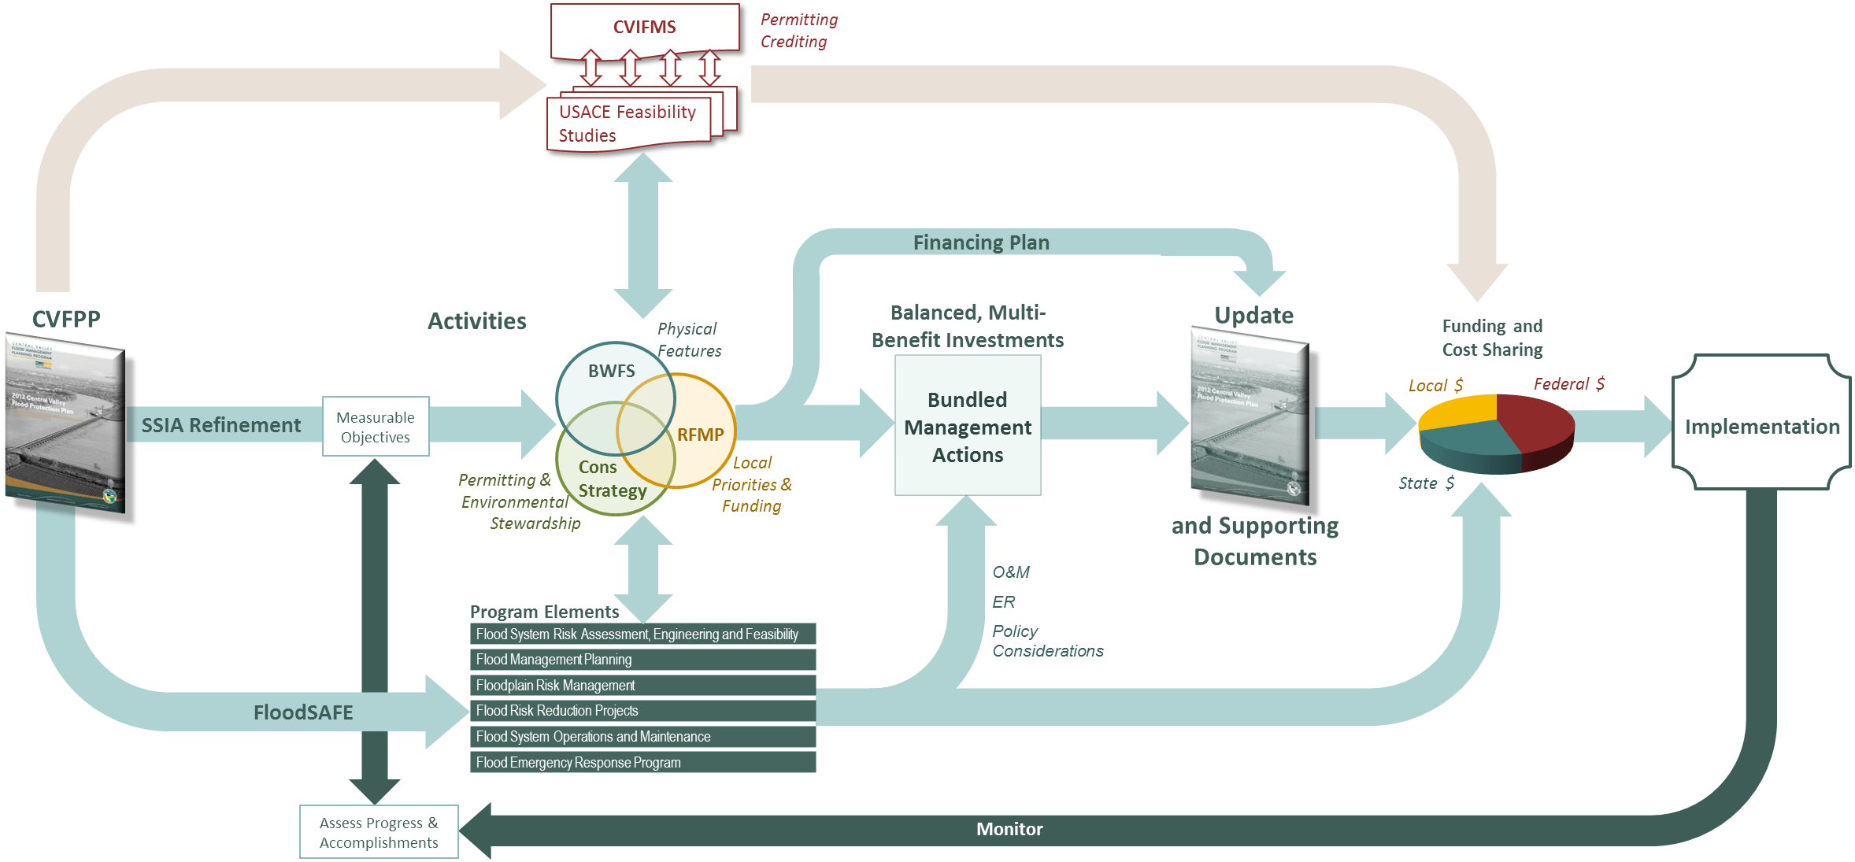
One Process, Many Activities
Notes:
You’ve been given an 11x17 handout
Remember: today I’m only focusing on the BWFS
This graphic is intended to provide context to how the BWFS fit into other efforts, and show that BWFS is only one of many activities leading to the development of the 2017 CVFPP.
1st Segment – Many parallel activities with different focuses.
Current Focus (BWFS, CS, RFMP)
BWFS – focus on physical features
CS – focus on permitting strategies and Env Stew
RFMP – focus on local priorities and funding capacities
FloodSAFE programs:
implement the SSIA and help refine SSIA
develop ER and O&M strategies
formulate system management policies
Central Valley Integrated Flood Management Study
Watershed Study potentially leading to feasibility studies
Identify areas of potential Federal interest in SSIA, with a focus on Sacramento River Basin
Explore implementation challenges related to permitting, crediting, and system-wide benefits assessment
These parallel activities are important because they all contribute to developing Balanced, Multi-benefit Investments.
Financing Plan
will require information developed in earlier phases of planning (BWFS, CS, RFMP). So, we have to get through these first, then develop financing plan.
we’ll need RFMP financial plans and information on federal funding capacities
currently, starting with a Framework, building towards the Plan.
Funding and Cost Sharing
Implementation
We won’t necessarily wait on implementation. Near term implementation is happening and will continue and be checked against Measurable Objectives.

Slide 4
Relationship to CVFPP Planning Efforts
State-Led
Basin-Wide Feasibility Studies
Central Valley Flood System Conservation Strategy
State Interest
CVIFMS and Other Federal cost-share
feasibility studies will help identify areas of Federal interest in CVFPP implementation
Local/Regional Priorities
Locally-led Regional Flood Management Planning
Notes:
BWFS are one of several CVFPP implementation planning activities, and are being conducted alongside development of the Conservation Strategy (also DWR-led) and Regional Flood Management Planning (locally-led). The two state-led efforts are identifying State interest in changes to the flood management system, while RFMP is identifying local and regional interests and priorities. Where these planning studies overlap is where we are likely to find the strongest potential for broadly supported implementation projects.
This is the “We need to keep working together” Graphic
This Venn Diagram is looking at the scope of the 3 major CVFPP Implementation Planning efforts currently underway.
As you know:
CS Scope is on permitting strategies, restoration, species protection, habitat connectivity etc.
BWFS Scope is on refining physical features of the SSIA, and the State’s Interest
RFMP Scope is on defining local priorities and funding capacities
Given the nature of how our flood system is managed, there is obvious overlap between these efforts.
This conceptually shows variations of where those overlaps could occur.
Where they overlap, could represent bundled management actions with multiple benefits that meet at least some of the needs of the various interests.
The Middle Area represents common overlap of all 3 efforts, and we are all seeking to maximize this.
Take Away:
The more we work together to understand each other’s perspectives and on developing bundled, multi-benefit solutions (the bigger we can get the overlap between efforts) the better chance we’ll have at gaining support and funding.
Areas of no overlap will likely remain important to the various interests.
So, where are the opportunities to do this and how do we integrate the efforts?
see next slide and 11x17 handout showing timing of planning steps to have informal discussions and share information.

Slide 5
Timeline
FCSA for Sacramento & San Joaquin River Basins Comprehensive Study
October 2011 Amendment to FCSA approved by Board (not executed by USACE)
July 21, 2010 Board Approves FCSA for CVIFMS
1995
2005
2010
CA Flood Legislation Passed (2006, 2007)
August 28, 2009 Board & DWR Memorandum of Understanding for CVIFMS
2011 USACE Planning Modernization
Notes:
The Sacramento and San Joaquin River Basins Comprehensive Study (Comprehensive Study) was initiated in February 1996 with the signing of an initial FCSA between the USACE and Reclamation Board (now Central Valley Flood Protection Board). The February 1996 FCSA expired on February 2009. The Central Valley Integrated Flood Management Study (CVIFMS) is being carried out under the same authority of the Comprehensive Study.

Slide 6
2010 FCSA
Sponsors
Federal: U.S. Army Corps of Engineers, Sacramento District
State: The Central Valley Flood Protection Board
Local: Department of Water Resources
Total cost $1,720,000
Cost-shared equally with State
Up to 100% through in-kind services
Federal authority provided under the Flood Control Act of 1962 (Public Law 87-874) and May 8, 1964 resolution of the House Committee on Public Works

Slide 7
2010 FCSA (cont)
Called for development of a Project Management Plan for CVIFMS
Scope a more detailed, five-year feasibility study
Future funding for the feasibility study was to be provided through a subsequent FCSA or amendment
USACE completed a draft PMP for CVIFMS in 2011
Amendment to FCSA was prepared consistent with the PMP, and signed by the Board in October 2011
USACE did not execute the amendment due to Subsequent USACE Planning Modernization guidance

Slide 8
USACE Planning Modernization
Guidance released in early 2012
Streamlines Federal feasibility studies for greater efficiency and timeliness
3 years
$3 million
Increased vertical alignment within USACE
Provides opportunities for greater collaboration with local sponsors, including use of locally-generated data
All Federal feasibility studies underwent scope review and prioritization following release of the guidance

Slide 9
Late 2012 CVIFMS Re-Scoping Efforts
One watershed study concurrent with State’s BWFS
Federal interest in cross-regional, system improvements identified in the CVFPP
Institutional and governance concerns associated with long-term implementation of the CVFPP
Establish need for follow-on feasibility studies
Consistent with USACE Planning Modernization and the 5-year update schedule for the CVFPP
Revised PMP prepared in June 2013
Significant collaboration among study partners

Slide 10
Benefits of CVIFMS Watershed Plan
Focus on system-based water resources problems
Assess technical work already completed by the State for its suitability in assessing Federal interest
Participate in State’s BWFS and Central Valley Flood System Conservation Strategy
Evaluate resource conditions related to flood risks and ecosystem conditions
Identify implementation challenges in policy, permitting, and crediting
Make recommendations for future actions, including potential feasibility studies

Slide 11
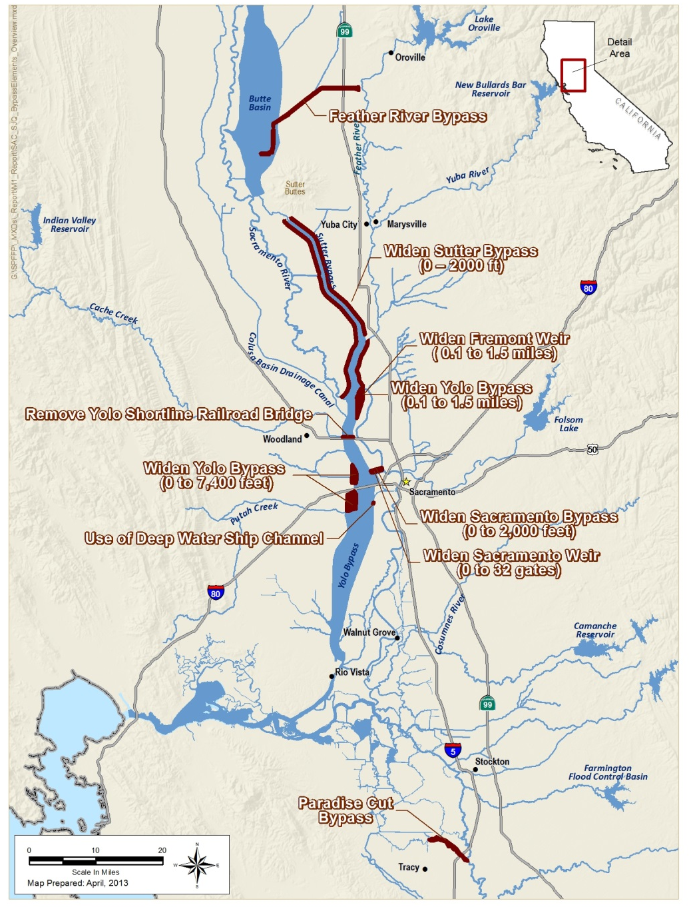
Focus on System Improvements
Potential Federal interest in CVFPP System Improvements in Sacramento River Basin
Consideration of system improvements in San Joaquin River Basin via Lower San Joaquin Feasibility Study
Notes:
Bypass system improvements:

Slide 12
Major Activities In CVIFMS PMP
Task 1: Technical data and tools gap analysis
Task 2: Without-project condition(s)
Task 3: Participation in, review and summarizing of CVFPP implementation planning efforts (BWFS, regional planning, Conservation Strategy)
Task 4: Federal interest in CVFPP implementation
Task 5: Policy and guidance recommendations (crediting, permitting, governance)
Task 6: Watershed Plan preparation
Task 7: Coordination and support

Slide 13
CVIFMS Schedule
Task Description | Schedule (Days after FCSA Amendment Execution)
1. Gap Analysis | 90 days
2. Forecast Without Project Conditions | 120 days
3. Participate, Review, Summarize | 180 days
4. Assessment of Federal Interest | 350 days
5. Policy and Guidance Recommendations | 350 days
* Decision Point Meeting | 365 days
6a. DRAFT Watershed Plan | 450 days
6b. FINAL Watershed Plan | 540 days
7. Coordination and Support | 540 days

Slide 14
Amendment 1 to FCSA
Total Watershed Study cost: $5,000,000
Non-federal in-kind contributions $2,417,000
Credit to the non-Federal in-kind $2,417,000
Non-federal proportionate share about 48%

Slide 15
Next Steps
Briefing on CVIFMS July 12th
Motion to Approve Amendment 1 July 26th
USACE Approval of Amendment 1 August 2013
CVIFMS Implementation 2013 -2016
Notes:
Technical Workshop #2 would cover:
Application of tools (H&H, Cl. Change, economic?, life safety?, Cons Strategy tools?)
Initial Results of Technical Analyses to evaluate performance of system elements

Slide 16
Contact Information
DWR: Christopher Williams, Project Manager
(916) 574-2375
christopher.williams@water.ca.gov
CVFPB: Bob Scarborough, Project Manager
(916) 574-1422
robert.scarborough@water.ca.gov
USACE: Glen Reed, Project Manager – Civil Works
(916) 557-7630
Anthony.G.Reed@usace.army.mil
Notes:
Technical Workshop #2 would cover:
Application of tools (H&H, Cl. Change, economic?, life safety?, Cons Strategy tools?)
Initial Results of Technical Analyses to evaluate performance of system elements

Slide 17
Questions or Comments?

