Slide 1
Sutter butte flood control agency (SBFCA) feather river west levee project (FRWLP) Laurel Avenue Repair Project (LARP), Sutter County June 24, 2016
APPLICATION 18793-4
Notes:
Pointer – visible
SBFCA there for questions

Slide 2
BOARD ACTION
Consider adoption of Resolution 2016-15, which approves Permit 18793-4 to include the following work:
degrade the levee approximately one-third its height and install approximately 4,300 linear-feet of cutoff wall;
correct levee geometry deficiencies to:
three horizontal to one vertical (3H:1V) waterside and 2H:1V landside slopes
20-foot wide levee crown;
fill existing swale south and existing ditch north of Laurel Avenue; and
replace pipe penetrations and correct encroachments that do not comply with Title 23, Division 1, Article 8 (Title 23 Standards)

Slide 3
AUTHORITY OF THE BOARD
California Water Code § 8534, 8590 – 8610.5, and 8700 – 8710
CCR, Title 23, Division 1 (Title 23):
§ 6 – Need for a Permit
§ 11 – Variances
§ 13 – Evidentiary Hearings
§ 108 – Existing Encroachments
§ 112 – Streams Regulated and Nonpermissible Work Periods
§ 116 – Borrow and Excavation
§ 120 – Levees
§ 121 – Erosion Control
§ 123 – Pipelines, Conduits, and Utility Lines
§ 124 – Abandonment of Pipelines
§ 130 – Patrol Roads and Access Ramps
Rivers and Harbors Act of 1899, Title 33, USC, § 408 (Section 408)
1953 MOU between USACE and Board
Notes:
The authority of the Board is shown on this slide, as outlined in the SR Section 5.0

Slide 4
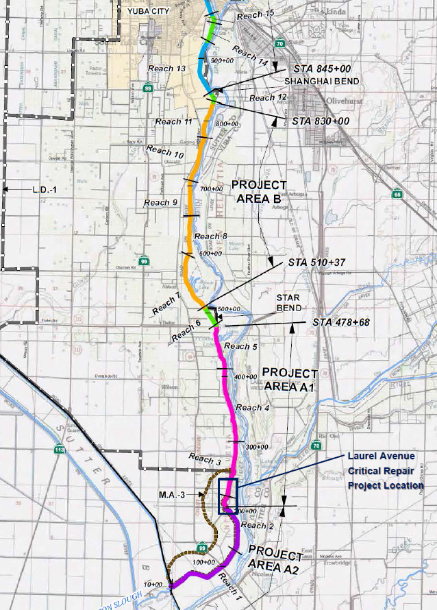
PROJECT LOCATION
The project is located:
in Sutter County
south of Yuba City
east of SR 99 and west of SR 70
FRWLP extends from Thermalito Afterbay Dam downstream 41 miles approximately 3.5 miles north of the confluence with the Sutter Bypass
LARP extends 4,900 linear-feet from south of Laurel Avenue north to just south of Oak Avenue
Yuba City
Thermalito Afterbay
FRWLP
SR 70
SR 99
Feather River
Sutter Bypass
Laurel Avenue Repair Project
3.5 miles north confluence

Slide 5
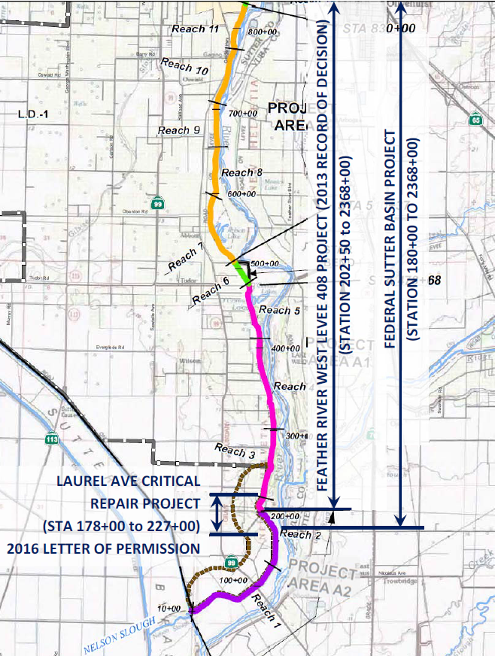
COMMENTS & ENDORSEMENTS
U.S. Army Corps of Engineers (USACE) Sacramento District Letter of Permission (LOP) is anticipated to be received in early July
Indicating that USACE will approve the request to alter the Federal flood risk reduction project, subject to conditions
when received staff will check for conformity and incorporate into the permit (covers LARP, including 178+00 to 180+00)
The Federal Sutter Basin Project authorized by Congress through the Water Resources Reform and Development Act of 2014 (covers LARP 180+00 to 202+50)
USACE Headquarters Record of Decision (ROD) dated September 13, 2013 (covers LARP 202+50 to 227+00)
Maintenance Area 3 endorsed the project on May 4, 2016 without conditions
USACE ROD (202+50 to 2368+00)
The Federal Sutter Basin Project (180+00 to 2368+00)
Laurel Avenue Repair Project (178+00 to 227+00)
USACE LOP (178+00 to 227+00)

Slide 6
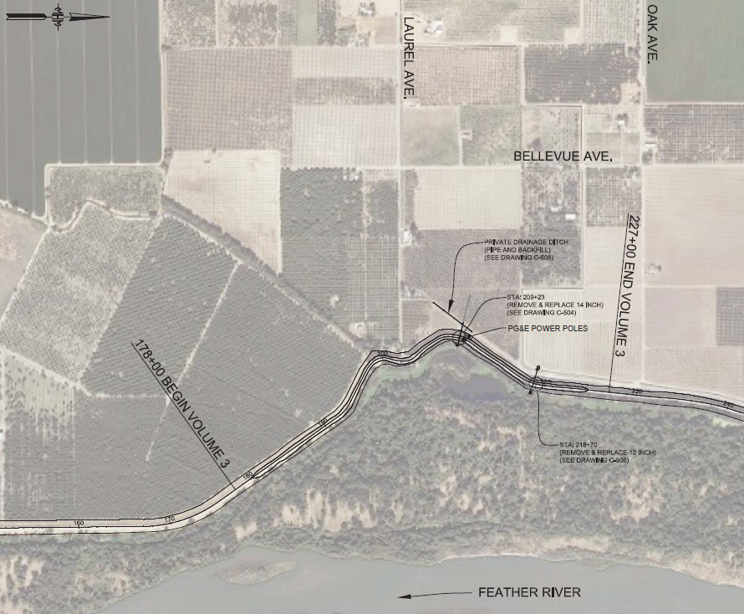
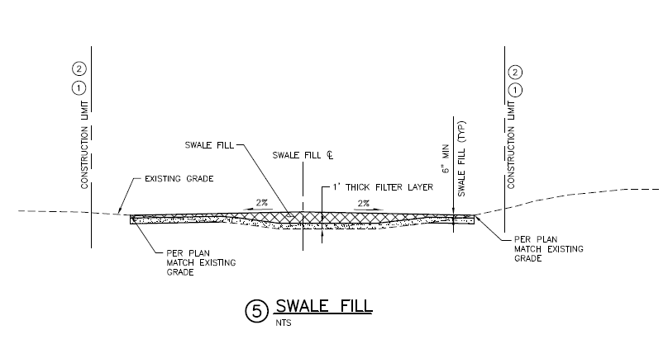
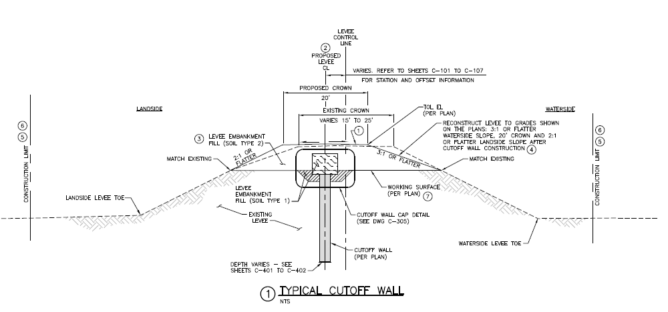
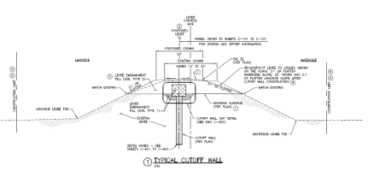
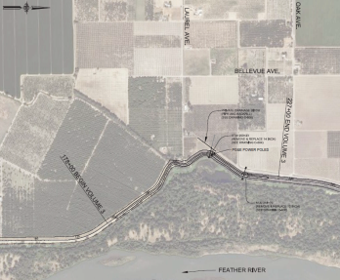
PROJECT DETAILS
degrade the levee approximately one-third its height and install approximately 4,300 linear-feet of cutoff wall and correct levee deficiencies
fill existing swale south and existing ditch north of Laurel Avenue; and
replace pipe penetrations and correct encroachments that do not comply with Title 23 Standards
Irrigation Pipe Penetration (replaced by this project)
Crown width = 20’
Landside
Waterside
Degrade levee 1/3 its height and match existing
2:1
3:1
2 - PG&E Power Poles (relocated outside prism)
Storm Drain Pipe Penetration (replaced by this project)
Cutoff Wall
Notes:
1 – 209+23 Irrigation Pipe Penetration (replaced as part of project)
2 – 210+00 (2) PG&E Poles Relocated Outside Levee Prism
3 – 218+70 Storm Drain Pipe Penetration (replaced as part of this project)

Slide 7
HYDRAULIC SUMMARY
overall FRWL project hydraulics (from Thermalito Afterbay Dam to Sutter Bypass) approved May 24, 2013 for the FRWLP, Project Area C, Permit 18793-1
proposed LARP does not include any features that alter the 2013 approved hydraulic analysis
therefore, staff has determined that no further hydraulic analysis is needed
Notes:
FRWLP Hydraulics May 2013 also used for Areas B & D

Slide 8
GEOTECHNICAL SUMMARY
Board staff has reviewed SBFCAs geotechnical information in support of the LARP, and based on this review, has determined:
the proposed project is expected to result in no adverse geotechnical impacts to the SRFCP or FRWL;
With the exception of the requested variances, the proposed design complies with applicable Title 23 Standards and would remediate levee seepage, slope stability, levee geometry, and encroachment deficiencies within the proposed project area.

Slide 9
REQUESTED VARIANCES
SBFCA is requesting five variances to Title 23 Standards, pursuant to § 11(a) and (b), as follows: (per Staff Report Section 7.5)
§ 120(a)(9) – because inspection trench not needed due to continuous cutoff wall
§ 120(a)(13) – to allow appropriate performance tests and specifications for zoned levee material properties
§ 120(a)(18) – to allow eight inch lifts due to zoned levee material properties
§ 123(d)(20) – to allow use of Controlled Low Strength Material (CLSM) for backfill of pipes
§ 130 (Figures 8.08 and 8.09) – to allow maximum grades of 14 percent for access ramp reconstruction
Notes:
Per staff report Section 7.5

Slide 10
CEQA / WATER CODE 8610.5
CEQA Analysis is included in Resolution 2016-15, which was submitted to the Board and posted to the Board’s website as part of the Staff Report Addendum yesterday (June 23, 2016)
Board members have a copy of the Staff Report Addendum, which includes:
The Board’s CEQA Findings that were just adopted by SBFCA’s Board at their meeting on Wednesday, June 22, 2016
Board Resolution 2016-15, including the Board’s CEQA Findings
SBFCA Resolutions 2016-03 and 2016-04, which adopt the SEIR and MMRP (respectively)
SBFCA’s CEQA Findings for the Final SEIR for the modification to the FRWLP
Water Code § 8610.5 Considerations are included in Resolution 2016-15
Notes:
Do not say, but handout Addendum and Resolution

Slide 11
STAFF RECOMMENDATION (1/2)
Board staff recommends that the Board: (in substantially the form provided)
Adopt: The CEQA findings and Resolution 2016-15
Approve:
Five requested construction variances to Title 23, § 120(a)(9), (13), and (18); § 123(d)(20); and § 130 (Figures 8.08 and 8.09) pursuant to § 11(a) and (b);
Draft Flood System Alteration Permit 18793-4, conditioned upon receipt and incorporation of the anticipated USACE Sacramento District Letter of Permission.

Slide 12
STAFF RECOMMENDATION (2/2)
Delegate authority to the Executive Officer to:
Make non-substantive changes to the draft permit to incorporate the anticipated USACE decision;
Issue technical construction variances as needed to incorporate requested design changes due to unanticipated field conditions that may be encountered during construction;
Direct the Executive Officer to:
Take the necessary actions to issue Permit 18793-4; and
Prepare and file a Notice of Determination pursuant to CEQA with the State Clearinghouse.

Slide 13
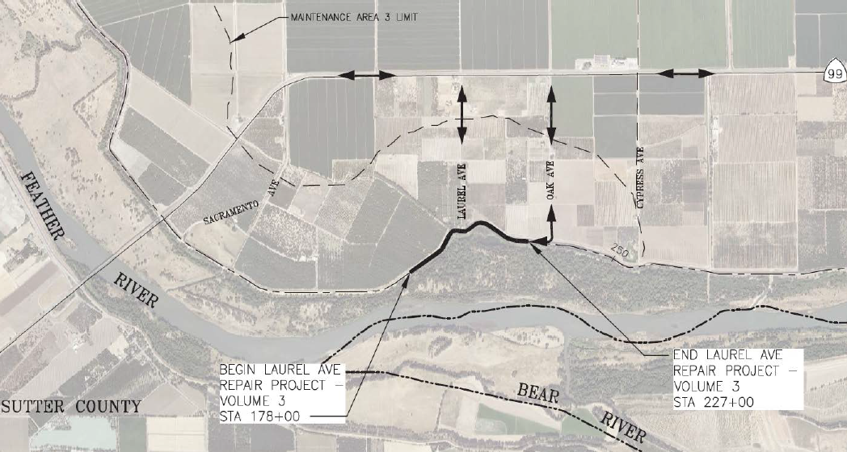
QUESTIONS
Presented by: Nancy Moricz, Senior Engineer

