Slide 1
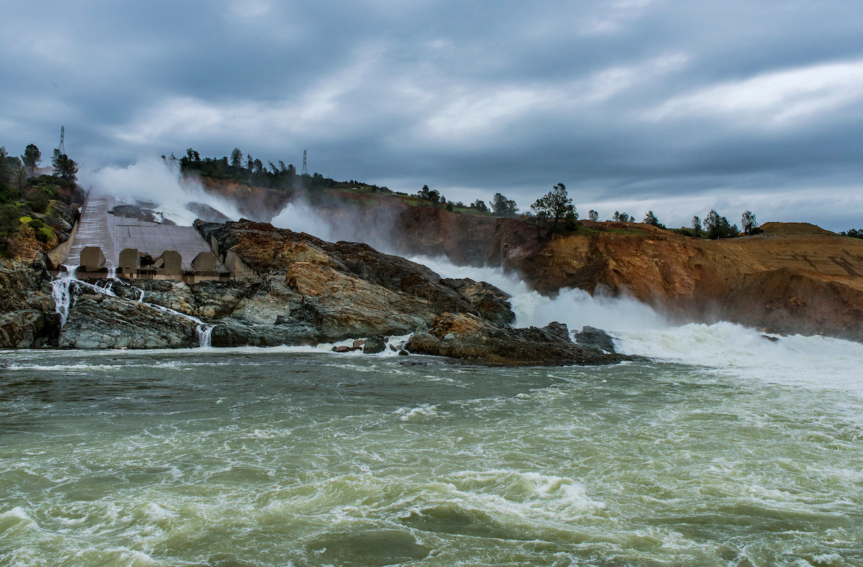
Update on Oroville Emergency Recovery Efforts
April 28, 2017
Randy Fessler, PE
DWR Security & Emergency Management Program
Emergency Response Program Manager

Slide 2
Oroville Spillways Recovery Framework February 22
Board of Consultants initial briefing and site visit March 1/2
Construction contractor outreach initiated 3
Design team staffed 4
Design concepts workshop 6
Geologic and geotechnical exploration – Phase I 9
Board of Consultants design/technical briefing No. 1 10
RCC sampling and testing initiated 11
Design concepts refined 13
Project definitions and objectives 13

Slide 3
Major design criteria established March 15
Construction contract sequencing and approach 16
Board of Consultants design/technical briefing No. 2 17
Design concepts selected for analysis 18
Advertised site preparation contract (road and slope stabilization) 21
Bids opened for site preparation project 25
Notice to begin work issued for site preparation project 28
Alternatives analysis summary 28
Assessment of original spillway construction 30
Board of Consultants design/technical briefings No. 3 30/31

Slide 4
Spillways contract advertised 31
Bids for spillways project opened, Kiewit $275 million 15
Reservoir operation risk assessment (DWR, USACE, FERC) 18
Notice to begin work issued for spillways project 21
Left slope stabilization controlled blasting 22
Site mobilization begins, rock crusher and batch plants May 8
Construction scheduled to begin June 1
Target end of construction for Phase I Nov 1
Begin Phase 2nd Phase of project 2018

Slide 5
Questions ??
Randy Fessler, PE
DWR Security & Emergency Management Program
Emergency Response Program Manager

