Slide 1
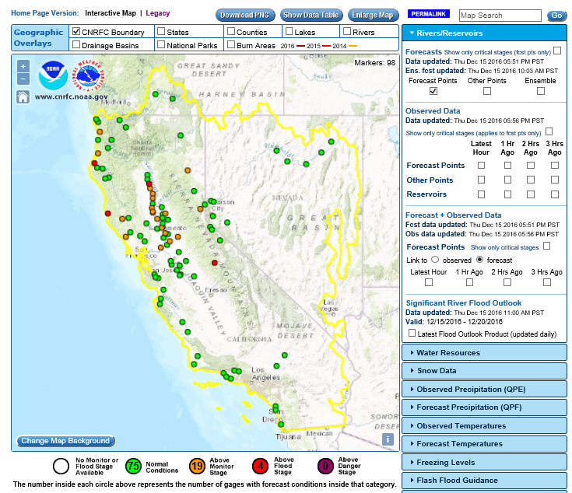
www.cnrfc.noaa.gov

Slide 2
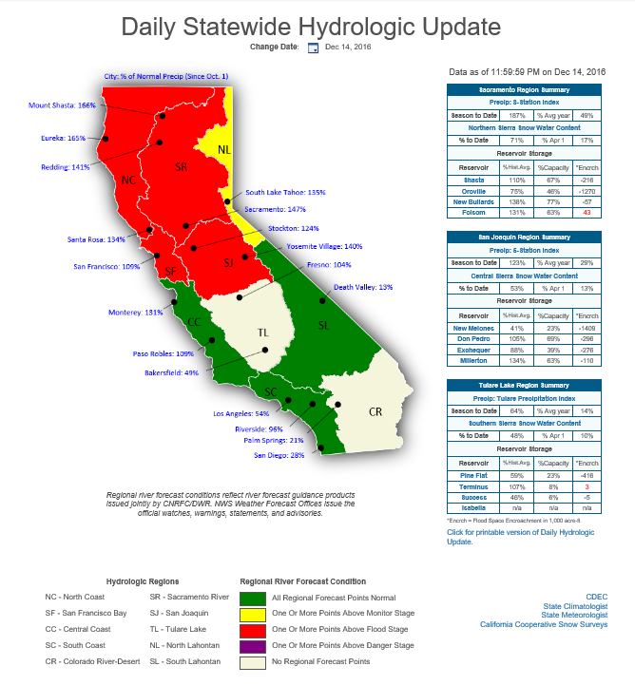
cdec.water.ca.gov/floodER/hydro/

Slide 3
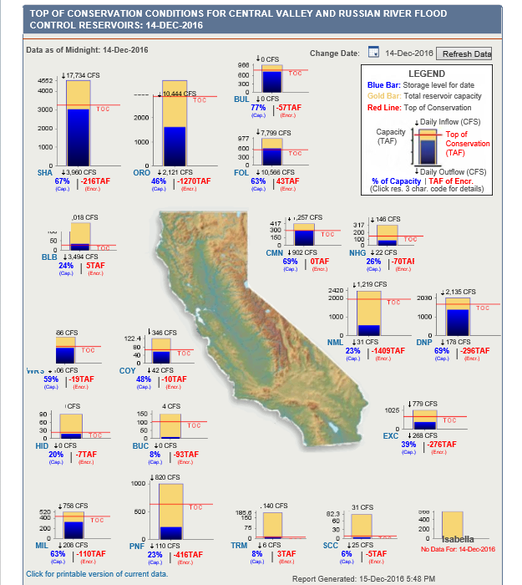
cdec.water.ca.gov/cdecapp/resapp/GetDailyFCgraphs.action

Slide 5
