Slide 1
Division of Flood Management Activities December 2017 Central Valley Flood Protection Board Meeting Sacramento City Hall Building December 15, 2017
Presented By:
Jeremy Arrich
Acting Chief, Division of Flood Management
California Department of Resources

Slide 2
2017 Storm Damage Emergency Rehabilitation Update
Of the 15 USACE Sites to be Repaired in 2017
15 have completed construction
0 are under construction
Of the 30 DWR Critical Sites to be Repaired in 2017 (including SBFCA)
30 have completed construction
0 are under construction

Slide 3
Summary of USACE PL 84-99 Sites
 | Sacramento Area | San Joaquin, Delta and Other Areas
Total Number of USACE PL 84-99 Sites | 69 | 295
Priority 1, 2, 3 or 4 USACE PL 84-99 Sites (15 Sac Basin sites to be repaired in 2017) | 34 | 14
No Action USACE PL 84-99 Sites (3 SBFCA Sites Considered DWR Critical) | 18 | 4
Ineligible USACE PL 84-99 Sites (3 Sac Basin Sites considered DWR Critical) | 17 | 277

Slide 4
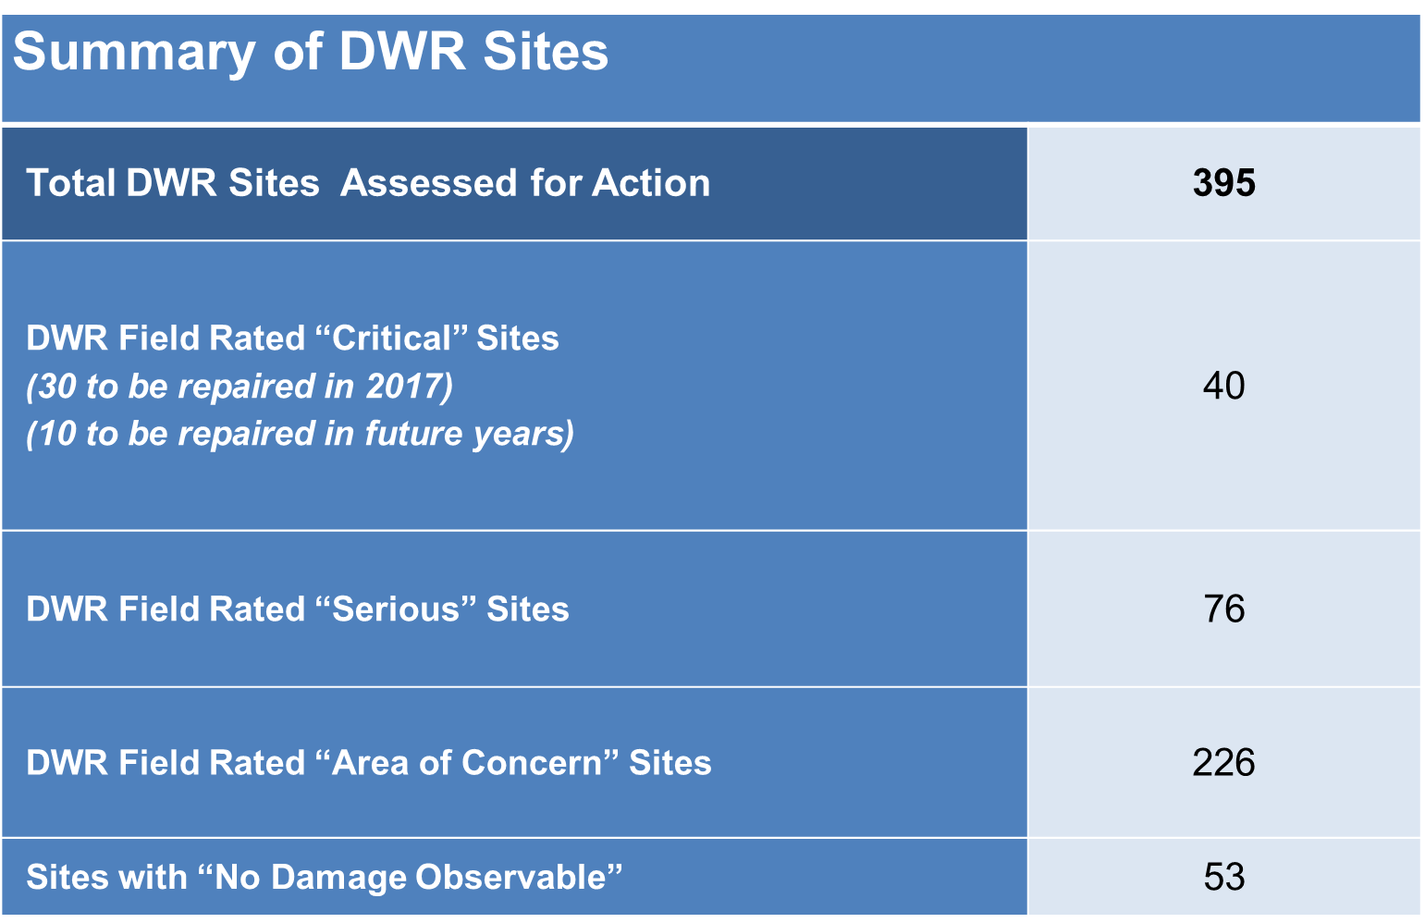

Slide 5
Contingency Planning
For Sites Not Being Repaired in 2017:
DWR working with LMAs to develop robust contingency plans for all DWR critical and serious sites, and all USACE sites.
For areas of concern, LMAs develop their own plans as part of normal flood planning processes
Draft Final Contingency Plans completed Nov 17
Process will continue to be ongoing as new sites are identified and/or conditions of known sites change
Plans have been uploaded to FERRIX

Slide 6
Questions
Website
http://water.ca.gov/floodmgmt/repair/
2017 Storm Damage Emergency Rehabilitation Program Summary
Updated Weekly
Contact Us
leveerepair@water.ca.gov
(916) 838-5509

Slide 7
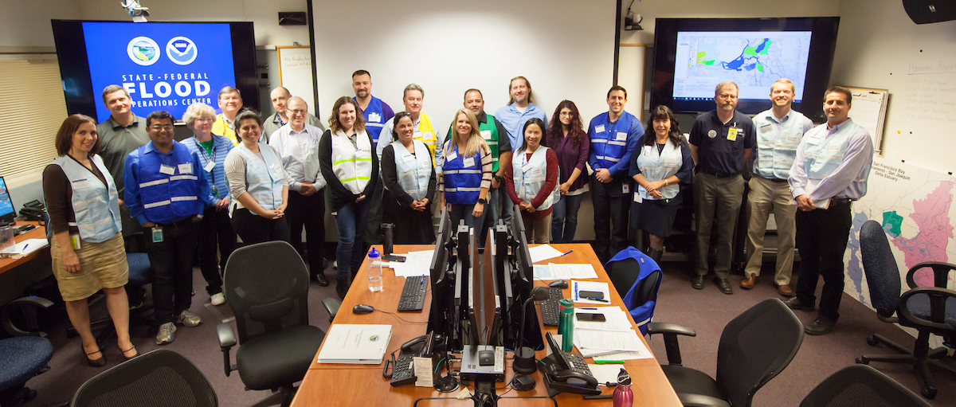
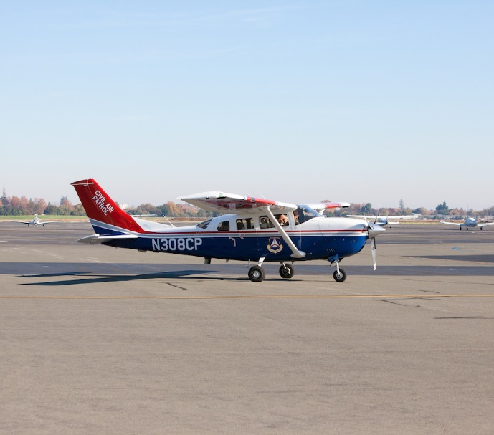
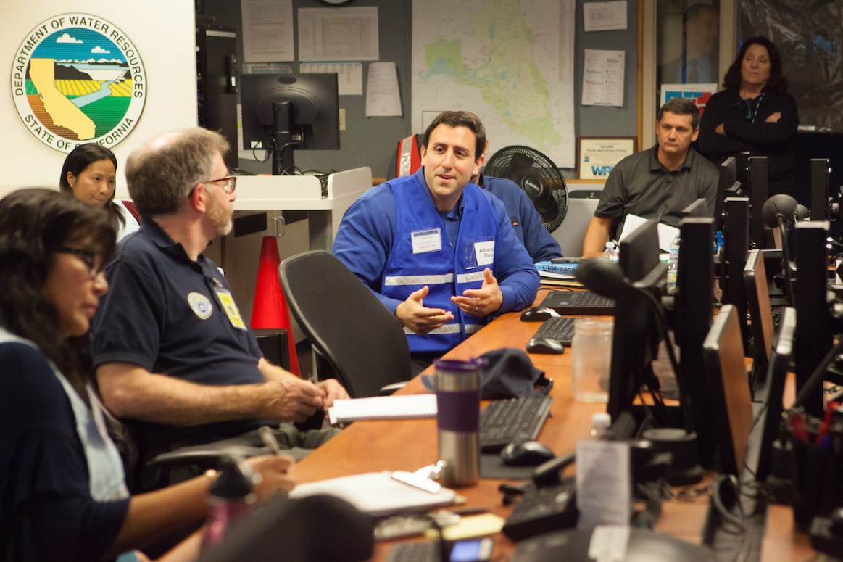
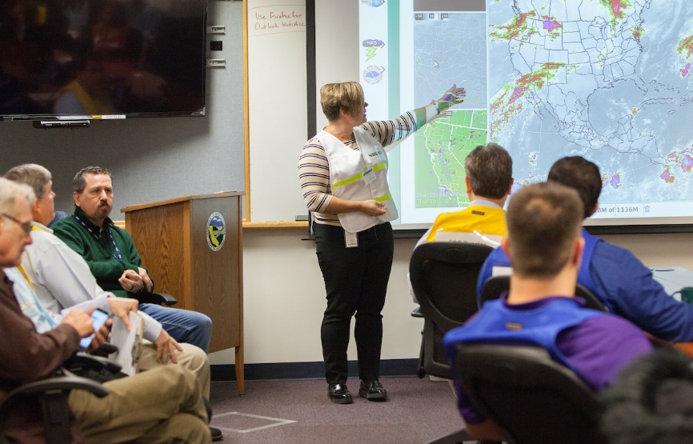
Delta Emergency Response Aerial Exercise

Slide 8
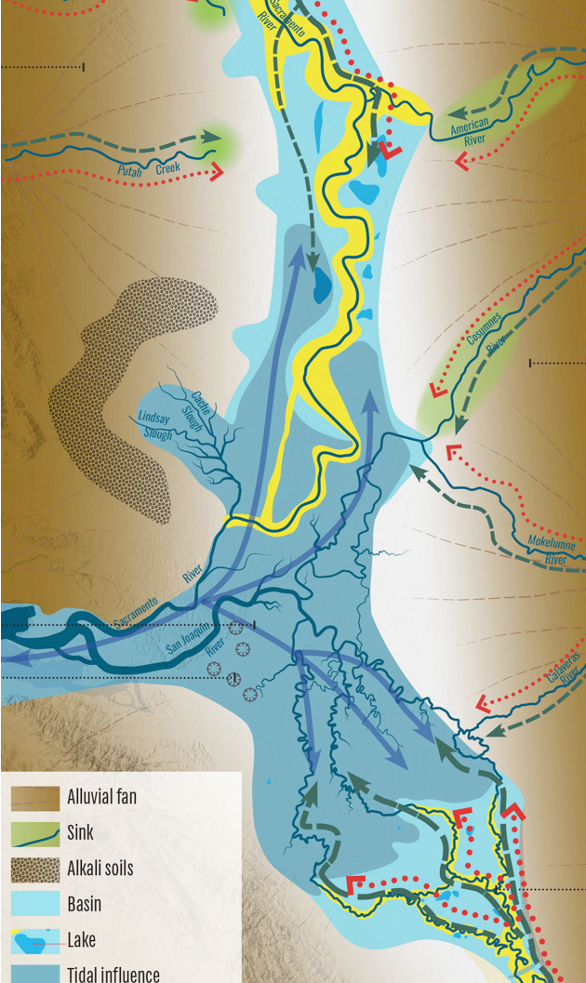
Delta Coordination
Weekly meetings between DWR the DSC and CVFPB to coordinate planning activities related to Delta levees
Objective: to ensure consistency between the CVFPP, Delta Plan, and DWR levee investments
Shared definitions of Operations, Maintenance, Repair, Rehabilitation, and Replacement
Understanding various cost shares and ability to pay
Addressing investment priorities via competitive local assistance programs
The interagency working group is also sharing information on correspondence and pending legislation
Image Source: A Delta Renewed, A Guide to Science-Based Ecological Restoration. San Francisco Estuary Institute Aquatic Science Center

Slide 9
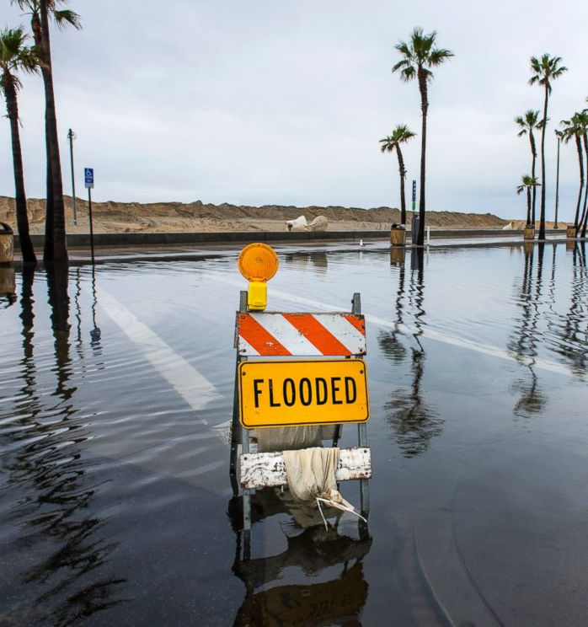
National Flood Insurance Program
Reauthorized until Dec. 22
On November 14, the House passed HR 2874, “the 21st Century Flood Reform Act”
10 competing House and Senate bills
DWR has reviewed the competing bills and is tracking the progress of potential bill consolidation in conference committee

Slide 10
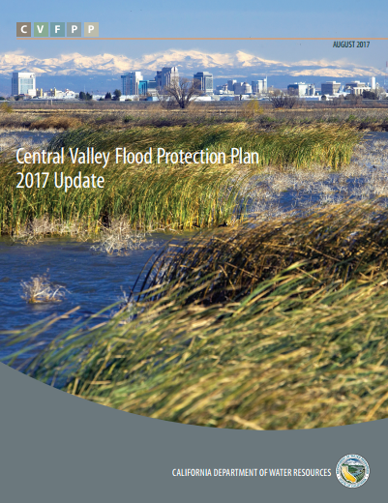
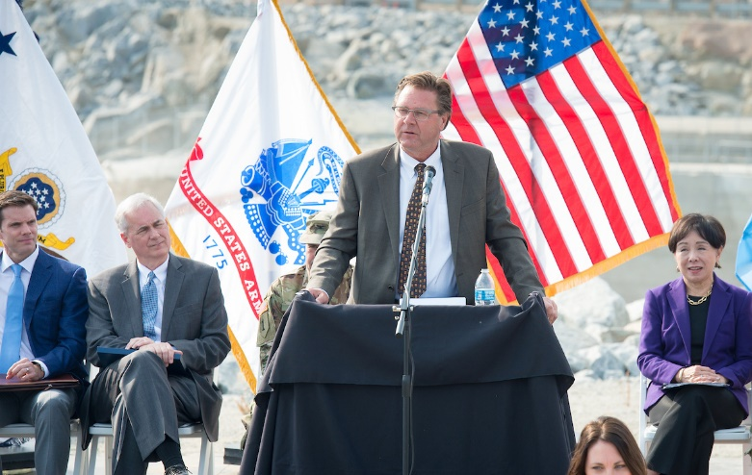
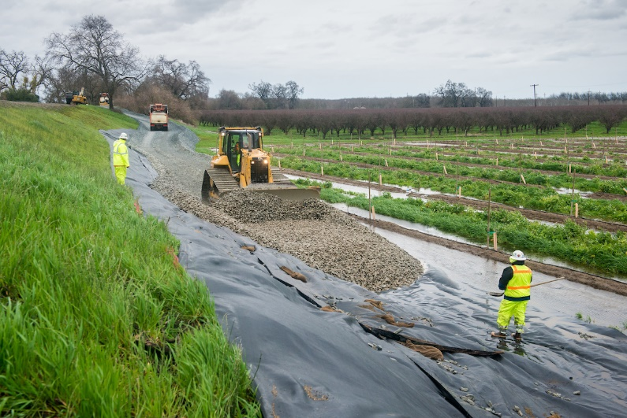
2017 Accomplishments
Folsom Dam Auxiliary Spillway Completion
2017 CVFPP Update Adoption
Emergency Response Efforts

Slide 11
Jeremy Arrich
Acting Chief, Division of Flood Management
California Department of Water Resources
December 15, 2017

