Slide 1
Informational Briefing Lower San Joaquin River Feasibility Study (LSJRFS) December 15, 2017
Presented by:
Eric Martinez (DWR)
Patrick Howell (USACE)
Notes:
Informational presentation on the current status, accomplishments, and next steps for the study.

Slide 2
Project Sponsors
Federal Sponsor:
United States Army Corps of Engineers (USACE)
Project Management by Sacramento District (USACE-SPK)
Non-federal Sponsors:
Central Valley Flood Protection Board (Board)
Project Management by Department of Water Resources (DWR) Flood Projects Office and Board Staff Coordination
San Joaquin Area Flood Control Agency (SJAFCA)

Slide 3
Study Background
2009 : Study Initiated - Feasibility Cost Sharing Agreement (FCSA) executed between USACE & SJAFCA
2010: Amendment No. 1 to the FCSA was approved, officially adding the Board as a non-federal sponsor
2013: Study re-scoped to comply with 3x3x3 USACE Planning Modernization Guidelines
2015: 3x3x3 Exemption request approved by USACE Headquarters
2017: 3x3x3 Exemption request approved by USACE Headquarters

Slide 4
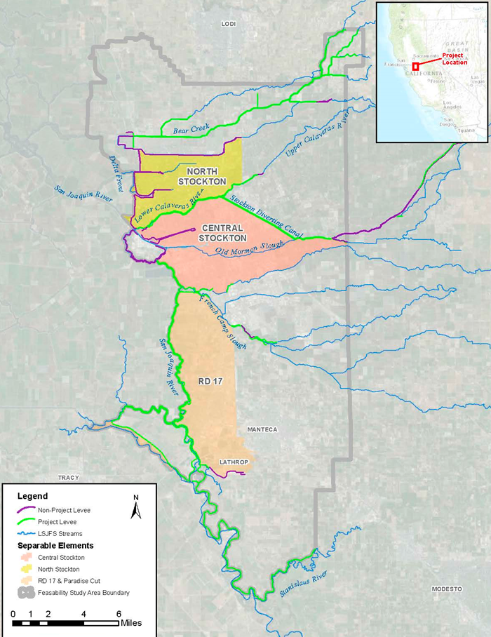
Study Area
Re-scoped to focus on high risk, high consequence separable areas
North Stockton
Central Stockton
Both highly urbanized
RD-17
40% urbanized
Screened out ~15,000 acres of Urban, Urbanizing and Agricultural Lands for alignment with EO 11988
NORTH
STOCKTON
CENTRAL
STOCKTON
RD 17
Notes:
RD17 excluded due to EO11988 but may be revisited as this is an interim feasibility study.

Slide 5
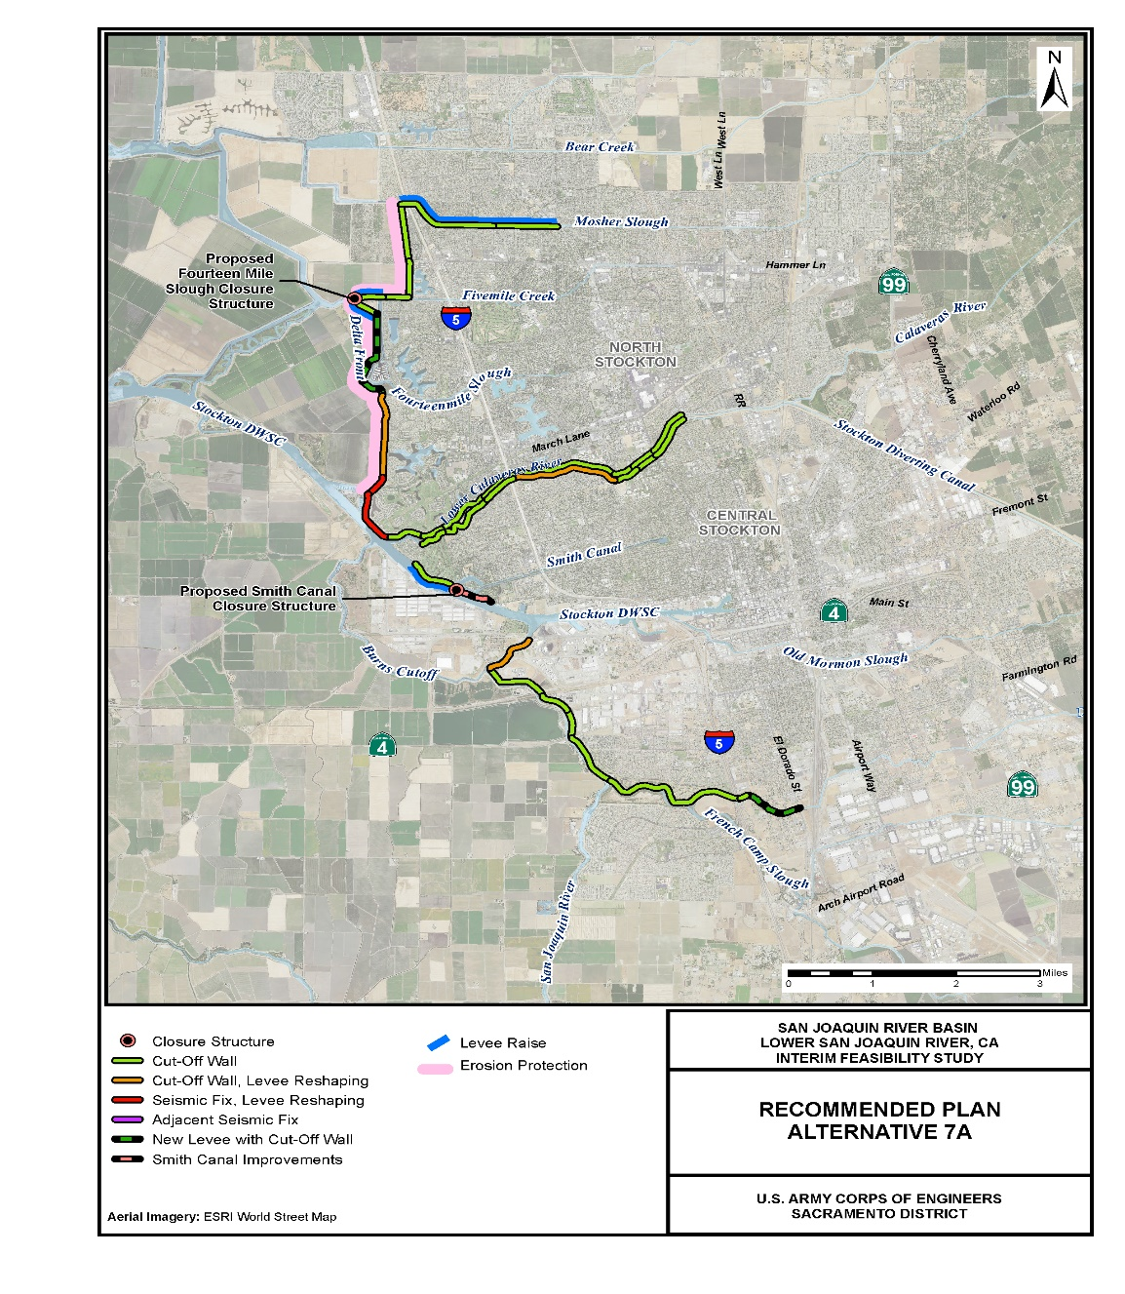
Recommended Plan
Alternative 7a
Total Cost: $1,597,751,000 (est.)
Net benefits: $255,065,000 (annual est.)
Features
Approximately 23 miles levee improvement
Smith Canal and Fourteen Mile Slough closure structures
Extension of RD 404 Levee to prevent flanking from French Camp Slough
Reduces risks to
~122,000 people
~80,000 structures
~$28.7B in damageable property
NORTH
STOCKTON
CENTRAL
STOCKTON

Slide 6
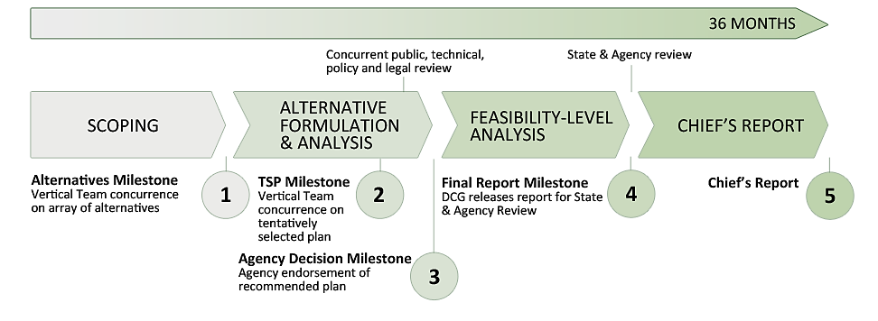
Study Schedule
Milestone | Original | Waiver
Senior Leaders Panel (formally Civil Works Review Board | May 2014 | December 2017
Release of Integrated Final Report/Envir. Impact Report for State/Agency & Public Review | July 2014 | January 2018
Complete Responses to Review | October 2014 | March 2018
Coordination of Final Report & Chief’s Report | November2014 | March 2018
Chief’s Report | December 2014 | March/April 2018
------------------
60 MONTHS
✓
✓
March 2013
Aug. 2014
February 2018
March/April 2018
✓
October 2015

Slide 7
Study Budget
Total Study Costs - $9.153 M
Non-federal obligation - $4.509 M
All Sponsors Obligations toward the study have been fulfilled

Slide 8
Next Steps
Today - Present Senior Leaders Panel Briefing
March/April - Chief’s Report signed by Chief of Engineers
Future – Assistant Secretary of the Army for Civil Works (ASA(CW)) submits Chief’s Report to the U.S. Congress
Future – During closeout possible amendment for records, not critical now
Future – Congressional Authorization
Future – Pre-Construction Engineering and Design (PED) Phase, requires design agreement

Slide 9
Questions?
Presented by:
Eric Martinez, MCE
Project Manager – Flood Projects Office (FPO), DFM, DWR
Patrick Howell, Jr., PMP, MBA
Project Manager – USACE
Ali Porbaha, PE
Project Manager – Board staff

