Slide 1
Informational Briefing Terminus Dam - Lake Kaweah Project November 17, 2017
Presented by:
Remy Gill (DWR)
Katie Charan (USACE)

Slide 2
Project Sponsors
Federal Sponsor:
United States Army Corps of Engineers (USACE)
Project Management by Sacramento District (USACE-SPK)
Non-federal Sponsors:
Central Valley Flood Protection Board (Board)
Project Management by Department of Water Resources (DWR) Flood Projects Office and Board Staff Coordination
Kaweah Delta Water Conservation District (KDWCD)

Slide 3
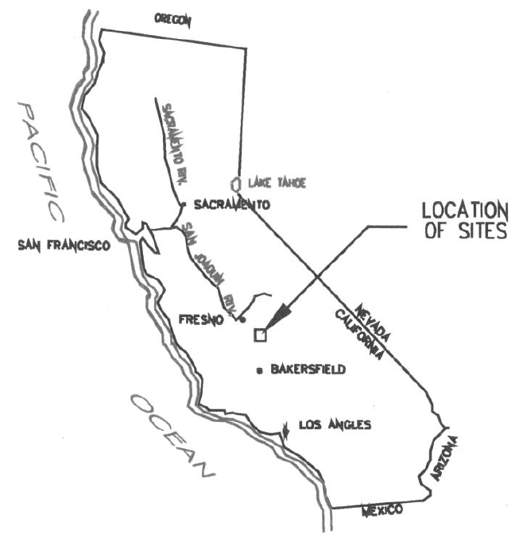
Project Location
Lake Kaweah
Kaweah River
Watershed
Lake Kaweah on Kaweah River in Tulare County
Enlargement project increased flood protection to approximately 70-years by raising spillway 21 feet to an elevation of 715 feet
Enlargement Project Increased Lake Kaweah’s capacity from 143,000 AF to 185,600 AF
Notes:
Previously had a 46-year level of protection

Slide 4
Project Background
1962 : USACE constructs Terminus Dam, forms Lake Kaweah
1966, 1969, 1978, 1980, 1982, 1983, 1986: Flooding downstream
1988-1996: Feasibility Study completed
1996: Congressional WRDA Authorization for project
1998: Reclamation Board intent to become Non-Fed Sponsor
2001: PCA Executed between the Local District, USACE, and the Reclamation Board
2001-2005: Lake Kaweah Enlargement Construction
2007 : Congressional WRDA Authorization for reimbursement (to KDWCD from USACE)

Slide 5
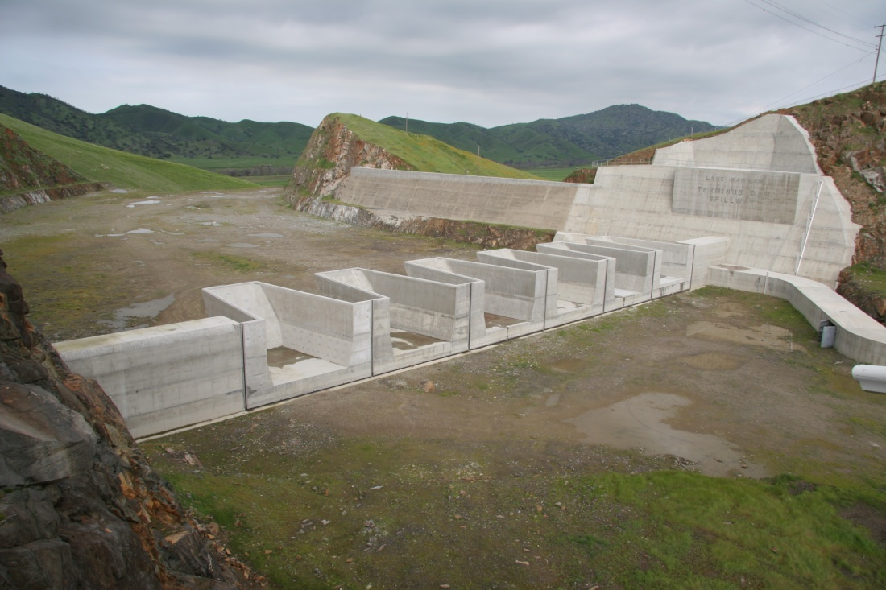
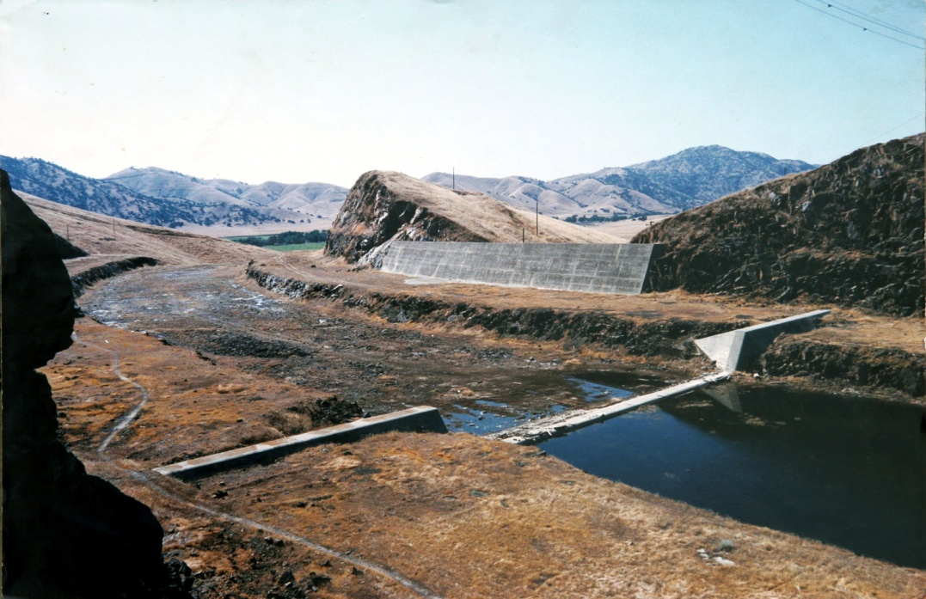
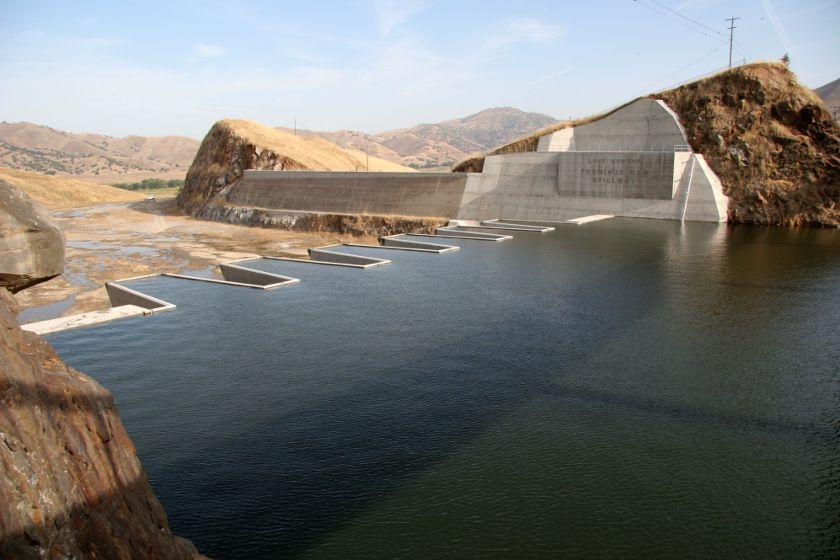
Project Highlights
…After
The Spillway
Before…
Empty
Full

Slide 6
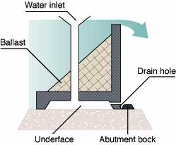
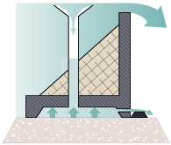
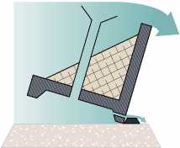
Fusegate Basics
Normal Operating Pool
Pool At Tipping Elevation
Fusegate Tipping

Slide 7
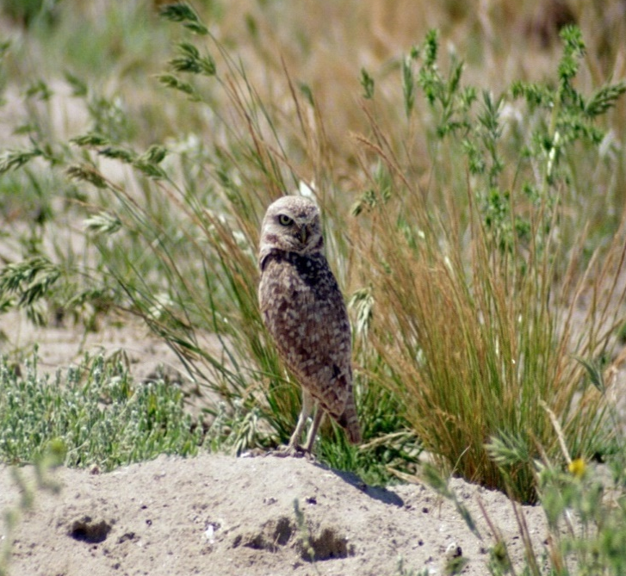
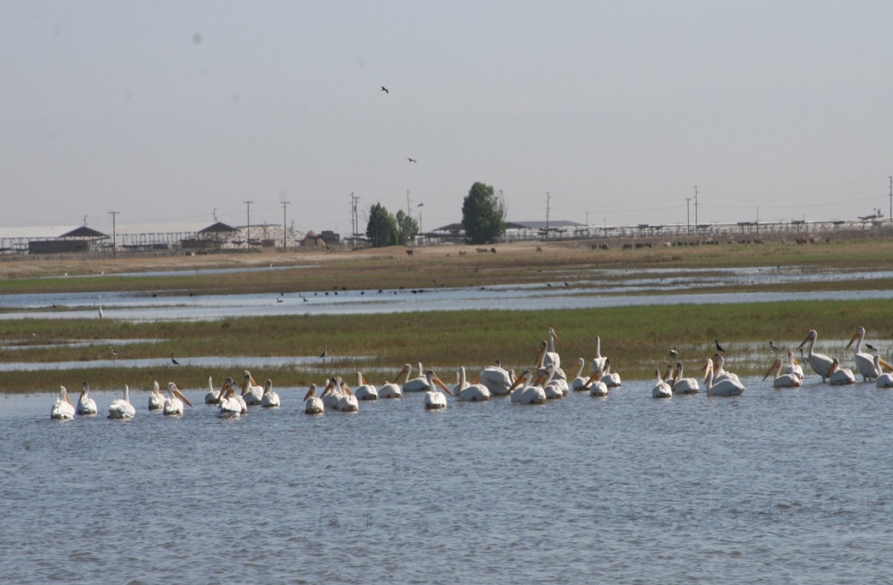
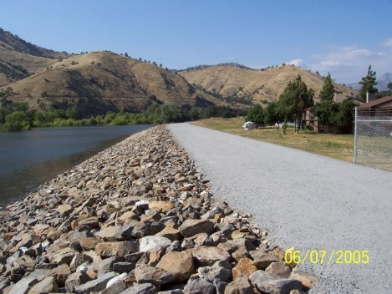
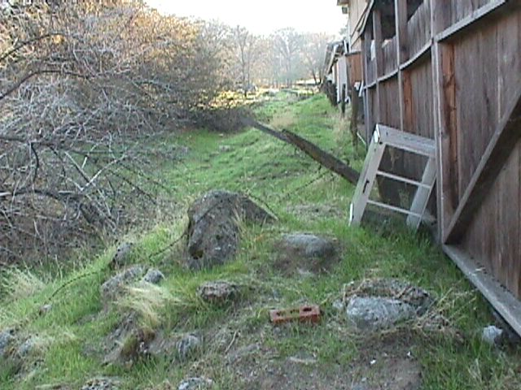
Reimbursement Activities
Burrowing Owl Shorebird Site
Tulare Lakebed Mitigation
Best Western Dike
Demolition
and
Clearing

Slide 8
Next Steps for Project Closeout
Approve Project Cooperation Agreement (PCA) Amendment #1. To be signed by CVFPB and USACE (locals have already signed).
Reimburse funds to Kaweah Delta Water Conservation District for work completed prior to the execution of the PCA.
Reimburse funds by January 31, 2018
Perform Project Close Out by September 30, 2018

Slide 9
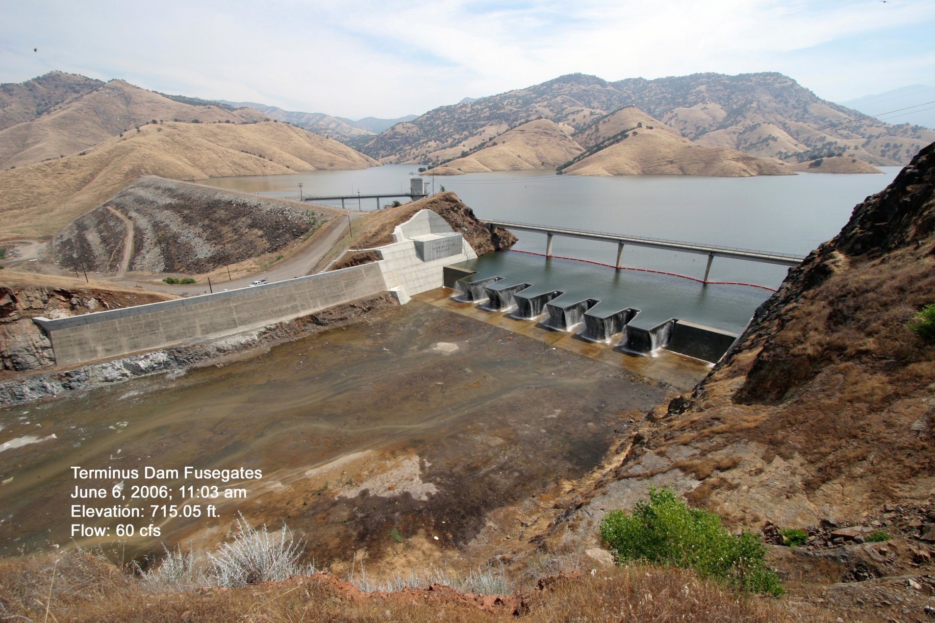
Questions?

