Slide 1
SOUTH SACRAMENTO COUNTY STREAMS, CA, san Joaquin River Basin, Flood control Project October 28, 2016
INTERIM oMRR&R transfer
Confluence of Morrison & Elder Creek-Jan 1995
Notes:
Pointer – visible
Introduce Selva Selvamohan
Steve Cheney or Mike Bruchner UPRR (Nebraska)
Branden Straham, UPRR Consultant (hydraulics)
John Schoonover, CH2M Hill UPRR consultant
Sean Minard LD1

Slide 2
REQUESTED ACTION
Consider approval of Central Valley Flood Protection Board (Board) Resolution 2016-17 which in pertinent part:
Accepts, from the U.S. Army Corps of Engineers (USACE), interim responsibilities for operation, maintenance, repair, replacement, and rehabilitation (OMRR&R) of the Project, constructed by USACE under a Project Cooperation Agreement with the Reclamation Board (now the Central Valley Flood Protection Board (Board)) executed May 2005 (Attachment C), and pursuant to USACE Sacramento District letter (Attachment D) to the Board; and
Transfers those interim OMRR&R responsibilities to SAFCA in accordance with the USACE OMRR&R Manual (Attachment E1) and project as-built drawings (Attachment E2), and pursuant to a Local Project Cooperation Agreement executed May 2005 (Attachment F) between the Board and SAFCA by a draft Board letter (Attachment G).

Slide 3
PROJECT SPONSORS
Federal Sponsor:
United States Army Corps of Engineers
Project Management by Sacramento District
Non-Federal Sponsors:
Central Valley Flood Protection Board
Local Sponsor:
Sacramento Area Flood Control Agency

Slide 4
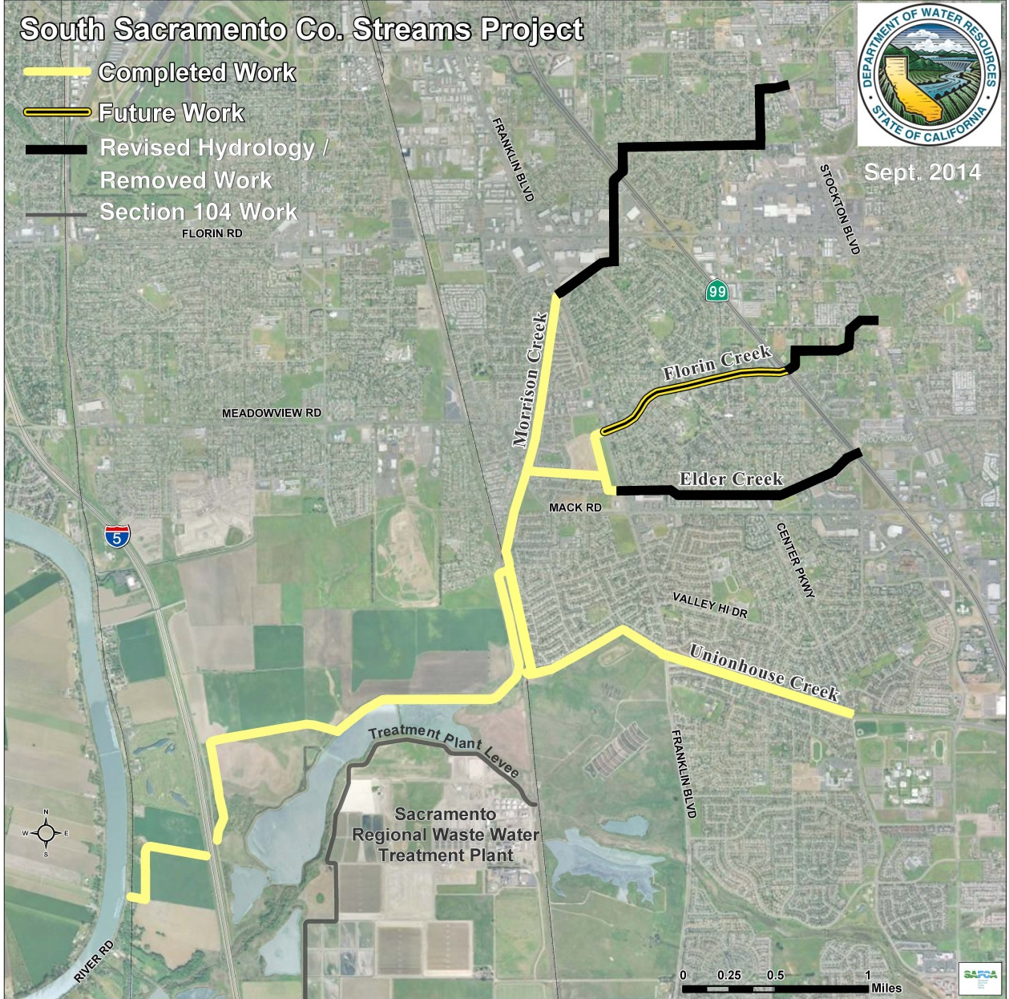
PROJECT LOCATION
Work removed from early designs
SR 99
Florin Creek
Morrison Creek
Elder Creek
I-5
Morrison Creek Stream Group Basin
Unionhouse Creek
Transferred Work
WTP Ring Levee
Beach-Stone Lake Basin

Slide 5
BOARD’S AUTHORITY
Code of Federal Regulations, Title 33, Chapter II, Part 208
California Water Code § 12642 and § 12670.14(d)(1) and (d)(2)
California Code of Regulations, Title 23, Division 1 (Title 23)

Slide 6
PROJECT BACKGROUND (1/3)
South Sacramento experienced nine major flood events between 1952-2011 (largest in 1986, 1995, and 1997).
To initiate the project:
Final Feasibility report and EIS/EIR completed in 1998
Authorized in Water Resources Development Act of 1999 (PL 106-53)
Limited Reevaluation Report (LRR), included revised hydrology, and Environmental Assessment completed in 2004

Slide 7
PROJECT BACKGROUND (2/3)
Project Cooperation Agreement (PCA):
Agreement between USACE and Board executed in May 2005
Established 65% Federal / 35% Non-Federal Cost Share
Local Project Cooperation Agreement (LPCA):
Agreement between Board and SAFCA executed in May 2005
Established 70% State / 30% Local Split of Non-Federal Cost Share
The authorized project purposes are:
Flood damage reduction
Ecosystem restoration

Slide 8
PROJECT BACKGROUND (3/3)
Project Design Criteria:
The project design criteria is based on the USACE’s Risk & Uncertainty (R&U) analysis for a 100-year flood event
Notes:
Be ready 200 year question

Slide 9
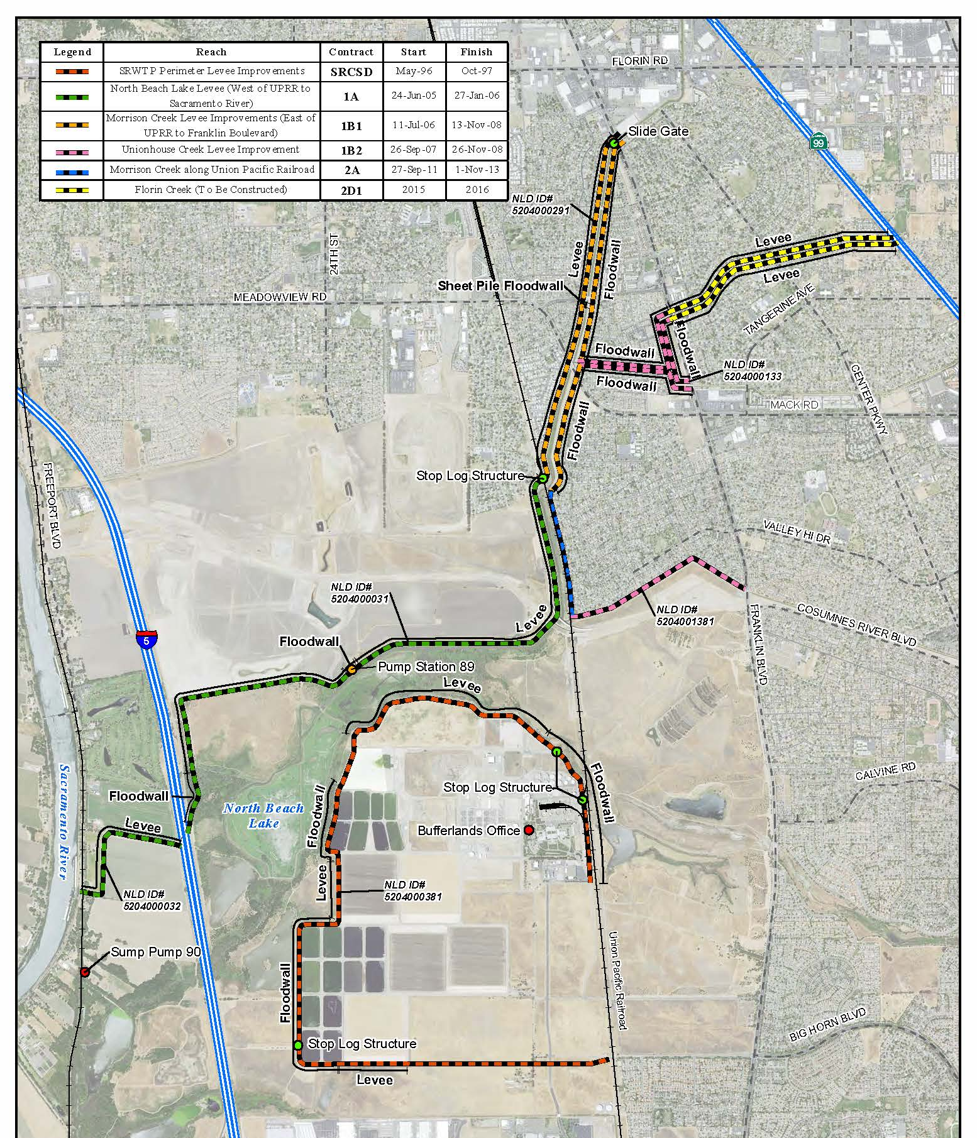
TRANSFERRED WORK
Divided into Phases 1A, 1B1, 1B2 and 2A
TRANSFERRED ELEMENTS:
Phase 1B1
Phase 2D1
North Beach Lake Levee and Floodwall Improvements, West of Union Pacific Railroad (UPRR) to Sacramento River (Contract 1A, completed January 27, 2006);
Morrison Creek Levee and Floodwall Improvements, East of UPRR to Franklin Boulevard (Contract 1B1, completed November 13, 2008);
Unionhouse, Florin, and Elder Creeks Levee Improvements upstream to Franklin Boulevard (Contract 1B2, completed November 26, 2008);
Morrison Creek left bank (east) floodwall along UPRR (Contract 2A, completed November 1, 2013).
Phase 1B2
Phase 2A
Phase 1A
SRCSD

Slide 10
CEQA ACTION
This transfer of OMRR&R responsibilities is a ministerial action statutorily exempt from CEQA under Guidelines section 15268.

Slide 11
STAFF CONCLUSION
Board staff concludes that the interim OMRR&R responsibilities for project elements completed under Contracts 1A, 1B1, 1B2, and 2A have been appropriately transferred by USACE to the Board pursuant to the PCA, and may now be transferred from the Board to SAFCA pursuant to the LPCA.

Slide 12
STAFF RECOMMENDATION
Staff recommends that the Board adopt Resolution 2016-17, which:
accepts interim responsibilities for OMRR&R from USACE;
determines that the proposed transfer from the Board to SAFCA is a ministerial action statutorily exempt from CEQA under Guidelines section 15268;
transfers those responsibilities pursuant to LPCA, and as described in the Interim OMRR&R Manual and as-built drawings, to SAFCA;
directs the Board’s Executive Officer to:
execute the draft letter to SAFCA in substantially the form provided, and
file a Notice of Exemption with the State Clearinghouse.

Slide 13
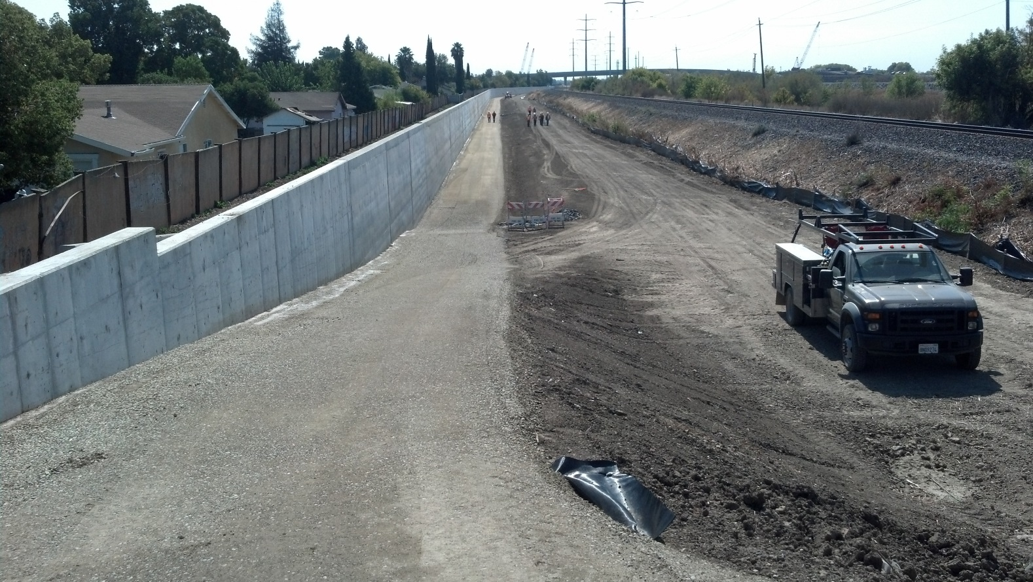
QUESTIONS
Prepared & Presented by: Deb Biswas, PhD, PE, Engineer, WR
Environmental Review: Ruth Darling, Senior Environmental Scientist
Staff Report Review: Eric Butler, PE, Supervising Engineer, PIC Branch Chief
Mitra Emami, PE, Acting Chief Engineer
Kanwarjit Dua, Board Counsel

