Slide 1
Three Amigos Project Update
Paige Caldwell
August 26, 2016
USACE Sacramento District

Slide 2
Background
Following the 1997 flood event, the choice was made to pursue a non-structural alternative (NSA) in lieu of repairs at RDs 2099, 2100, and 2102.
In 1998, USACE completed a hydraulic impact report of the NSA, and confirmed these findings in December 2014.
In 2001, USACE completed flowage easement acquisition for 2 of 4 properties. Two property owners refused.
Ring levee design as required in the USACE/USFWS MOA was completed and presented to USFWS, however, the Service has requested that USACE not construct the ring levee.
USACE completed NEPA documentation in 1998

Slide 3
Current Activities
Acquisition of one of the two outstanding flowage easement purchases is complete; currently awaiting signatures of final flowage easement purchase.
Ring levee reconciliation memo from USFWS has been received.
Draft O&M manual based on the changed conditions is complete; circulating for comments now. Plan to meet with CVFPB staff next week to discuss.
Notes:
There are currently 4 RDs in the O&M Manual, and the revised version would simply include one RD (2101).

Slide 4
Future Actions
Finalize final flowage easement purchase
Finalize language for CVFPB’s O&M manual and meet with CVFPB staff to discuss
Transfer O&M Manual update to CVFPB

Slide 5
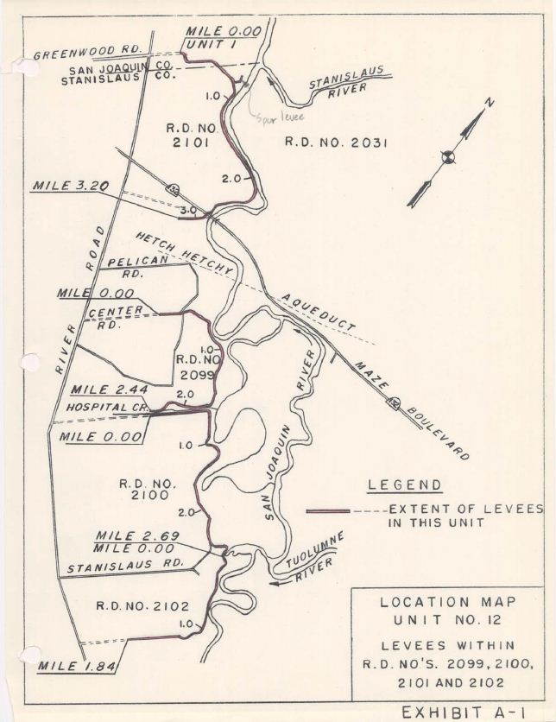

Slide 6
