Slide 1
Colors

Slide 2
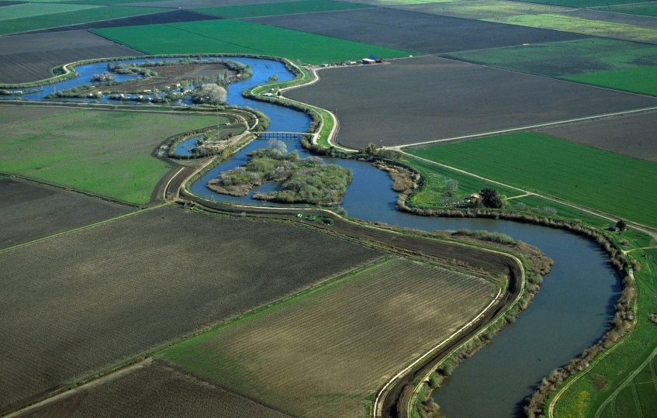
DELTA LEVEES MAINTENANCE SUBVENTIONS PROGRAM
Sandi Maxwell, P.E.
Presented at the
Central Valley Flood Protection Board
Sacramento, California
August 26, 2016

Slide 3
Why are we here today?
Describe our 2016 Guideline Update process
Request adoption of the Delta Levees Maintenance Subventions 2016 Guidelines
Request approval of the Subventions Program Fiscal Year 2016/2017 funding plan in the amount of $12 million
Request authorization for DWR to proceed with preparation and circulation of the Subventions Program work agreements for signature by the Board’s Executive Officer

Slide 4
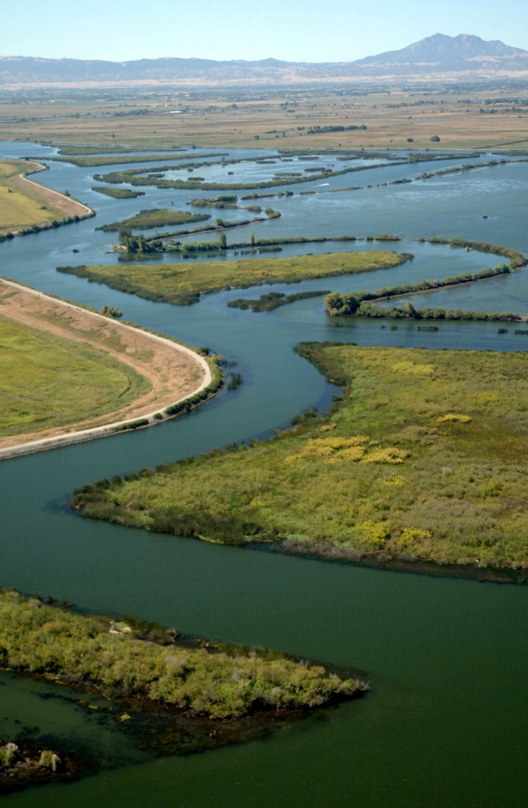
Update Process
2011
September 23, 2011
CVFPB adopted update to the 2007 Subventions Guidelines
2015
Coordinated with Stakeholders before guideline release
September 30, 2015 - posted Guidelines on DWR website and informed stakeholders
Public Meetings
Extended comment period to 61 days
Comments due December 1, 2015
2016
Posted Comments and Response to Comments on DWR website on February 10, 2016
Sought CVFPB approval June 24, 2016
Met with stakeholders July 20, 2016
Seek CVFPB approval August 26, 2016

Slide 5
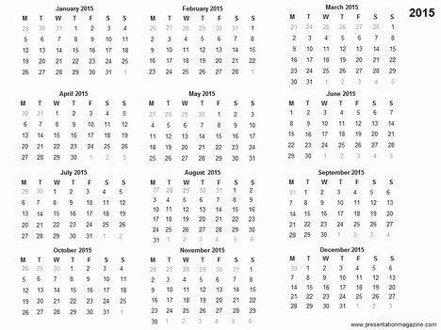
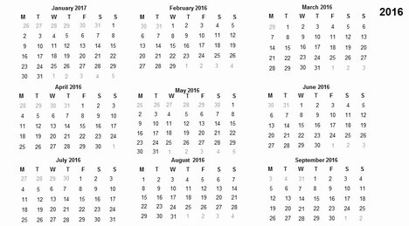
Guidelines update start
1st dedicated Delta engineer stakeholder meeting
Agency stakeholder meetings
2015
Public comment period
30 day public comment extension granted
Comments & responses posted to website and announced at DLHAC
DLHAC (18)
Meeting with CVFPB Subcommittee
First request to CVFPB for guidelines update approval
2016
2nd dedicated Delta engineer meeting at Board request
2nd request to the CVFPB for guidelines update approval
2016 SUBVENTIONS DRAFT GUIDELINES OUTREACH SUMMARY

Slide 6
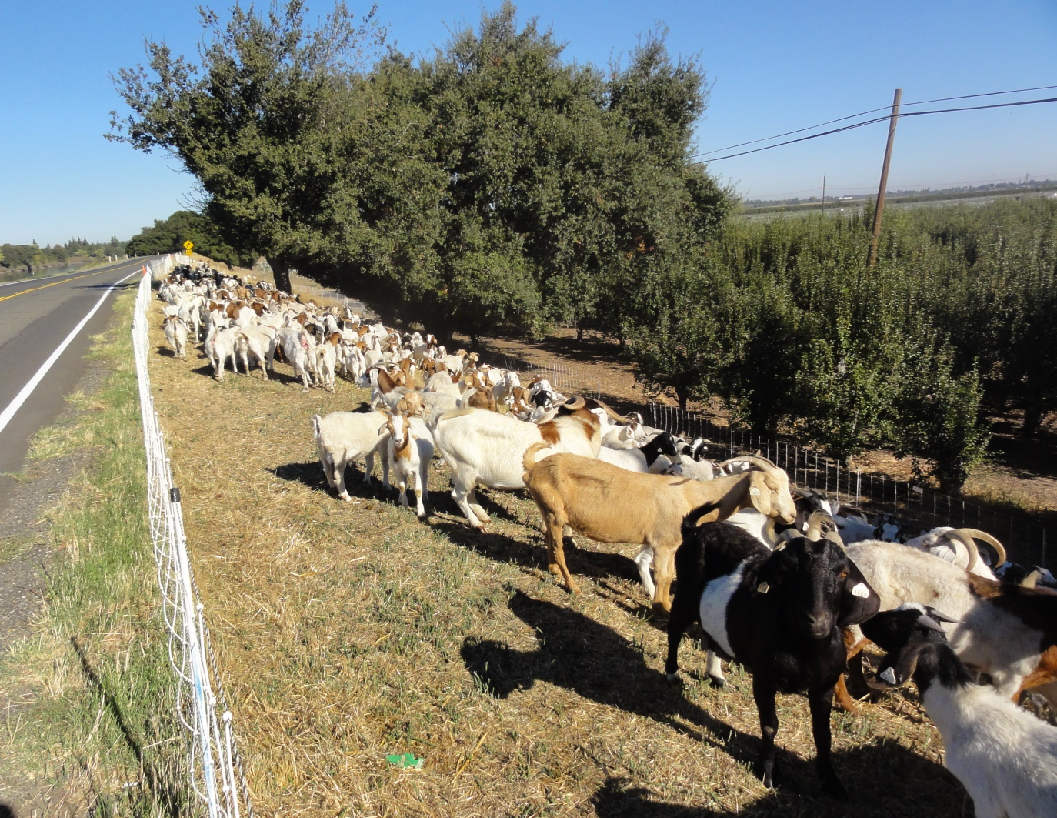
QUESTIONS?

Slide 7
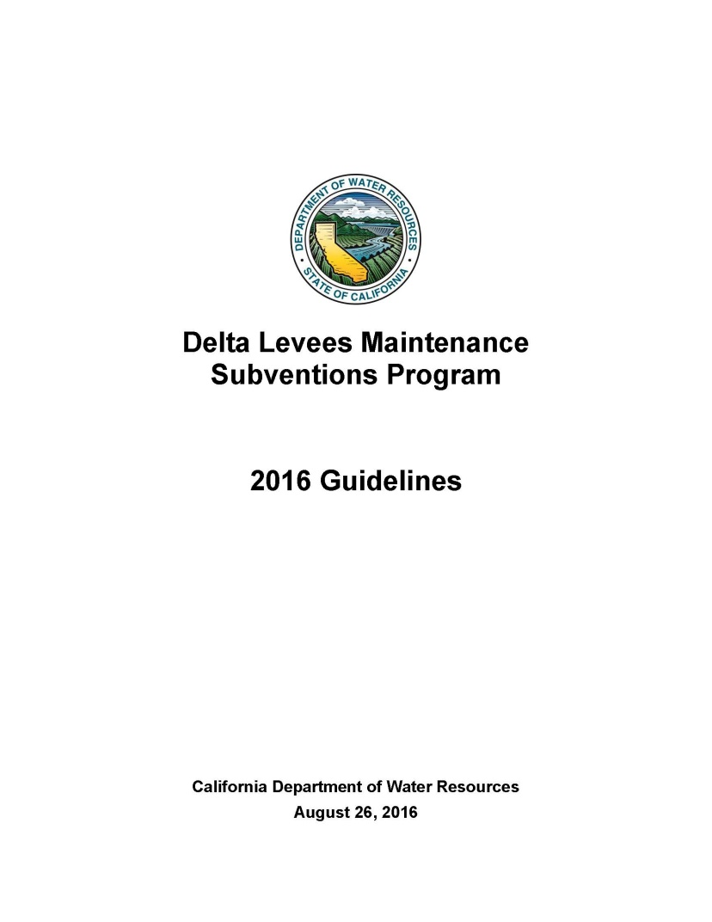
2016 Guidelines
Authorized by CA Water Code §12984
Guide the administration of the Subventions Program

Slide 8
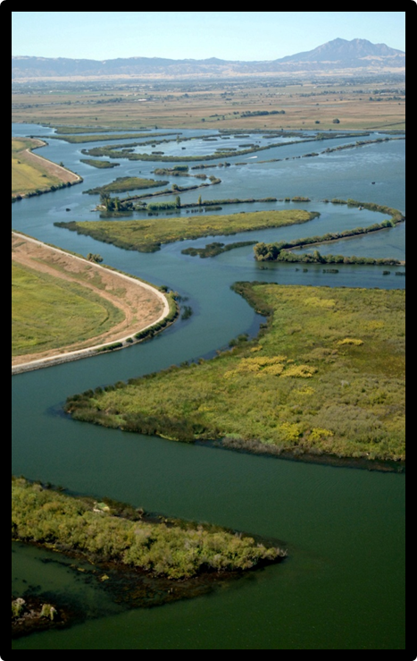
Why update the Guidelines?
To incorporate legislative changes
To clarify the 2011 Guidelines
To address recent issues and concerns
To improve the program

Slide 9
Accomplishments
Incorporate Legislative changes
Improve financial accountability
Ensure that State funds are spent appropriately
Improve requirements to ensure no net loss of habitat
Clarify program requirements

Slide 10
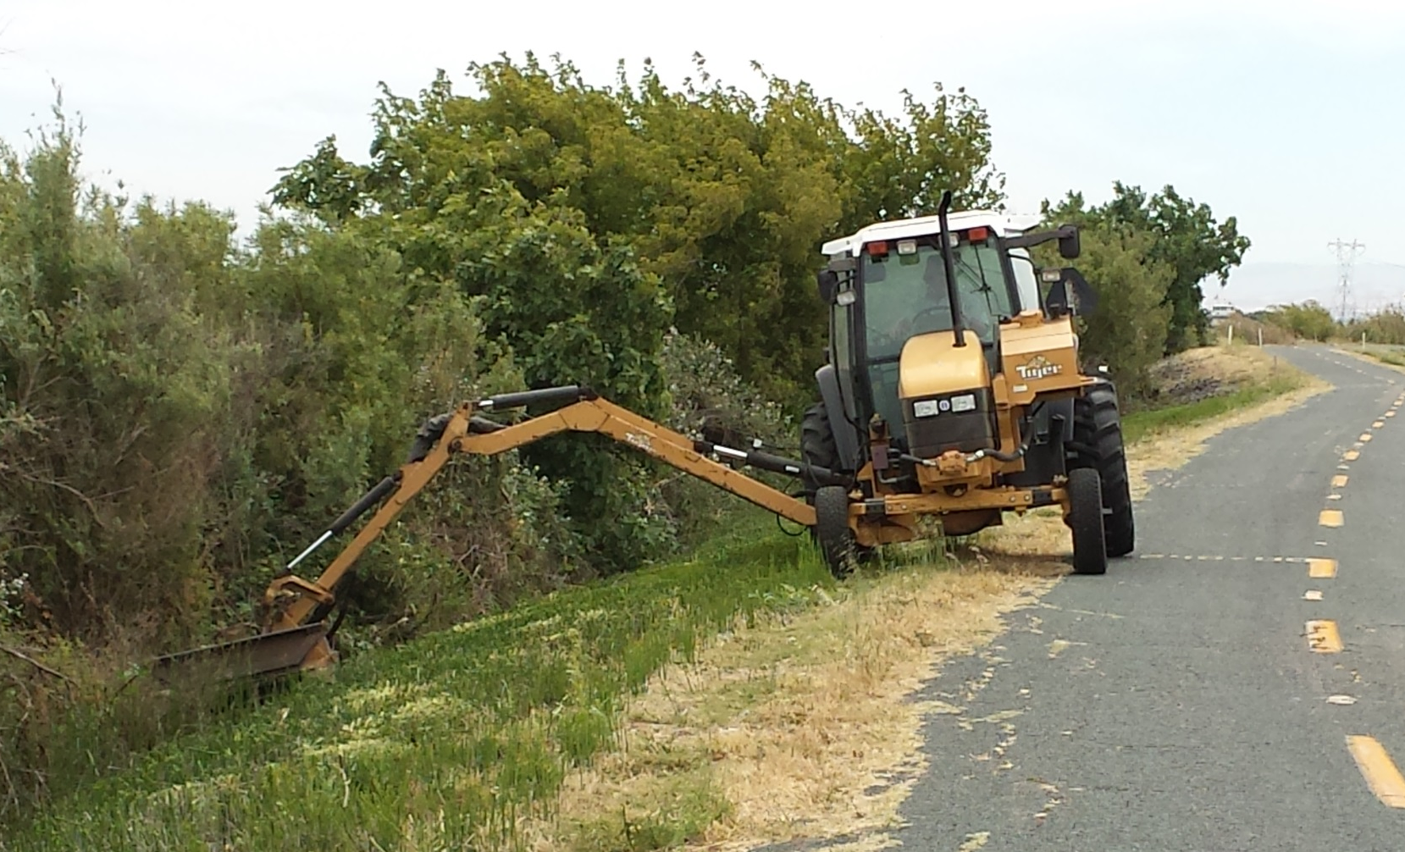
QUESTIONS?

Slide 11
Staff Recommendations
DWR staff recommend the Board:
Adopt the Delta Levees Maintenance Subventions 2016 Guidelines.

Slide 12
Funding FY 2016-2017
HELPING THE DELTA

Slide 13
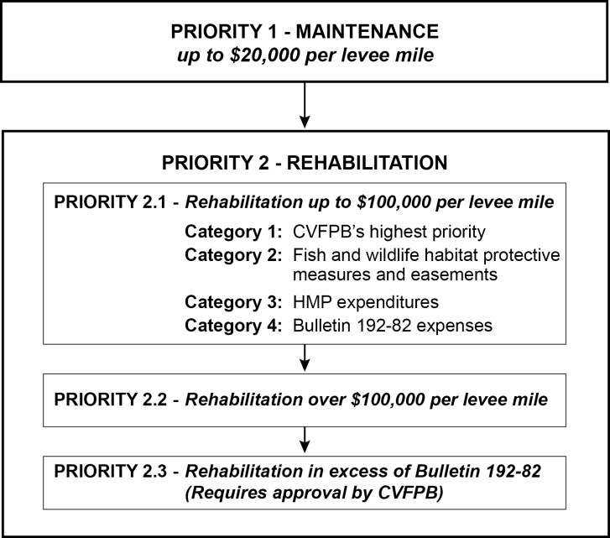
Subventions Program
Priority of Funding

Slide 14
Program Funding
Fiscal Year 2014/2015 Details
 | Eligible work | State reimbursement (75%)
Maintenance Deductible ($1,000/levee mile) | ($710,900)
Priority 1 - Maintenance | $5,831,129 | $4,373,347
Priority 2 - Rehabilitation
Priority 2.1 | $4,371,677 | $3,278,758
Priority 2.2 | $454,624 | $340,968
Priority 2.3 | $0 | $0
Total | $11,368,330 | $7,993,073

Slide 15
Program Funding
Proposition 84 and 1E Funding
Fiscal Year | Approved funding | Source of funding | Claims received | Total eligible work | State reimbursement
2007/2008 | $26 million | Prop. 84 | 60 | $23 million | $16 million
2008/2009 | $20 million | Prop. 84 | 63 | $17 million | $12 million
2009/2010 | $18 million | Prop. 84 | 62 | $13 million | $9 million
2010/2011 | $15 million | Prop. 84 | 62 | $16 million | $11 million
2011/2012 | $12 million | Prop. 1E | 61 | $11 million | $8 million
2012/2013 | $12 million | Prop. 1E | 60 | $12 million | $8 million
2013/2014 | $12 million | Prop. 1E | 62 | $9 million | $7 million
2014/2015 | $12 million | Prop. 1E | 68 | $11 million | $8 million

Slide 16
Program Funding
Fiscal Year 2015/2016 Details
Approved funding - $12 million
Source of funding – Proposition 1E
Executed Work Agreements – 71
Final Claims due November 1, 2016

Slide 17
Program Funding
Proposed Funding for Board Approval
Fiscal Year 2016/2017
Fiscal Year | Proposed funding | Source of funding | Applications received
2016/2017 | $12 million | Prop. 1E & 84 | 71
Final claims due November 1, 2017
Proposed funding decided based on past funding and through discussion with stakeholders.

Slide 18
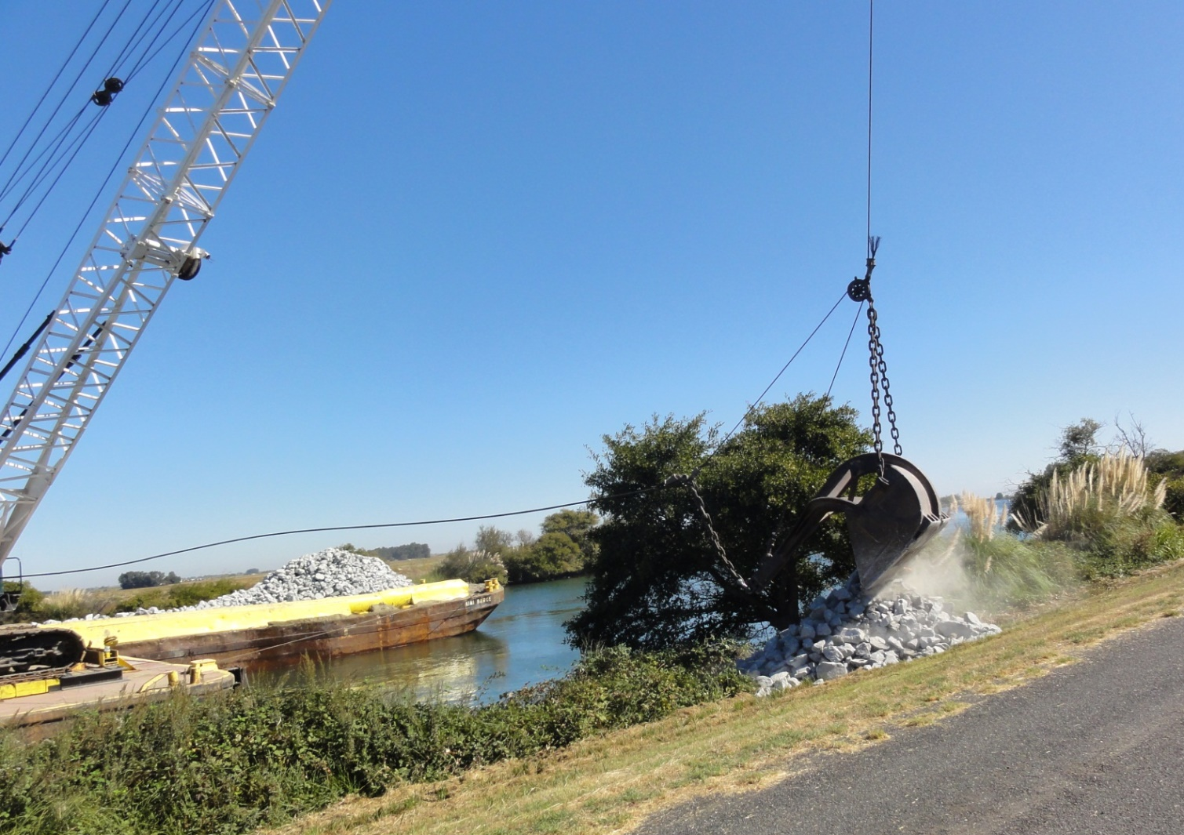
QUESTIONS?

Slide 19
Staff Recommendations
DWR staff recommend the Board:
Approve the funding plan in the amount of $12 million for the Delta Levees Subventions Program for Fiscal Year 2016/2017.
Authorize DWR to proceed with preparation and circulation of the Subventions Program work agreements for signature by the Board’s Executive Officer.

Slide 20
Program Funding
Application vs. Eligible Work
Approved Funding vs. State Reimbursement
$11
$7
$8

Slide 21
Subventions Program
Process
May - Announce deadlines to local agencies
July 1 - Receive applications from local agencies
October - Make recommendations for Board approval
Between Board approval and end of fiscal year:
Execute work agreements with local agencies and Board
Local agencies do the work: July 1 – June 30
November 1 - Local agencies submit final claims
After DWR receives claims:
Audit the claims
Conduct joint inspections with CDFW and Local Agency
Make payments for eligible reimbursement

