Slide 1
Delta Levees Investment Strategy CVFPB Briefing
July 22, 2016

Slide 2
Today’s Discussion
Background and Purpose
1
Risk and Level of Protection
2
Risk Results
3
Prioritizing Approach
4
5
Next Steps
2

Slide 3
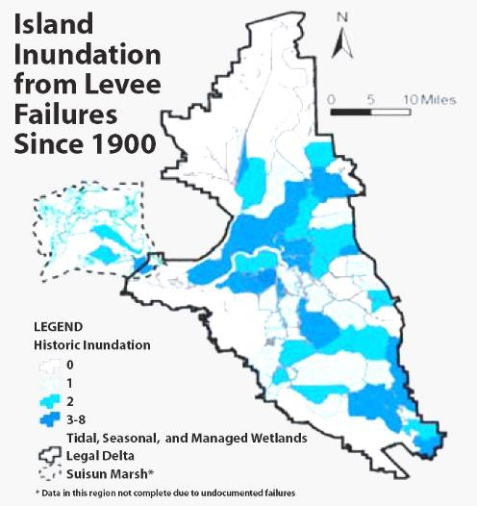
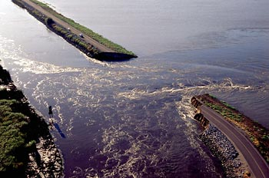
158 levee failures since 1900
Apparent declining rate of failure since the 1970s
3

Slide 4
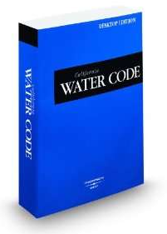
Sacramento-San Joaquin Delta Reform Act of 2009
85305. (a) The Delta Plan…reduce risks to people, property, and state interests…by promoting…strategic levee investments.
85306. The council, in consultation with the Central Valley Flood Protection Board, shall recommend…priorities for state investments in levee operation, maintenance, and improvements

Slide 5
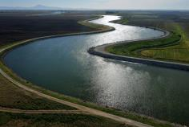
The assignment: Reduce risk in the Delta
People
Property
State Interests
Coequal goals
Water supply
Ecosystem
While considering the Delta as an evolving place

Slide 6
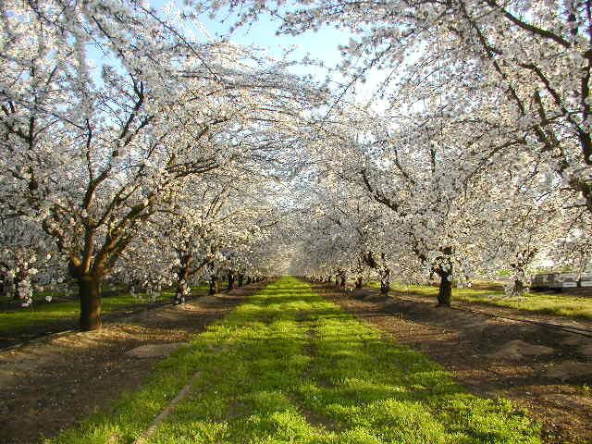
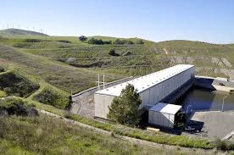
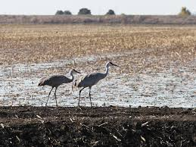
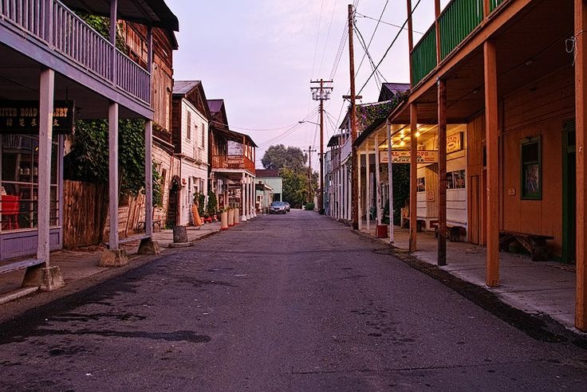
The expected outcome: Delta Levees Investment Strategy
Priority islands and tracts for investment
Comprehensive risk reduction strategy
Delta Plan policy changes
Recommendations to the Legislature and other agencies

Slide 7
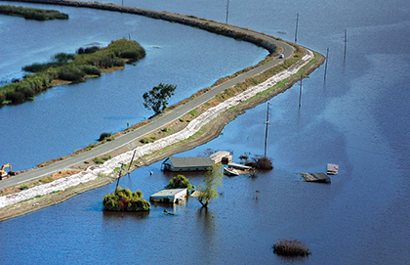
Tolerable Risk vs. Level of Protection
7

Slide 8
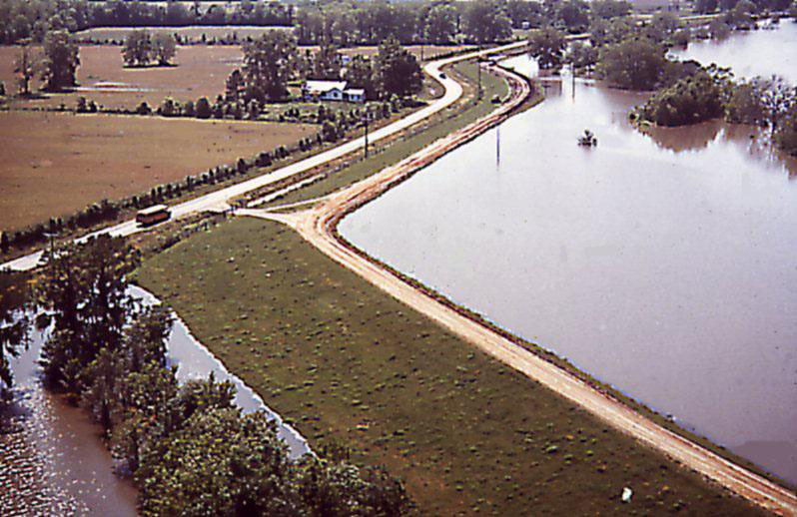
What is risk?
What is in harm’s way? How vulnerable is it?
What are the hazards and how likely are they to occur?
How will the structure perform?
Risk = Probability X Consequences

Slide 9
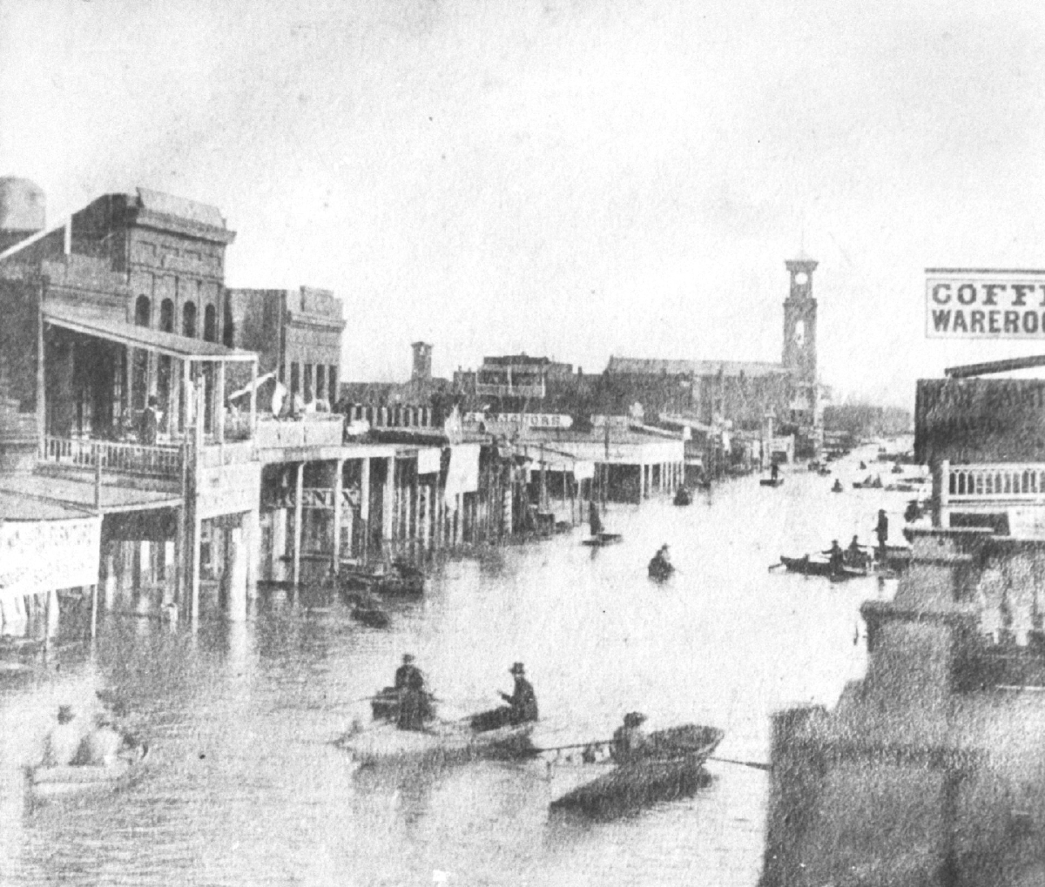
If we want to prioritize where to spend money…
Highest risk
High probability of occurrence
High consequences
Cost-effective actions to reduce risks
More bang for the buck
Manage residual risk
What risk is tolerable?
Sacramento 1862

Slide 10
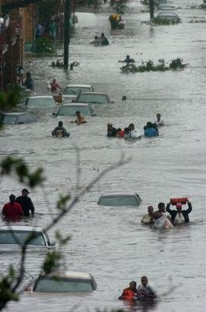
Current Level of Protection approach is limited
Considers only the probability of occurrence
Ignores the adverse consequences of flooding
Focuses on structural actions
Reduces focus on other actions to reduce risk
Implies that risk can be eliminated
100-year (or 200-year) protection is “safe”

Slide 11
One Percent Level of Protection
Current Guidance
Limitations
One percent AEP—NFIP (44CFR 65.10)
“100-year” level-of-protection
Basis for certification and FEMA accreditation
On the land-side of levee
No insurance is required
No special mitigation is required
Delta Stewardship Council

Slide 12
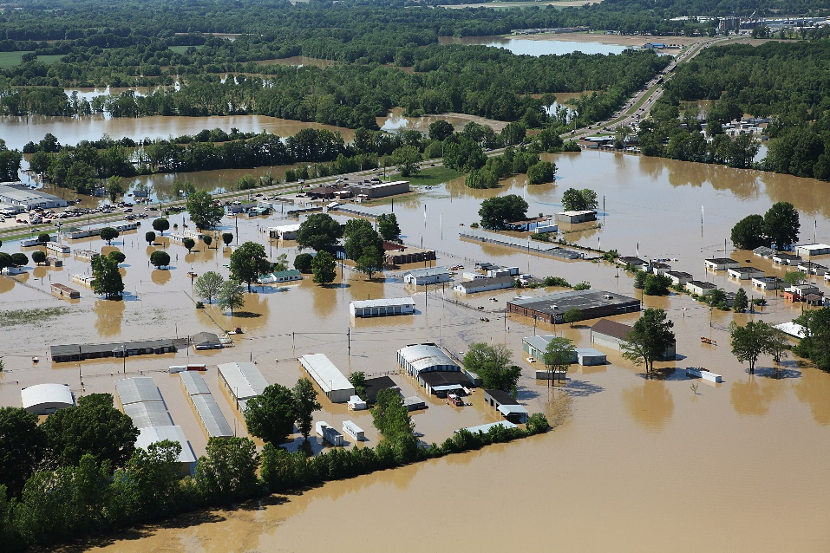
Limitations of the Level of Protection approach
The one-percent annual chance LOP is not a safety standard
Basically an insurance standard
Focuses on the hazard
Ignores consequences
Implies risk can be eliminated
Favors structural solutions
Hard to measure
Risk reduction
Cost-effectiveness

Slide 13
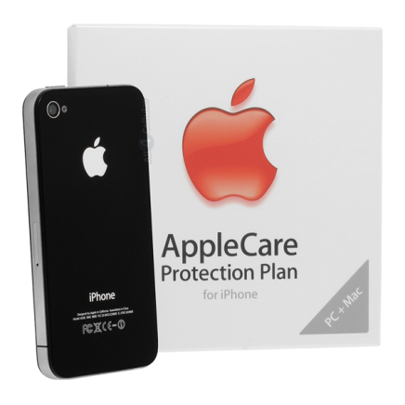
We make decisions everyday based on risk

Slide 14
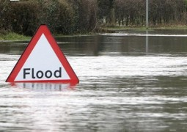
Principles of Tolerable Risk approach
Risk cannot be ignored
Absolute safety cannot be guaranteed
Life safety is paramount (USACE)
Risk should be As Low As Reasonably Practicable, or ALARP
ALARP is what can be reasonably done without spending an inordinate amount of time, money, or resources relative to the risk reduction benefits

Slide 15
How Much Risk is Tolerable?
HIGH
LESS TOLERABLE
Mining Accident
PROBABILITY
LIMIT OF TOLERABLE RISK?
Auto Accident
Dams
MORE TOLERABLE
LOW
Plane Crash
LOW
CONSEQUENCES
HIGH
RISK = PROBABILITY x CONSEQUENCES

Slide 16
Tolerable Risk
Unacceptable
Broadly acceptable
Range of Tolerability
Risk cannot be justified except under extraordinary circumstances
No further actions required. Risk regarded as insignificant

Slide 17
How Does Risk Change?
HIGH
LEVEES DETERIORATE
POPULATION GROWS
PROBABILITY
IMPROVE EVACUATION
CURRENT RISK
IMPROVE LEVEES
LOW
LOW
CONSEQUENCES
HIGH
RISK = PROBABILITY x CONSEQUENCES

Slide 18
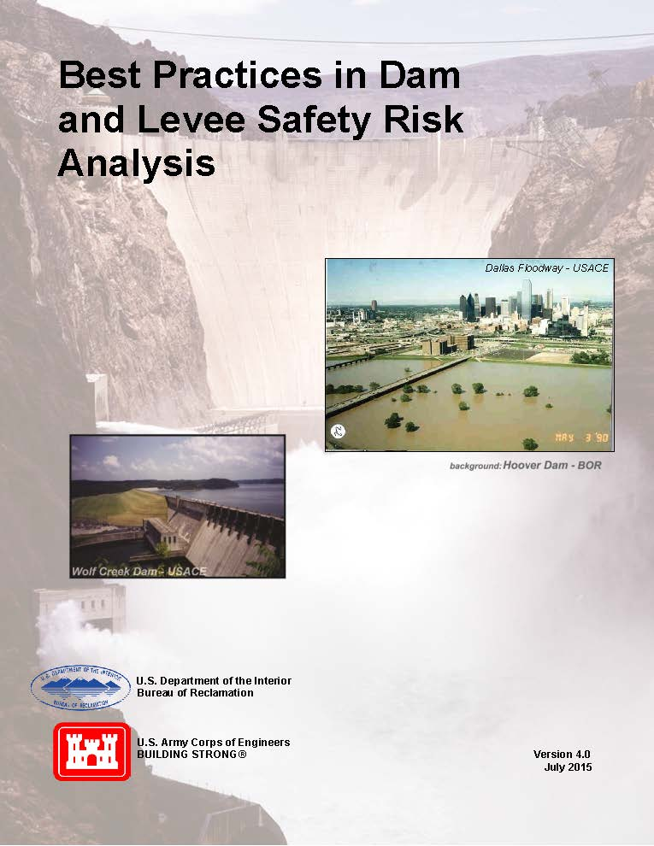
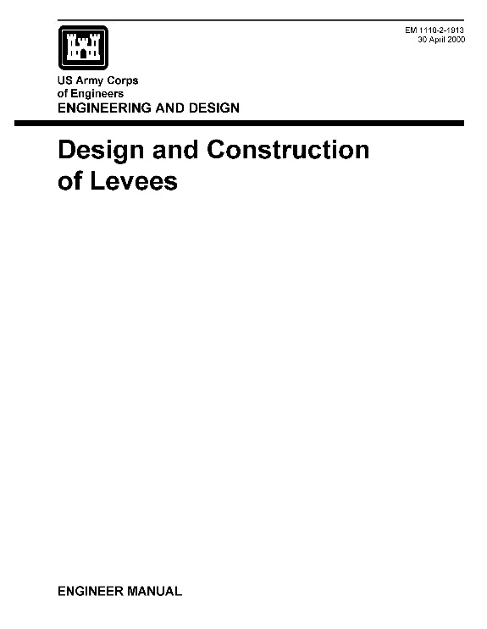
Tolerable Risk Guidance
Best practices identified by USACE and USBR (2015)
USACE Design and Construction of Levees (2016) will encourage risk assessment procedures

Slide 19
Applying the Tolerable Risk approach
Initial DLIS priorities based on risks and opportunities
Characterize Risk
Inventory assets
Identify hazards
Assess vulnerabilities
Calculate risk
Identify Options to Reduce Risk
Structural
Non-structural
Calculate risk reduction
1.
2.
Continuously Review
Communicate risks
Adapt to change
Perform robust OMRR&R*
Evaluate Options
Do measures reduce risk to tolerable levels?
Compare cost-effectiveness and trade-offs
Assess residual risk
4.
3.
*Operations, maintenance, repair, replacement, and rehabilitation

Slide 20
Advantage of Tolerable Risk
Facilitates
Understanding risk
Communicating risk
Managing risk
Recognizes
Risk cannot be eliminated
Absolute protection is not possible
Enables
Evaluation of trade-offs and cost-effectiveness
Efficient use of resources
Establishing priorities
Fair treatment
Accounts for
Both structural and non-structural options
If you can measure risk, you can measure the cost-effectiveness of efforts to reduce risk

Slide 21
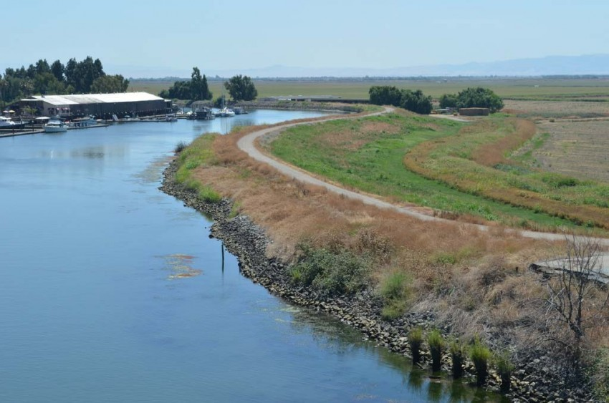
Applying tolerable risk Approach to the delta
21

Slide 22
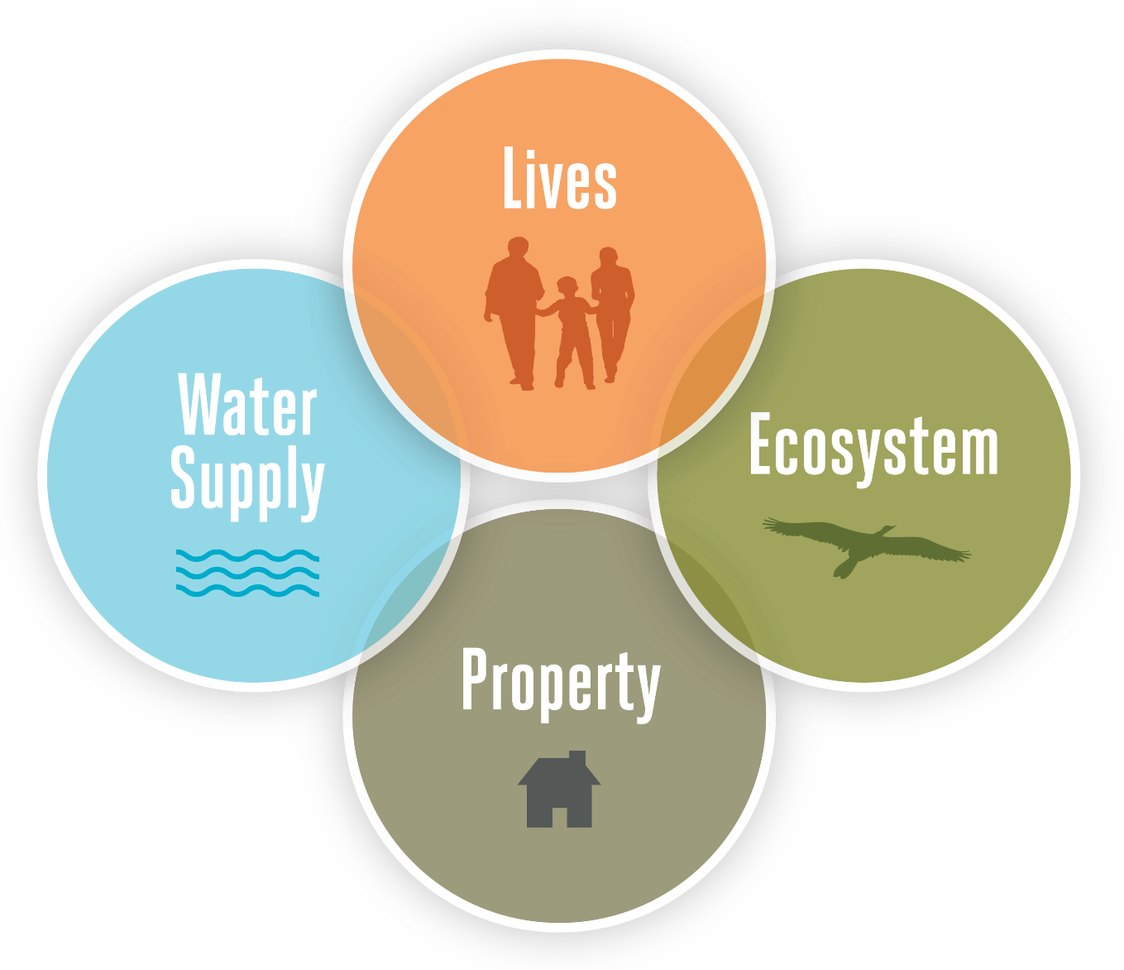
State Interests in the Delta

Slide 23
Delta Assets
Lives
Population
Property
Property value (structures and crops)
Infrastructure systems of statewide importance
Water Supply
Islands important for water quality, conveyance, and water supply infrastructure
Ecosystem
Terrestrial habitat and managed floodplains
Tidal and riparian habitat
Other Delta as Place Considerations
Legacy towns, prime agricultural lands, and public roadways

Slide 24
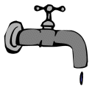
Risk Metrics in the Delta
Expected Annual Fatalities (EAF)
Harm to the Ecosystem
Expected Annual Damage (EAD)
Harm to Delta as a place
Water Supply Disruption

Slide 25
Delta Risk Maps
RISK TO DELTA AS A PLACE
ECOSYSTEM RISK
WATER SUPPLY RISK
FLOOD DAMAGE RISK (EAD)
LIFE LOSS RISK (EAF)

Slide 26
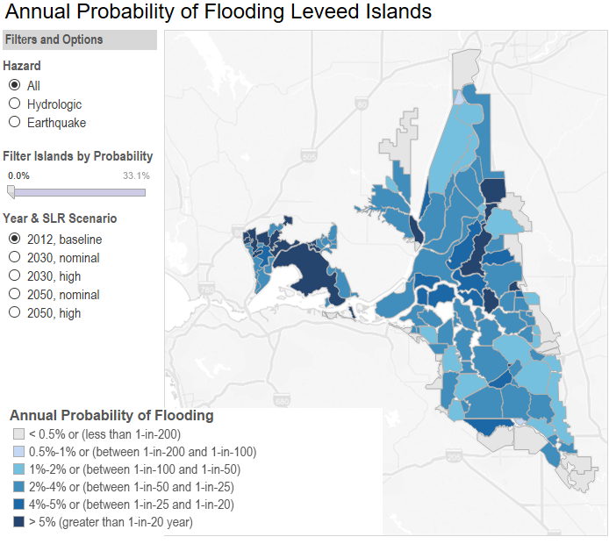
Probability of Flooding

Slide 27
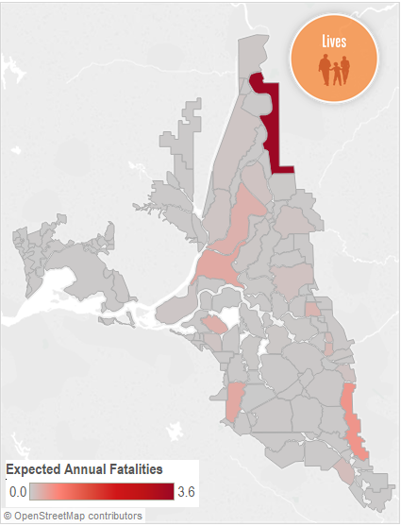
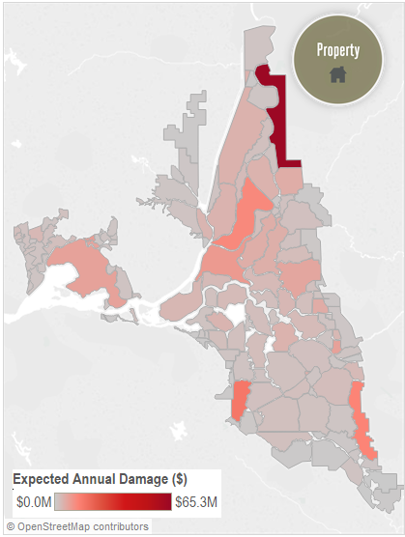
Preliminary Delta Risk Maps – Lives & Property

Slide 28
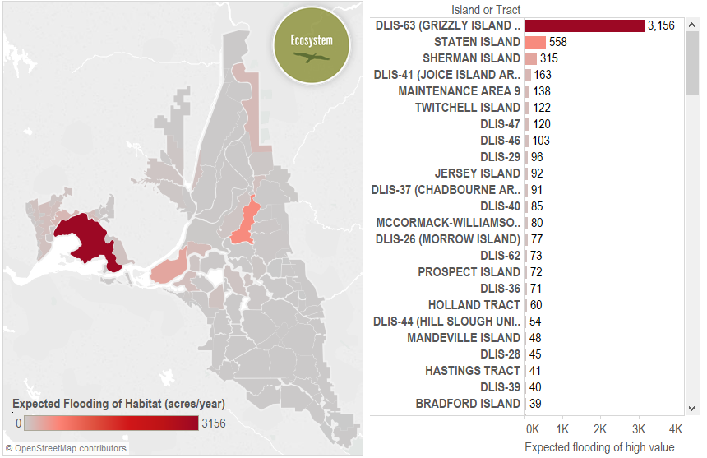
Risk to High-value Terrestrial Habitat

Slide 29
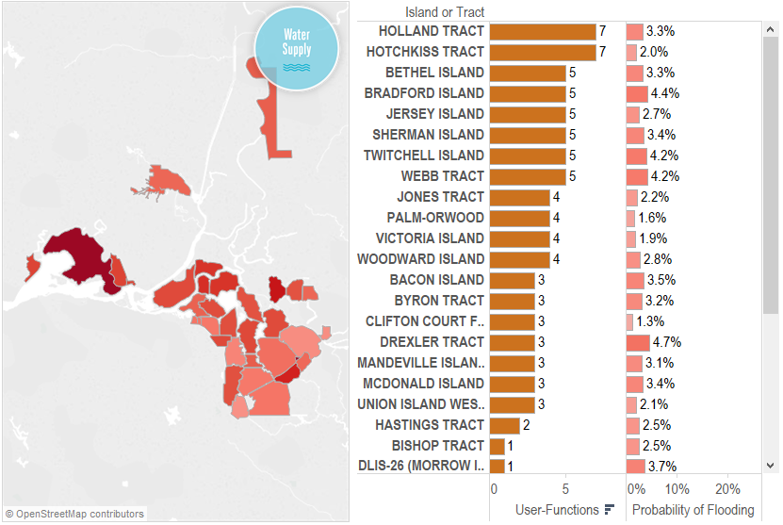
Water Supply Disruption
By function
Salinity barrier
Conveyance corridor
Infrastructure
By user group
10 major user groups
By percent of Delta diversions

Slide 30
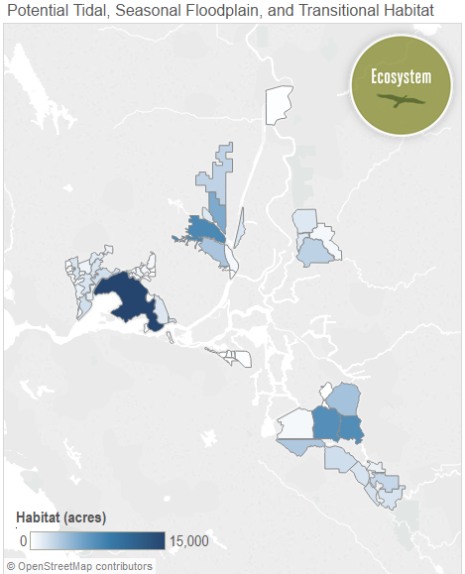
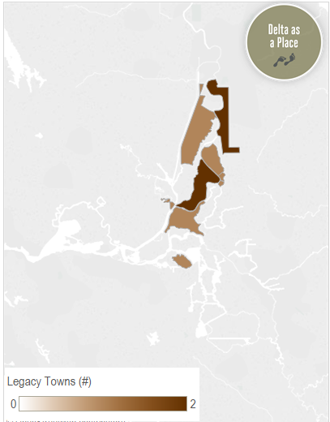
Additional Delta Information
Potential for Tidal Habitat
Islands with Legacy Towns

Slide 31
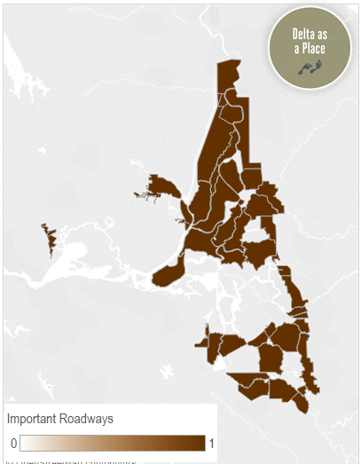
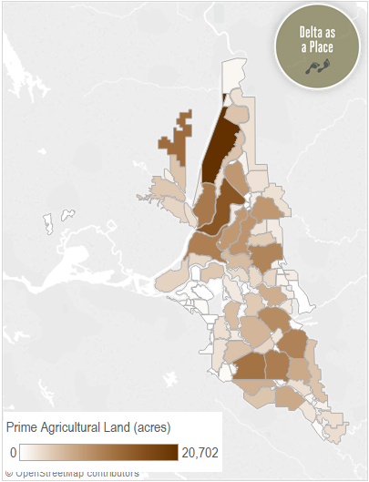
Additional Delta Information
Islands with Public Roadways
Prime Agricultural Lands

Slide 32
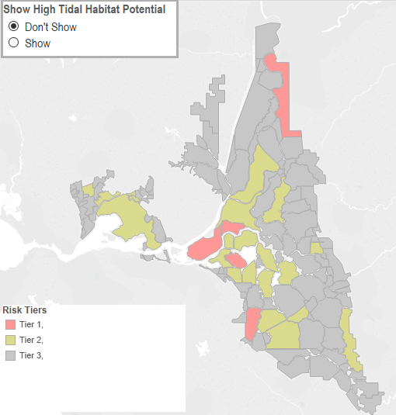
Example Tiered Risk Map
Example Composite Risk
Expected Annual Fatalities
Expected Annual Damages
Risk of Water Supply Disruption
Risk of Habitat Damage

Slide 33
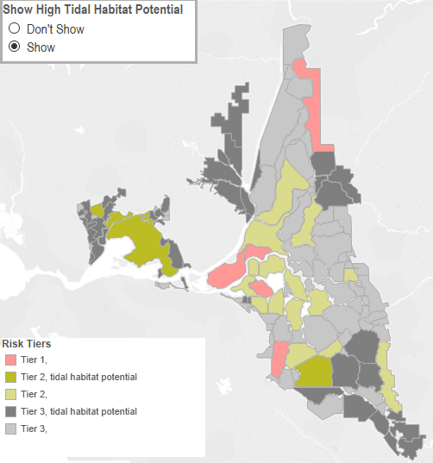
Tiered Risk Map, with tidal habitat potential

Slide 34
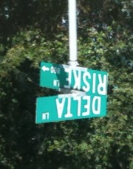
Applying Tolerable Risk Guidelines in the Delta
Enables clear communication of risk to decision-makers, stakeholders and the public
Identifies areas of highest risk
Places appropriate focus on the risk to life safety
Enables using risk metrics to inform decisions and prioritize investments
Lives and property
Water supply
Ecosystem
Delta as a place
Provides an open and transparent basis for prioritizing investments
Image: Andrea Gaffney
July 19, 2016
34

Slide 35
Next Steps – Near-term
Identify high priority islands for investment
Prepare draft risk reduction strategy
Investment priorities
Delta Plan risk reduction policy changes
Delta Plan recommendations
Begin CEQA review
Prepare report to the Legislature
Priorities and recommendations

Slide 36
Next Steps – Long-term
Characterize Risk
Inventory assets
Identify hazards
Assess vulnerabilities
Calculate risk
Identify Options to Reduce Risk
Structural
Non-structural
Calculate risk reduction
1.
2.
Continuously Review
Communicate risks
Adapt to change
Perform robust OMRR&R*
Evaluate Options
Do measures reduce risk to tolerable levels?
Compare cost-effectiveness and trade-offs
Assess residual risk
4.
3.
*Operations, maintenance, repair, replacement, and rehabilitation

Slide 37
dISCUSSION

