Slide 1
CVFPB Encroachment Permit Application Review Process Mike Thao, Acting Permitting Section Chief James Herota, Senior Environmental Scientist
INFORMATIONAL BRIEFING
Notes:
Good morning.
Mike Thao, Board Staff. Currently Acting Permitting Section Chief.
I will be providing an overview of the CVFPB permit application review process with:
James Herota (Senior Environmental Scientist for the Board) and
Ryan Larson (Chief of the Flood Protection and Navigation Section for the Army Corps of Engineers)

Slide 2
General Review Process Overview:
CVFPB receives and reviews permit application
CVFPB sends application to USACE for review
USACE reviews permit application
CVFPB receives USACE Letter of Permission
CVFPB issues permit
Notes:
Very high level overview of the Board’s permitting process, which will be explained more in detail later.
When a permit application is received, Board Staff reviews the application for California Code of Regulations, Title 23, Division 1 and CEQA compliance.
Once Board staff is complete with his/her review, the application is sent to the Corps’ Flood Protection and Navigation Section for review. The review may include:
Levee Safety
Hydraulics
Coordination with various agencies:
National Marine Fisheries Service (NMFS)
U.S. Fish and Wildlife Service (USFWS)
State Historic Preservation Officer (SHPO)
Tribal Coordination
Corps Regulatory
After these reviews are complete and the project is determined to not to be injurious to public interest and does not impair the usefulness of the Civil Works Project, the Flood Protection and Navigation Section sends the Board a Letter of Permission.
Board issues permit by:
Board staff presents project to the Board for approval as a consent or hearing
Through the Board’s Executive Officer, in which the project is posted on the Board’s website for 30 days prior to issuance

Slide 3
CVFPB Permit Application Review
Upload application into encroachment database
Conduct background research
Review application to ensure compliance with CCR, Title 23, Division 1 standards and CEQA
Send application to USACE Flood Protection and Navigation Section for review
USACE Letter of Permission is received
Issuance of Permit:
Board staff presents project to Board for consideration
Board Executive Officer (EO)
Notes:
This is a more detailed description of the Board’s permitting process:
(CLICK) When the Board receives an application, it is uploaded to Board’s encroachment database.
(CLICK) Staff is assigned to application and conducts investigation:
Existing permit for the proposed project
Making sure other encroachments are properly permitted
Verifying that the Local Maintaining Agency endorsed the project
Other pertinent information
(CLICK) Staff reviewed for Title 23 and CEQA compliance.
(CLICK) Staff sends application to the Corps’ Flood Protection and Navigation Section for review. Again, the review is rigorous and they coordinate with multiple agencies.
(CLICK) When the Board receives the Corps’ Letter of Permission, Board issues permit:
- Board staff presents project to the Board for approval as a consent or hearing
- Through Boards Executive Officer as described under Section 5 of Title 23, by posting the project on the Board’s website for 30 days prior to issuance

Slide 4
General Overview of USACE Permit Application Review
Proposed work located within USACE Civil Works Project
Section 408 – Alteration of a USACE Civil Works Project
Section 404* – Discharge of dredged or fill materials into Waters of the U.S.
Section 10* – Activities in, over, or under Navigable Waters of the U.S.
Proposed work located outside USACE Civil Works Project
Section 408 – No comments or recommendations letter regarding flood control
Section 404*
Section 10*
*Review may be required based on location
Notes:
Very high level overview of the Corps’ Flood Protection and Navigation review.
If the proposed project is determined to be located within the Corps’ Civil Works Project area, the application will undergo complete Section 408 review. 408 review is triggered when there is an alteration of the Project when the proposed project is located within the lands and real property interests acquired for the project.
If the proposed project is determined to be located outside the Civil Works Project area, the work is not an alteration to a Corps Civil Works Project and review under Section 408 is not conducted.
Section 404 and 10 permit may be required based on the location of the project.

Slide 5
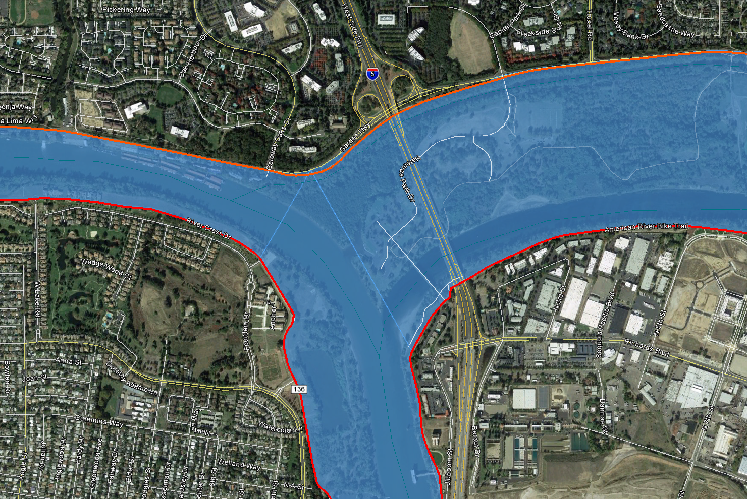
Within Civil Works Project:
Natomas
Sacramento River
American River
Sacramento
West Sacramento
N
Note: Projects located within Corps Civil Works Project is subjected to Section 408 review
Notes:
Shown here is an example of what is considered to be within Civil Works Project area.
The Blue area depicts Corps Project Channel.
Red solid lines depict Federal Corps Project Levees
Projects located within these areas would be subjected to Section 408 review.

Slide 6
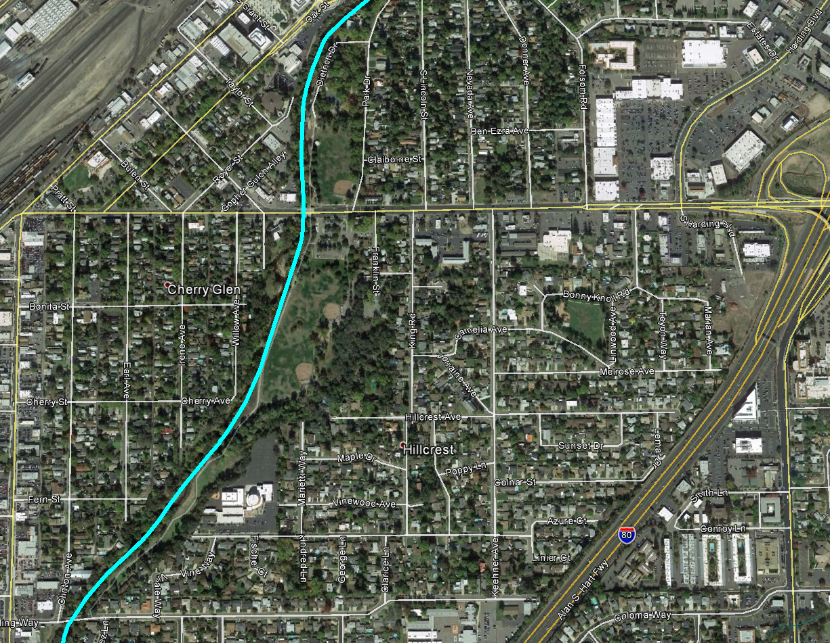
Outside Civil Works Project:
Dry Creek
City of Roseville
N
Note: Projects located outside Corps Civil Works Project is not subjected to Section 408 review
Notes:
Here is an example of an area outside the Civil Works Project area. The aqua colored line represents Dry Creek, located in the City of Roseville which is a regulated stream based on Table 8.1 of Title 23.
A Board permit may be required for proposed project located adjacent to the stream; however, would not be subjected to 408 review.
I will now turn the next few slides over to James Herota to speak more about Section 408 Review.

Slide 7
Section 408 Review (for proposed projects located within the lands and real property interests acquired for the USACE Civil Works project)
Engineer Circular (EC) 1165-2-216
Operations review
Engineering review (levee safety, hydraulics, and others as needed)
Environmental review and Regulatory Division coordination
USACE Regulatory Division: Section 404/10
Section 7 ESA Consultation (USFWS/NMFS)
Section 106/Tribal Consultation (SHPO and Tribes)
Notes:
Good afternoon Board President Edgar and Board Members. My name is James Herota, Senior Environmental Scientist, Board staff.
• I will provide an overview of the Board and USACE roles within the encroachment permit review process and explain how the Section 408 compliance review is completed by the USACE under the USACE policy Engineer Circular EC 1165-2-216 abbreviated as (EC) for future reference.
• The EC was effective July 1, 2014, and establishes the approval sequences for projects within a civil works project and outside a civil works project.
• Under the EC, Section 408 review includes proposed project effects on operation and maintenance, levee safety and hydraulics as well as impacts to the environment. The EC, now requires these 408 actions to meet environmental compliance requirements, prior to the USACE Section 408 approvals for “projects within a civil works project”. (I am not sure what the striked out verbiage means. Also, the EC has always required this—this is not new.)
• As a result, for “projects within a civil works project”, Section 408 approvals are not completed, until reviews by the USACE Regulatory Program are complete. Prior to the EC the 408 approval was made while the USACE Regulatory Program reviews were “in process”. (We discussed this on Tuesday. Prior to the EC there was no such thing as Section 408 approval. We wrote recommendation letters to the CVFPB.)
• The USACE Regulatory Program is responsible for coordinating environmental compliance under:
• Section 404 of the Clean Water Act/Section 10 Rivers and Harbors Act;
Section 408 actions must be made prior Section 404/10 actions. Coordination includes making sure we know that each group (404/10 and 408) is ready to make permit decisions. We also coordinate our consultations when possible so USACE is only consulting once for a proposed alteration.
• Compliance with the Endangered Species Act
• And compliance with Section 106 of the National Historic Preservation Act, including consultations with the State Historic Preservation Officer and Tribes.
(NO!)For Non-Civil Works Project, or encroachment permits that propose projects outside of a federal water or channel, a USACE Section 408 letter of permission may be issued while the USACE regulatory program review is in process under Section 10/404 and Section 106 consultations. As a result, Section 408 approvals are completed sooner for projects located “outside of civil works project”.(NO!)
Try this instead:
For proposed projects outside the USACE Civil Works Project, Section 408 does not apply because there is no alteration and no Section 408 review or approval is conducted, however, Section 404/10 permits may still be required. Applicants will need to coordinate directly with the USACE Sacramento Regulatory Division.

Slide 8
Board Staff Public Outreach
Inform applicants and representatives of CVFPB/USACE review processes
Applicant Pre-application meetings to discuss CVFPB/USACE permit requirements and timelines
Recommend applicants to attend USACE Regulatory Division Pre-application meetings for project planning, when appropriate
CVFPB website/FAQs
Notes:
• Board staff continues to work towards reducing review periods through ongoing public outreach and internal coordination between the staff of the Board and the USACE, Flood Protection and Navigational Section and the Regulatory Division.
• Staff informs applicants of Board/USACE review processes through Pre-application meetings to discuss Board /USACE permit requirements and timelines;
• Staff recommend applicants to attend USACE Regulatory Division Pre-application meetings for project planning purposes when there are complex projects with many consultations required;
• And staff provides regulatory compliance information on the CVFPB website/FAQs. (“regulatory” in this context could be misunderstood. The Board staff is not providing USACE REGULATORY (SECTION 404/10) COMPLIANCE information on its website.)

Slide 9
Efforts to Streamline Permit Processing
Categorical Permissions
Programmatic Agreement(s) with SHPO
Programmatic Consultations with USFWS and NMFS
Notes:
• Additional federal efforts to reduce review periods includes developing: These are additional efforts that we are collectively (USACE/CVFPB) working on that will improve permit processing times in the future.
• Categorical Permissions; Similar to Nation Wide Permits or Regional General Permits from the USACE Regulatory Program
• Programmatic Agreement(s) with the State Historic Preservation Officer (SHPO); and
• Programmatic Consultations with US Fish and Wildlife Service and National Marine Fisheries Service.
Ryan Larson, representing the USACE is present today to address specific questions regarding these federal efforts.

Slide 10
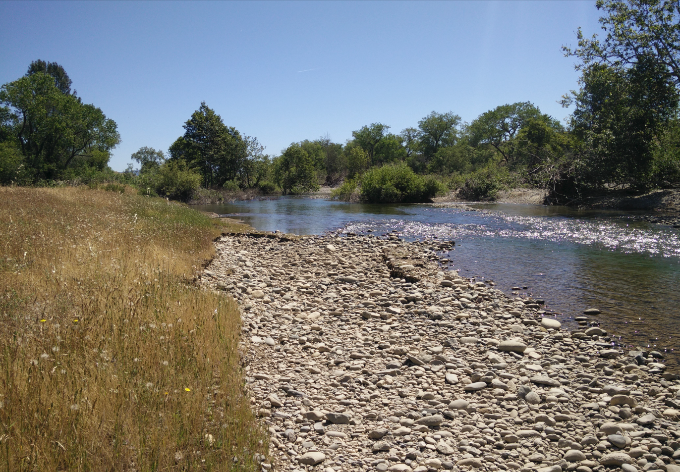
Questions?
Notes:
This concludes our presentation, Board staff and USACE staff are available to address your questions.

