Slide 1
PL 84-99 Implementation Process Status
2017 Storms
Central Valley Flood Protection Board Meeting
May 19, 2017
Agenda Item 9B
Gary W. Lemon
Acting Operations Branch Chief
Central Valley Flood Protection Board
David J. W. Wheeldon
Flood Maintenance Office
Division of Flood Management, DWR
Paige Caldwell
Readiness Section Chief
USACE – Sacramento
Notes:
W:\FLDMAINT\data\Presentations\PL 84-99 CVFPB May 19 2017.pptx
Good afternoon President Edgar, Vice President Suarez, Secretary Dolan, Members of the Board
Gary Lemon Board Staff, Acting Chief of the Operations Branch
I’m here with Mr. Dave Wheeldon from DFM – FMO
And Ms. Paige Caldwell from the USACE – Readiness Section Chief
Today we are here today to provide an informational briefing on the PL 84-99 Rehabilitation Process that is currently ongoing for the Sacramento River & Tributaries due to the 2017 storms we experienced this year.

Slide 2
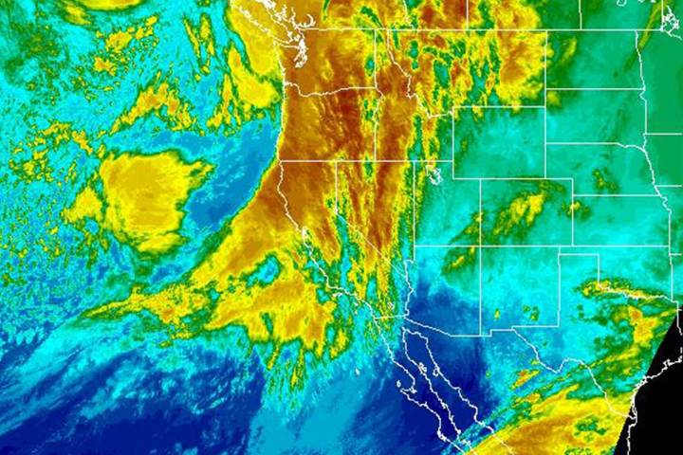
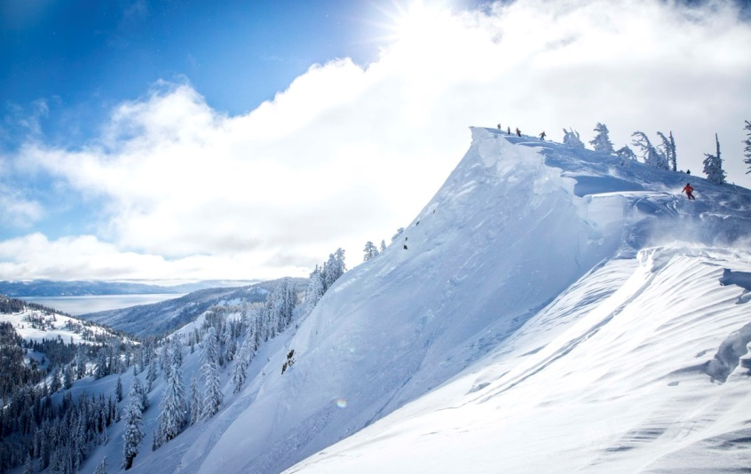
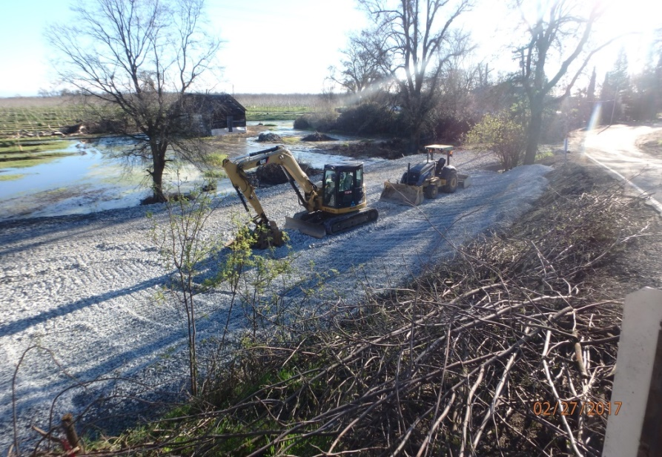
2017 Storms
Several “Atmospheric River” Weather Systems
Record Rain & Snowpack (Ski Resorts Report Record snow pack – 500”)
Emergency Response
(Landside Boils at RD1001)
Notes:
Some places in the Sierra’s received close to 42 feet of snow!

Slide 3
2017 Storms
January 6th : California-Nevada River Forecast Center goes to 24-hour staffing, issue four forecasts per day.
January 7th : Flood Operations Center is activated due to high precipitation and river stage forecasts. Flood fight specialists are deployed as needed.
January 10th : Sacramento Weir opened.
February 7th : DWR declares Department Emergency Mobilization in response to the Oroville Dam Emergency Spillway Incident.
February 8th : Sacramento Weir is opened for second time, 1st time since 1985 flood season.
February 20th : Second DWR Incident Command Team is deployed to assist San Joaquin Co. OES in Stockton for San Joaquin River Flood response. CVFPB and USACE personnel assist.

Slide 4
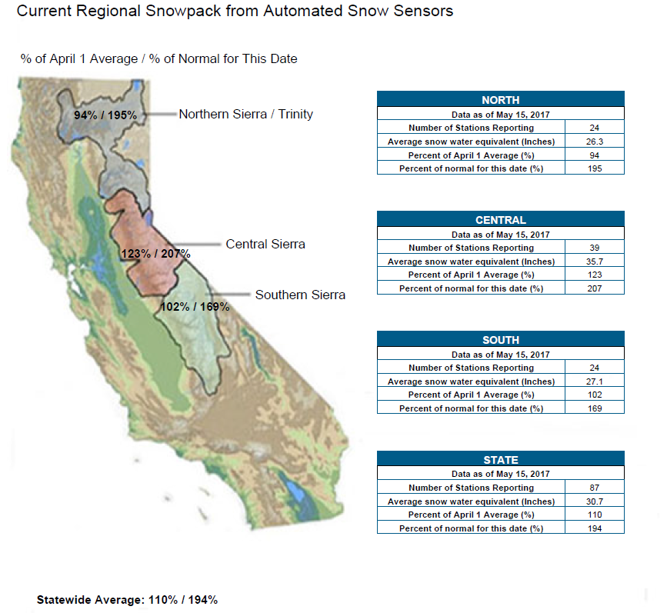
2017 Storms – Background

Slide 5
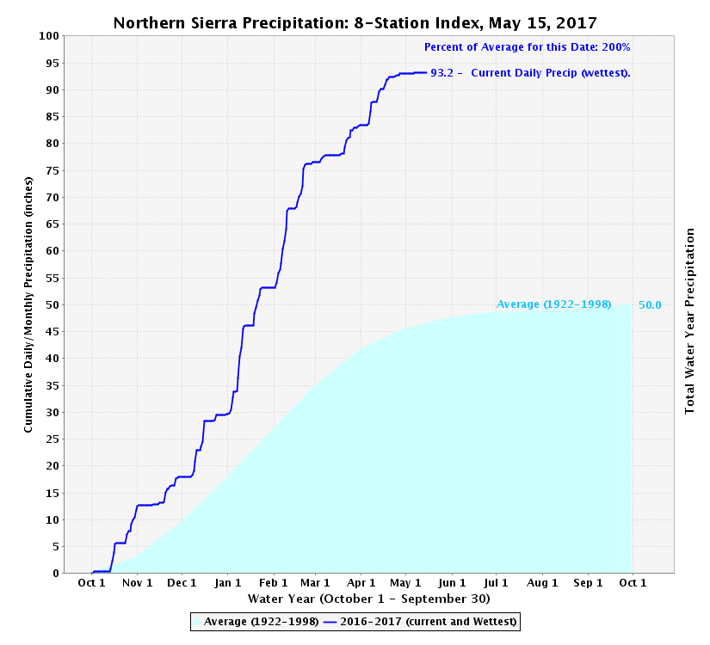
Notes:
On April 14, 2017: The Department of Water Resources, Northern Sierra Eight-Station Index hit an all-time high of 89.7, exceeding the mark of 88.5 set in the rainy season of 1982-83. On April 15th, the index stood at 90.2. Percent of Average for this Date: 200 %

Slide 6
PL 84-99 Rehabilitation Intent
The USACE flood disaster assistance program is intended to:
Supplement and support local interests upon their request for rehabilitation assistance.
To ensure continuation of reliable protection for people’s lives, communities, and property.
Conduct damage repairs that will restore flood risk reduction projects to pre-flood conditions.

Slide 7
State and Federal Levee Threat Mitigation Process
EMERGENCY RESPONSE (Failure w/i 48 hrs)
PL 84-99 Flood Emergency Assistance
DWR Emergency Response through DOE 10122
SPECIFIC EMERGENCY FLOOD EVENT
IMMINENT THREAT (Failure w/i 5 days)
Engineer’s Levee Threat Assessment (ELTA)
PL 84-99 Flood Emergency Assistance
DWR Emergency Response through DOE 10122
NON-EMERGENCY RESPONSE
Damages to be repaired before next flood season
DWR REHABILITATION
Non-PL 84-99 eligible or accepted repairs
USACE PL 84-99 REHABILITATION

Slide 8
USACE PL 84-99 Rehabilitation Process
Public Notice for Rehabilitation Assistance
Field Investigation - Project Information Report (PIR)
Division Review/Approval/Funding
Engineering and Design
Contract Awarded
Construction Complete

Slide 9
Public Notice for Rehabilitation Assistance
April 4, 2017: USACE sends Public Notice to CVFPB (Public Sponsor) asking if there are any requests for Rehabilitation assistance for Flood-Damaged Flood Risk Reduction Projects - Sacramento River & Tributaries – January to March 2017
April 7, 2017: CVFPB sends Notice and Rehabilitation Request Forms to all LMA’s
May 5, 2017: CVFPB Submits rehabilitation requests received from the LMA’s to USACE
64 individual damage sites submitted
15 systems containing these sites

Slide 10
PIR – Initial Screening
USACE Sacramento District to Verify:
PL 84-99 Status – system must be active or have approved LOI.
Site Visit and Damage Verification
DWR and CVFPB to participate, currently ongoing.
Site location, damage and mitigation evaluation.
USACE to prepare Project Information Report
Evaluated by system.
Work is economically justifiable.
Damage was sustained during the recent flood event.
Cost of repairs is more than $15,000.
USACE will discuss planned repairs with CVFPB prior to finalizing to discuss possible betterments.
The goal is for USACE to finalize PIR’s within 40 calendar days.

Slide 11
Environmental Considerations
USACE manages environmental compliance during or after PL 84-99 repair process.
NEPA
ESA
NHPA
State to Coordinate CEQA
Mitigation
Mitigation will be considered early in the process and the goal will be to incorporate into the project design.

Slide 12
Design Approach
Limited to repair or restoration to pre-flood condition.
Designed to current engineering practice, considered permanent repair (unlike temporary ER projects).
No betterments – level or protection or capacity, increasing levee height, original design/construction deficiencies.
Betterments can be added at sole cost of public sponsor if related to rehabilitation project and can be accommodated in the construction.
All real estate rights of entry to complete construction and for mitigation are required prior to the commencement of work through completion of mitigation.

Slide 13
Next Steps
Sacramento River and Tributaries PL 84-99 Rehabilitation Repair Target Goals:
Currently in USACE PIR Phase (mid-June)
USACE Approval of System repair list (end of June)
Cooperation Agreement (CA) finalized (end of July)
USACE Engineering and Design and Funding Request
Construction Contracts Awarded (early October)
Contractor mobilization (mid to late October)

Slide 14
Next Steps
San Joaquin River and Delta PL 84-99 Rehabilitation Assistance Requests
USACE will issue a Public Notice for these areas when water levels have receded enough for the LMA’s to assess damages.
Same process…
Notes:
Water levels remain high in the San Joaquin system, as today the Tuolumne River at Modesto is above monitor stage. The San Joaquin River at Vernalis is 1 foot below monitor stage but it is dropping. Snow levels are at 11,000 plus feet so show melt will be increasing.

Slide 15
QUESTIONS?

Slide 16
Regulations and Documents
USACE ER 500-1-1
USACE Flood Emergency Assistance Pamphlet
DWR Levee Threat Mitigation Process Booklet
DWR Rural Levee Design Criteria

Slide 17
Sponsor Costs
PL 84-99 Repairs are State-federal costs, no local (RD or LMA) direct costs
State sponsor responsible for Lands, Easements, Rights-of-ways, Relocations and Disposal Areas (LERRDs)
Betterments – if approved, 100% LMA
Incremental increase in cost for higher cost alternative through cash and/or work in kind.

