Slide 1
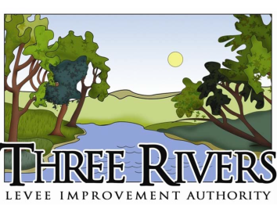
Three Rivers Levee Improvement Authority (TRLIA)
TRLIA’s Levee Improvement Projects in the Goldfields
(Paul Brunner, Executive Director) May 19, 2017 CVFPB Meeting
Item 10A

Slide 2
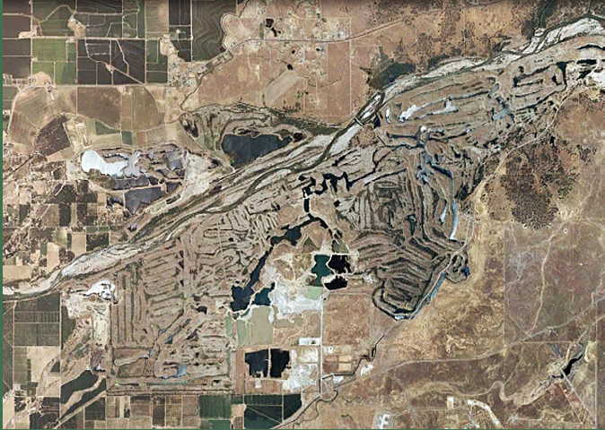
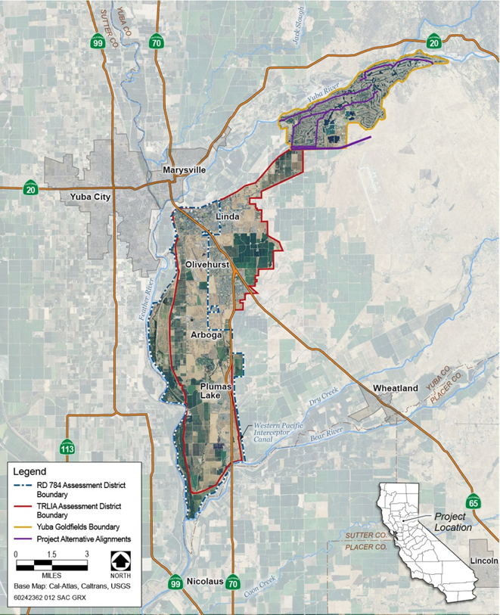
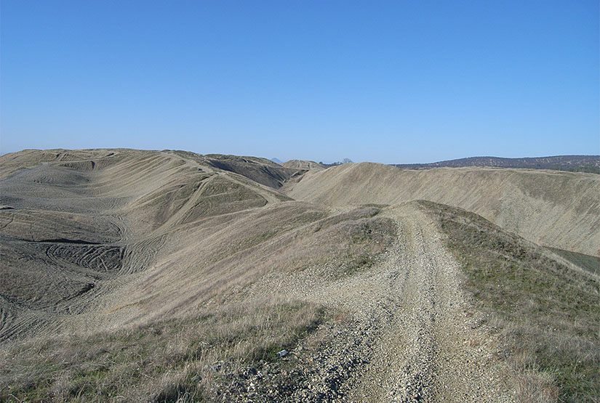
Location
Notes:
Located approximately 10 miles northeast of Marysville along the south side of the Yuba River near Daguerre Point Dam (DPD).
Encompass approximately 6,855 acres, and were formed by the dredging of hydraulic mining debris from the Yuba River floodplain, which began in the early 1900s.
Dredge Tailings, consisting of sands, gravels, and cobbles, was deposited along the active riverbank and interior floodplain, generating irregular gravel/cobble mounds and an undulating terrain interspersed with ponds.
Most recently, the Goldfields have been used to produce aggregate.
Current operations in the Goldfields include gold dredging by Cal-Sierra Development, Inc. (Cal-Sierra), and aggregate production by Western Aggregates, Inc.

Slide 3
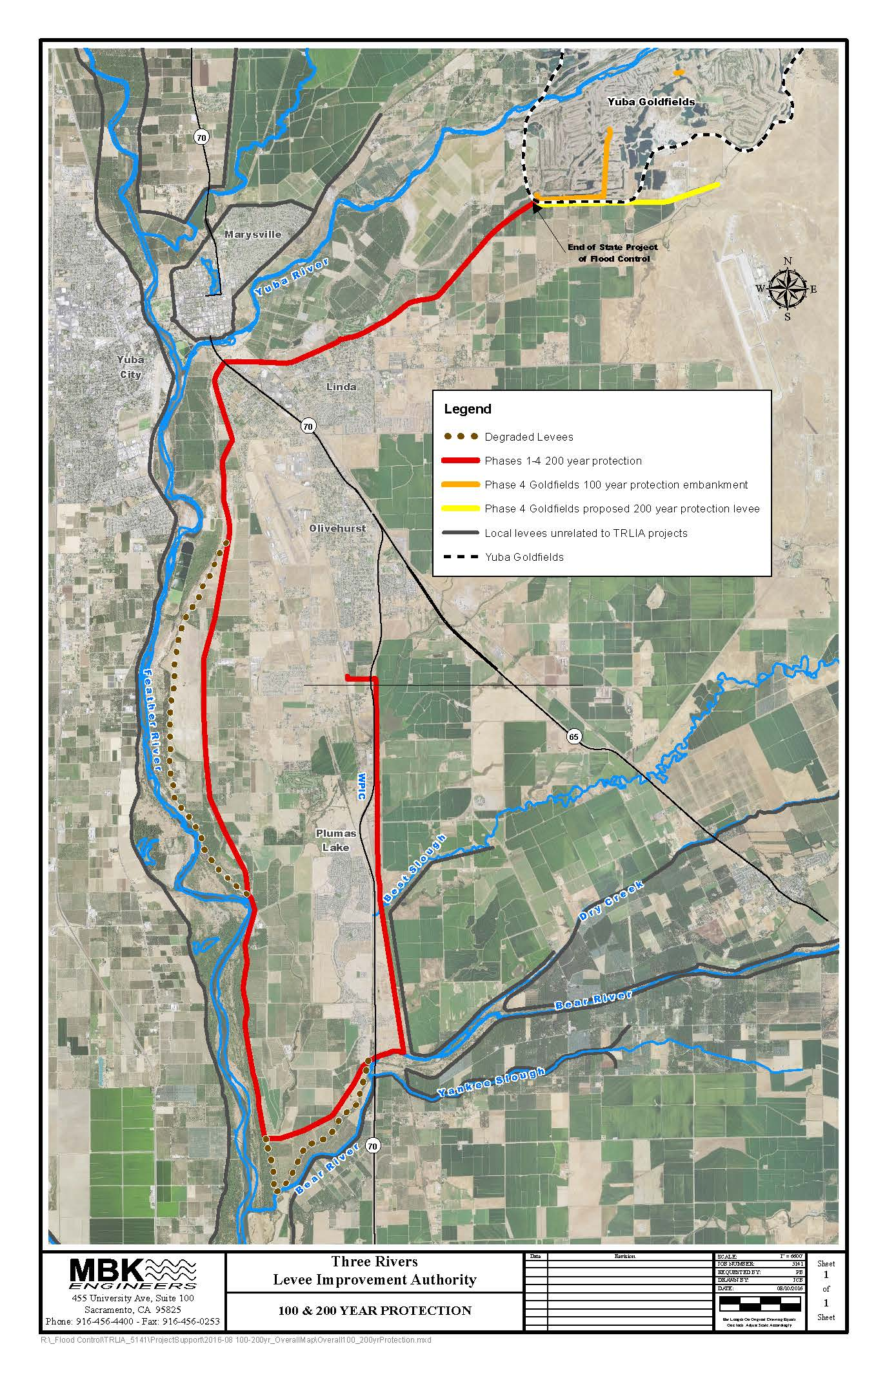
Progress Update since 4-24-2015 CVFPB Briefing
Adequate Progress Finding towards 200-Year Flood Protection Adopted in May 2016
Completed TRLIA’s Goldfields 10-yr interim 100-yr Flood Protection Project
Completing EIP UYLIP/WPIC 200-yr Project this summer
Finalizing UFRR agreement with DWR to complete 200-Year Goldfields Levee Project

Slide 4
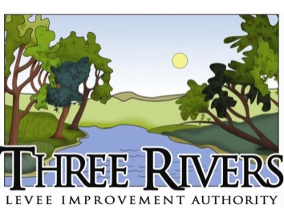
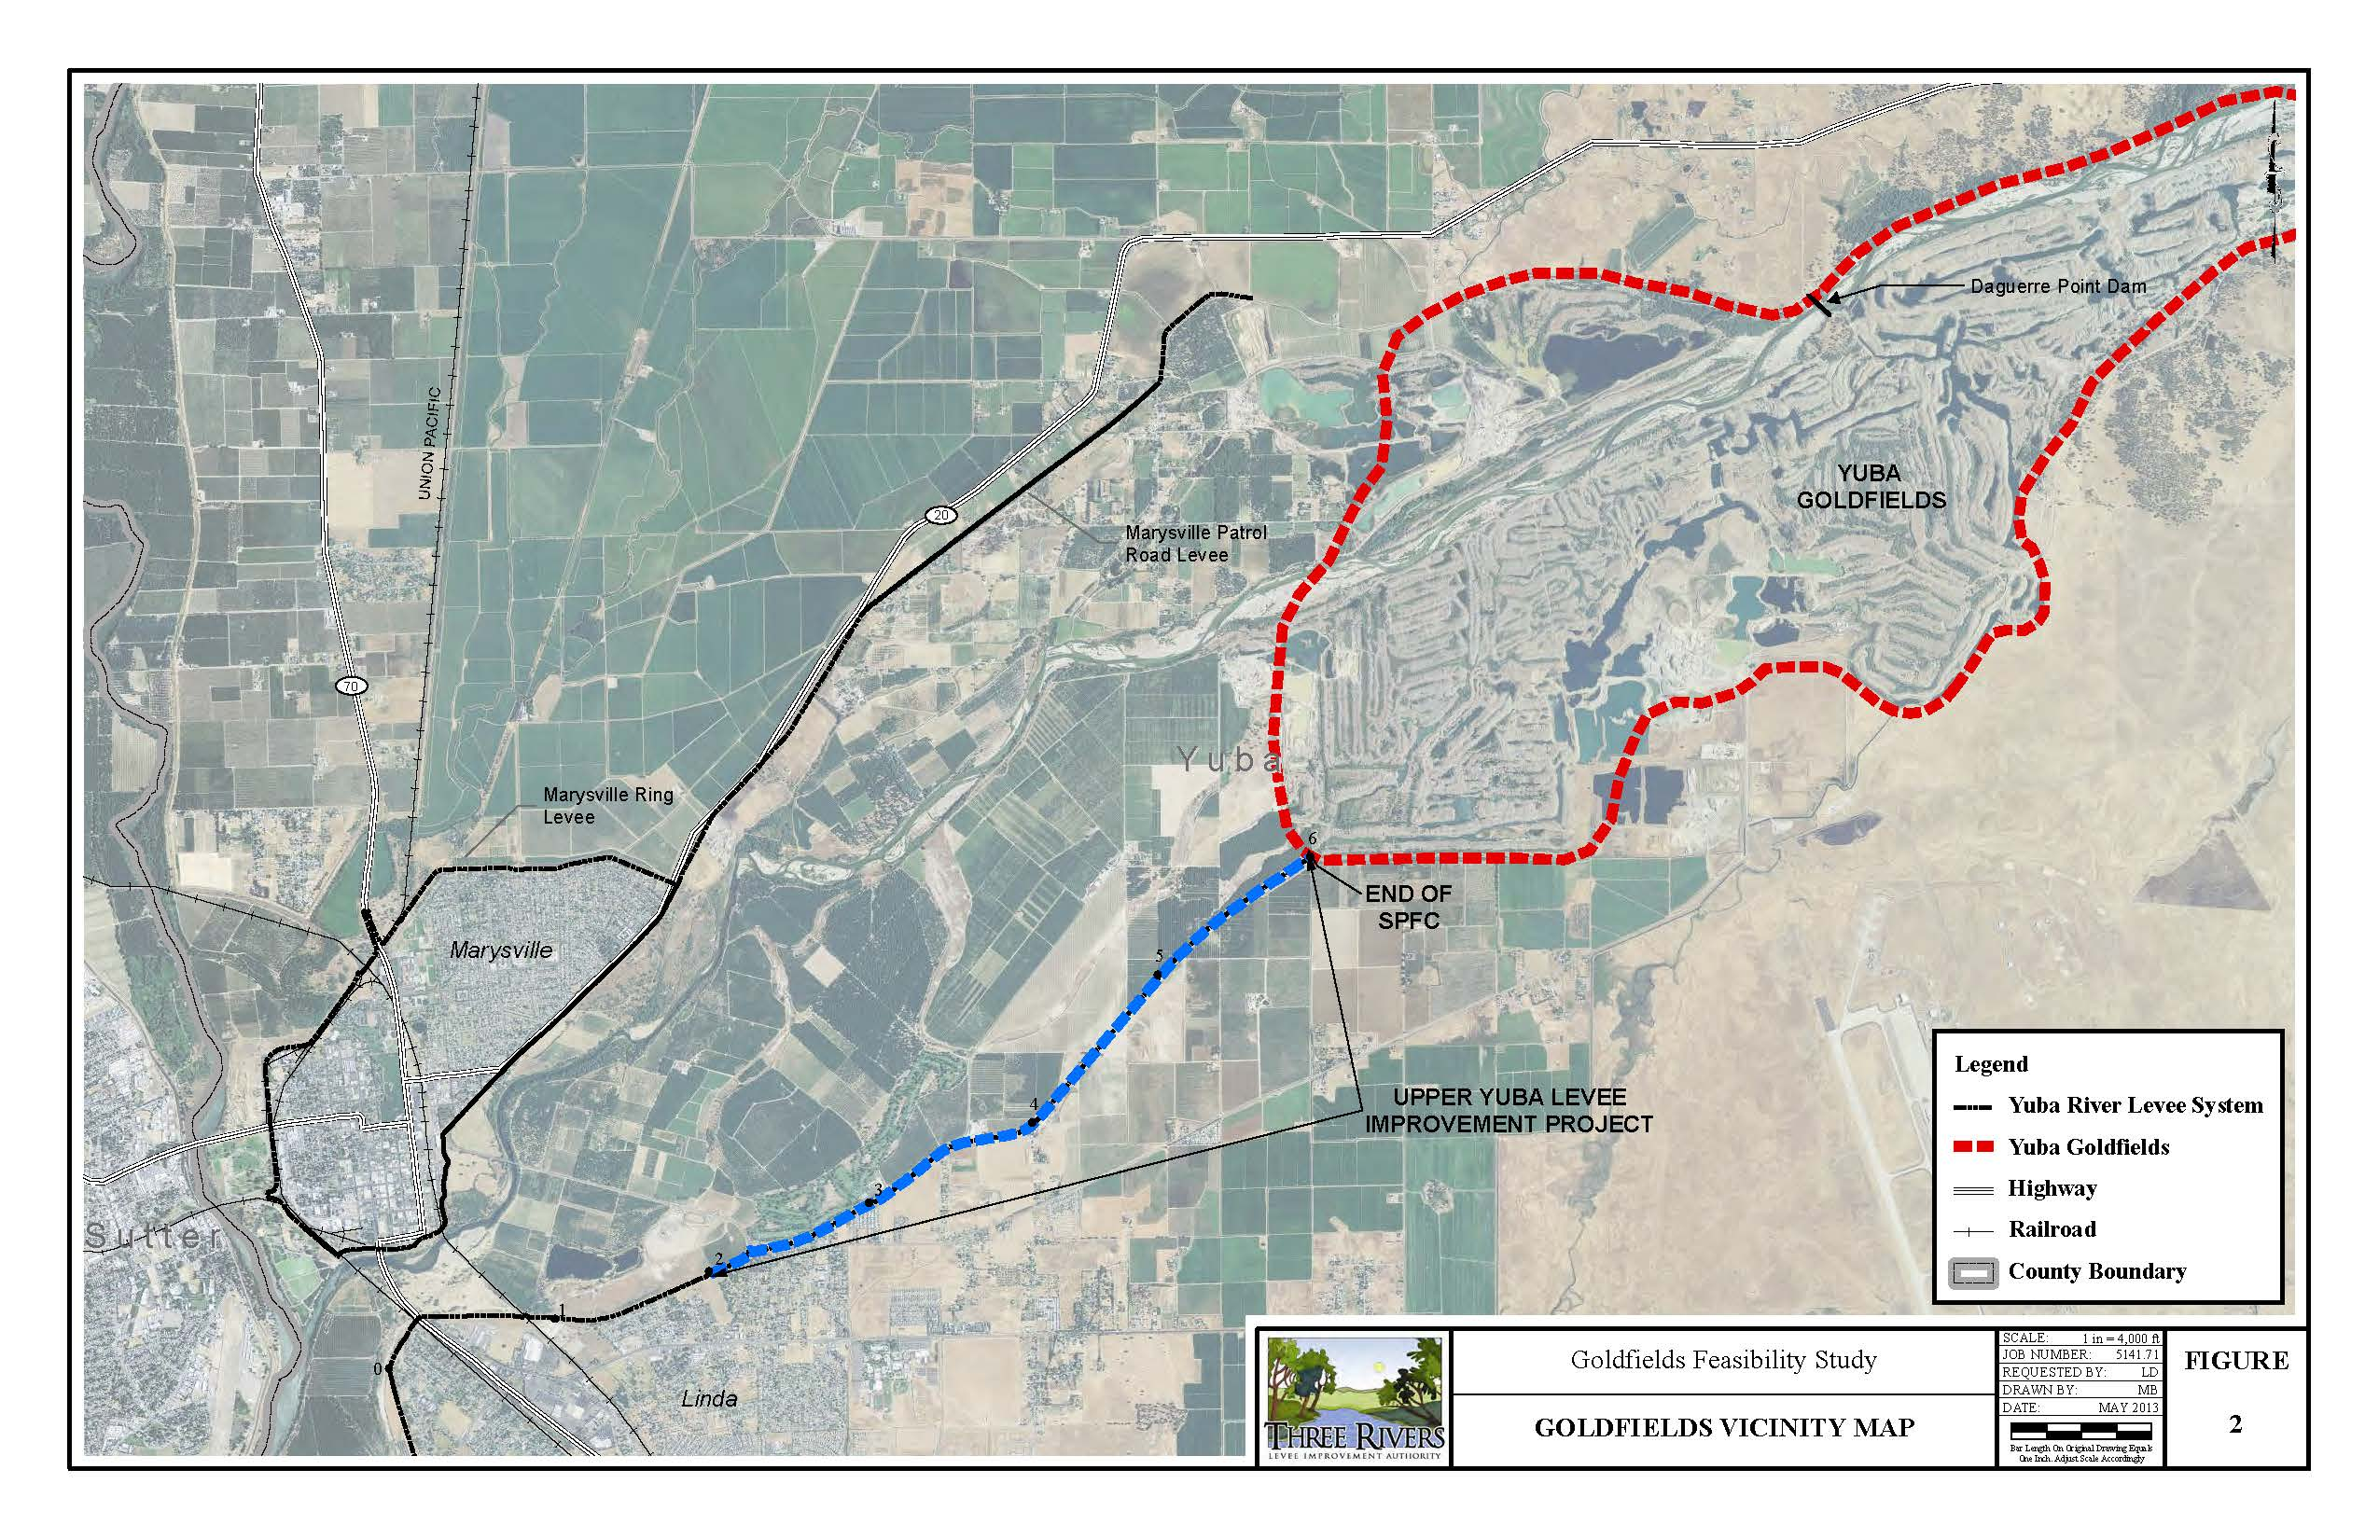
Federal and State Reliance on Goldfields as High Ground
The Sacramento River Flood Control Project (SRFCP) and State Plan of Flood Control (SPFC) are described in the 1953 Federal/State MOU as ending at High Ground on the South side of the Yuba River
The Goldfields is comprised of dredge tailings embankments caused by human activities
Both the SPFC and SRFCP assume that the High Ground will prevent flanking of the levee system

Slide 5
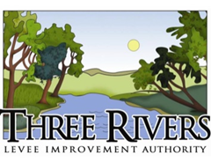
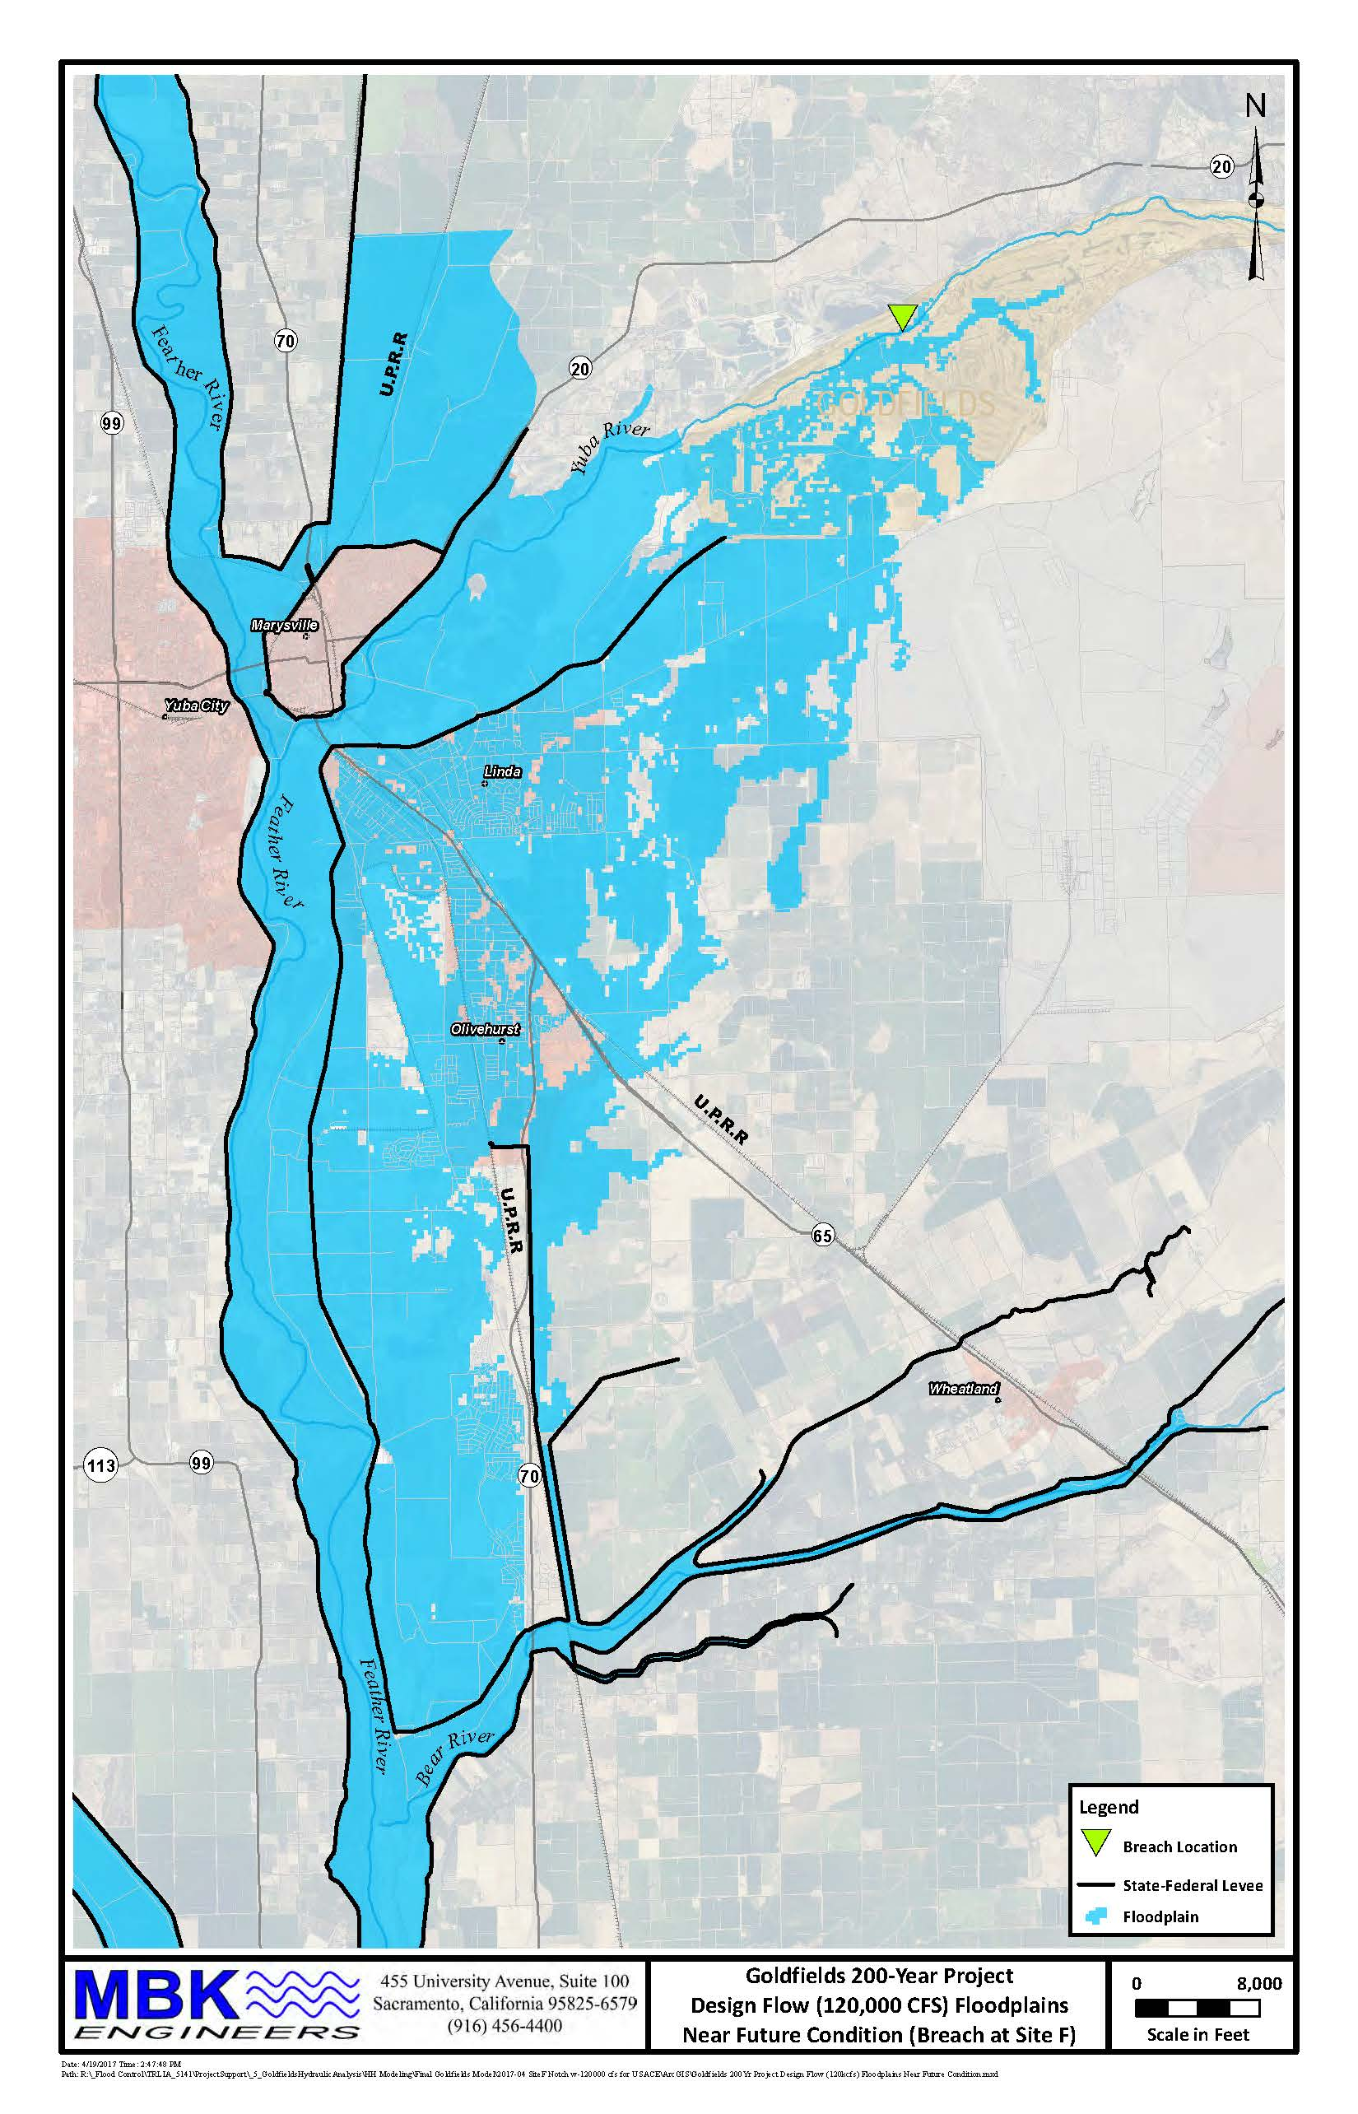
Goldfields is No Longer High Ground
TRLIA Hydraulic and Geo Technical Analysis show that the Goldfields no longer serve as High Ground for the 1957 authorized flow, the 100-year flow, or the 200-yr flow
The Federal/State Levee System can be Flanked and Flood South Yuba County

Slide 6
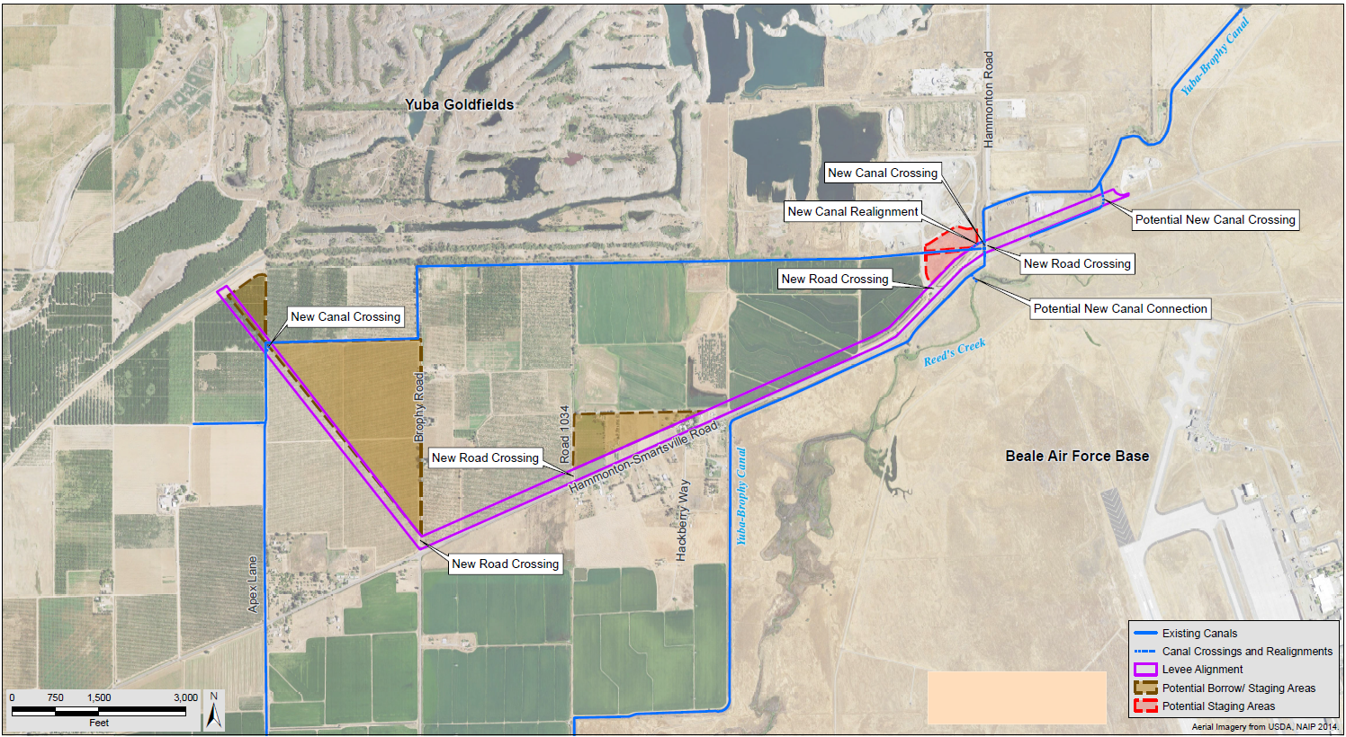
TRLIA 200-YR GOLDFIELDS LEVEE PROJECT
The Proposal is to replace the current deteriorating SPFC High Ground Project Feature (Goldfields) with a Replacement Levee south of the Goldfields that terminates at natural high ground
The Replacement Levee would be about 3.6 miles long and intercept all flows through the Goldfields and redirect them back to the Yuba River Floodway
The Replacement Levee is not an addition to the SRFCP/SPFC but remediation for an existing feature that is not performing as authorized

Slide 7
DWR/UFRR Requirements
In order to use Proposition 1E funds for construction or land acquisition for the Goldfields 200-yr project, it needs to be a feature of the SPFC
The UFRR agreement recognizes that the most likely vehicle to ensure that the project is recognized as part of the SPFC is through the Federal Section 408 process
DWR has agreed to fund design, real estate support, and CEQA/NEPA activities while TRLIA coordinates with USACE on Section 408
Adequate progress towards assurance that the project will be assumed to be part of the SPFC is needed by December 2018 in order for DWR to fund construction and land acquisition

Slide 8
Adequate Progress
Adequate Progress is defined as:
TRLIA’s submittal of Section 408 authorization request letter to the CVFPB requesting they initiate the 408 authorization process with the USACE. This initial request is for the USACE to begin the 408 Authorization Environmental Work (e.g. Section 106, and NEPA). TRLIA to make this request by March 30, 2017 to the CVFPB. (Done)
Establishment of the Safety Assurance Review Panel by June 2017 (Done)
USACE/TRLIA Draft EIS Public Meeting held by December 2018
TRLIA 65% design completed by December 2018

Slide 9
Next Steps
TRLIA needs to begin USACE coordination immediately to meet the Adequate Progress Goals established by DWR
TRLIA requests that the CVFPB send the Section 408 Initiation Letter to USACE as soon as possible

Slide 11
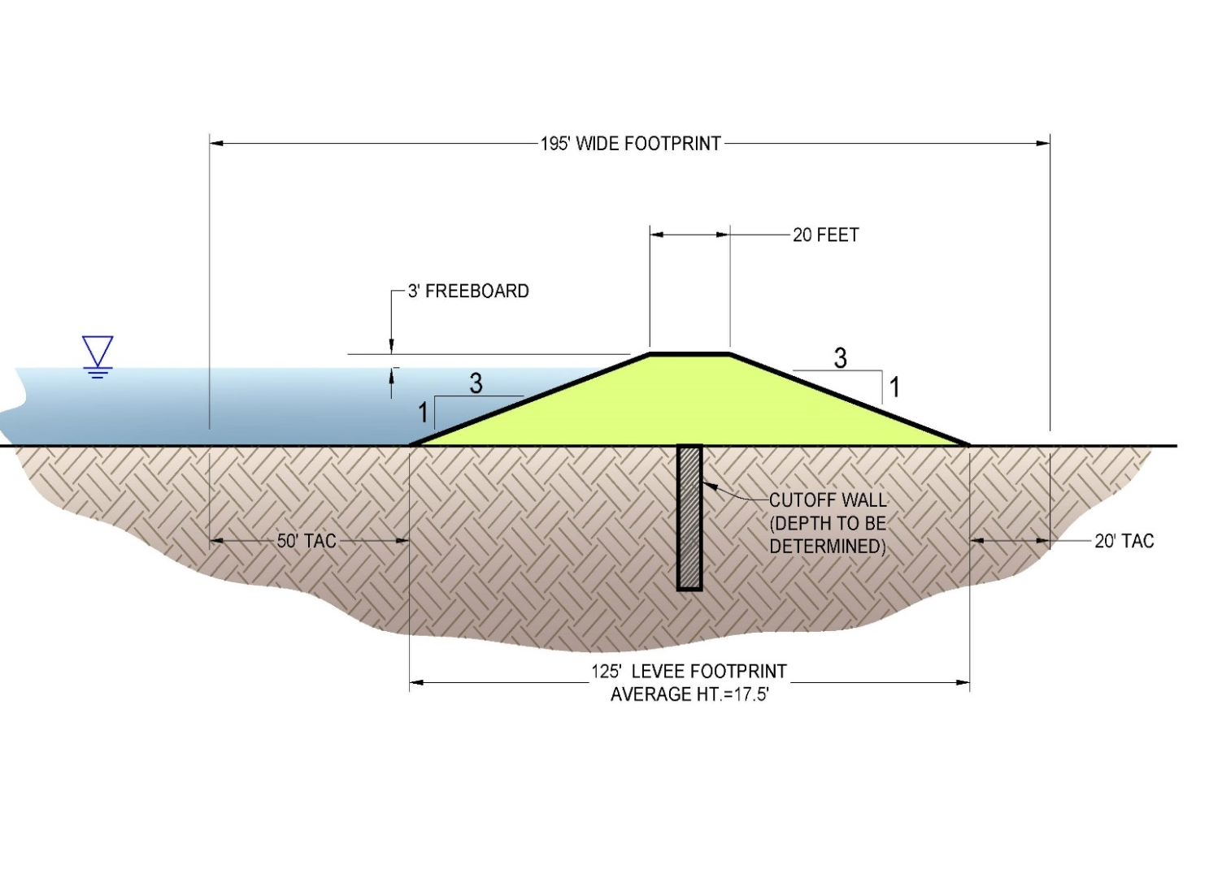
TRLIA 200-YR GOLDFIELDS LEVEE PROJECT
The Replacement Levee would be a standard flood protection levee that meets both Title 23 and ULDC Standards
Underseepage Remediation Features as Required
The Replacement Levee is not an addition to the SRFCP/SPFC but remediation for an existing feature that is not performing as authorized

