Slide 1
Forecast-Coordinated Operations (FCO) for the San Joaquin Tributaries
Presentation to the Central Valley Flood Protection Board
5/18/2018
Nathan Burley

Slide 2
San Joaquin FCO Program
Contributors: reservoir operators, Army Corps, downstream operators, DWR
Purposes: Improve system operations, unified funding requests
Activities: quarterly meetings, modeling presentations, data exchange
SJ FCO Decision Support System (DSS) Tool
Daily snowmelt model for big tributaries to the lower San Joaquin
Design based on Yuba-Feather FCO concepts
Developed by GEI and DWR with input from Army Corps, Res. Operators

Slide 3
Snowmelt and Reservoir Model
New Melones, Don Pedro, Exchequer, Friant, Pine Flat
Select Volume and Runoff Pattern
CNRFC, DWR, custom estimates
Snowmelt patterns from historical years, general patterns
Reservoir operations from Army Corps WCMs, or custom
Sharing functionality with Army Corps, Operators, DWR
Following slides are examples…

Slide 4
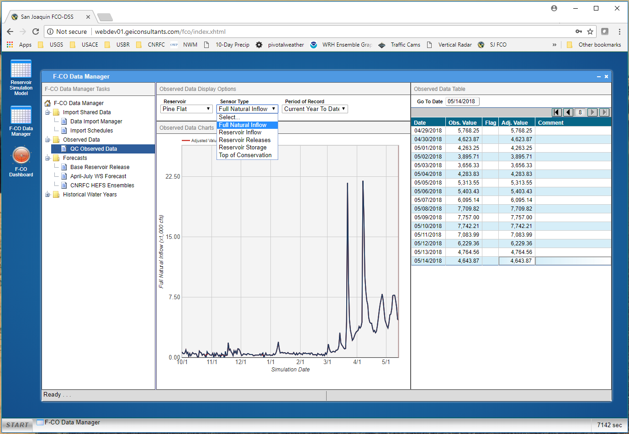

Slide 5
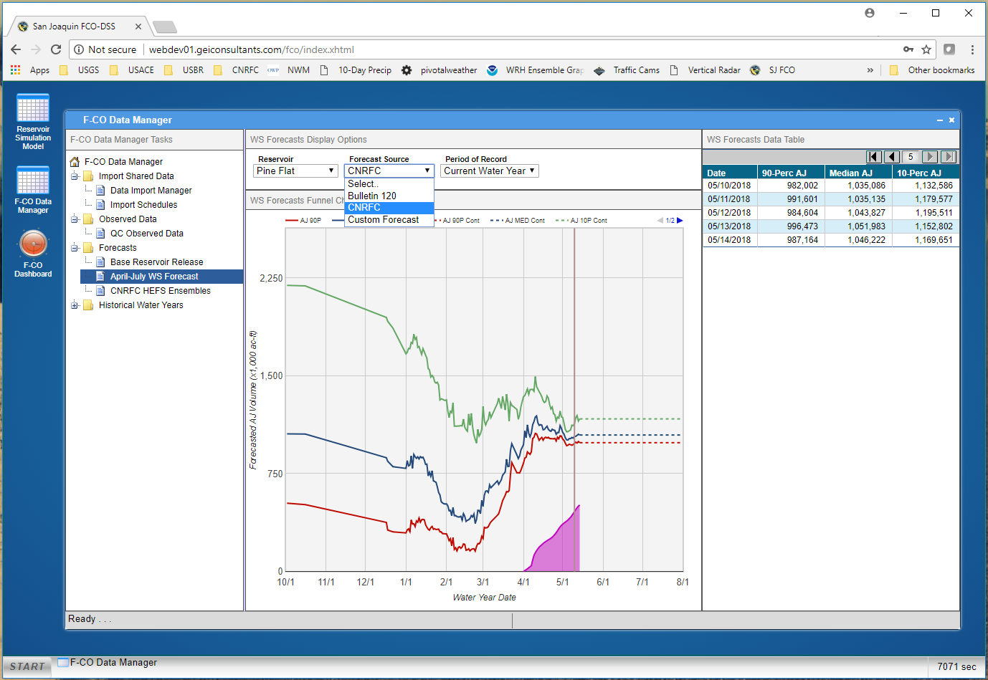

Slide 6
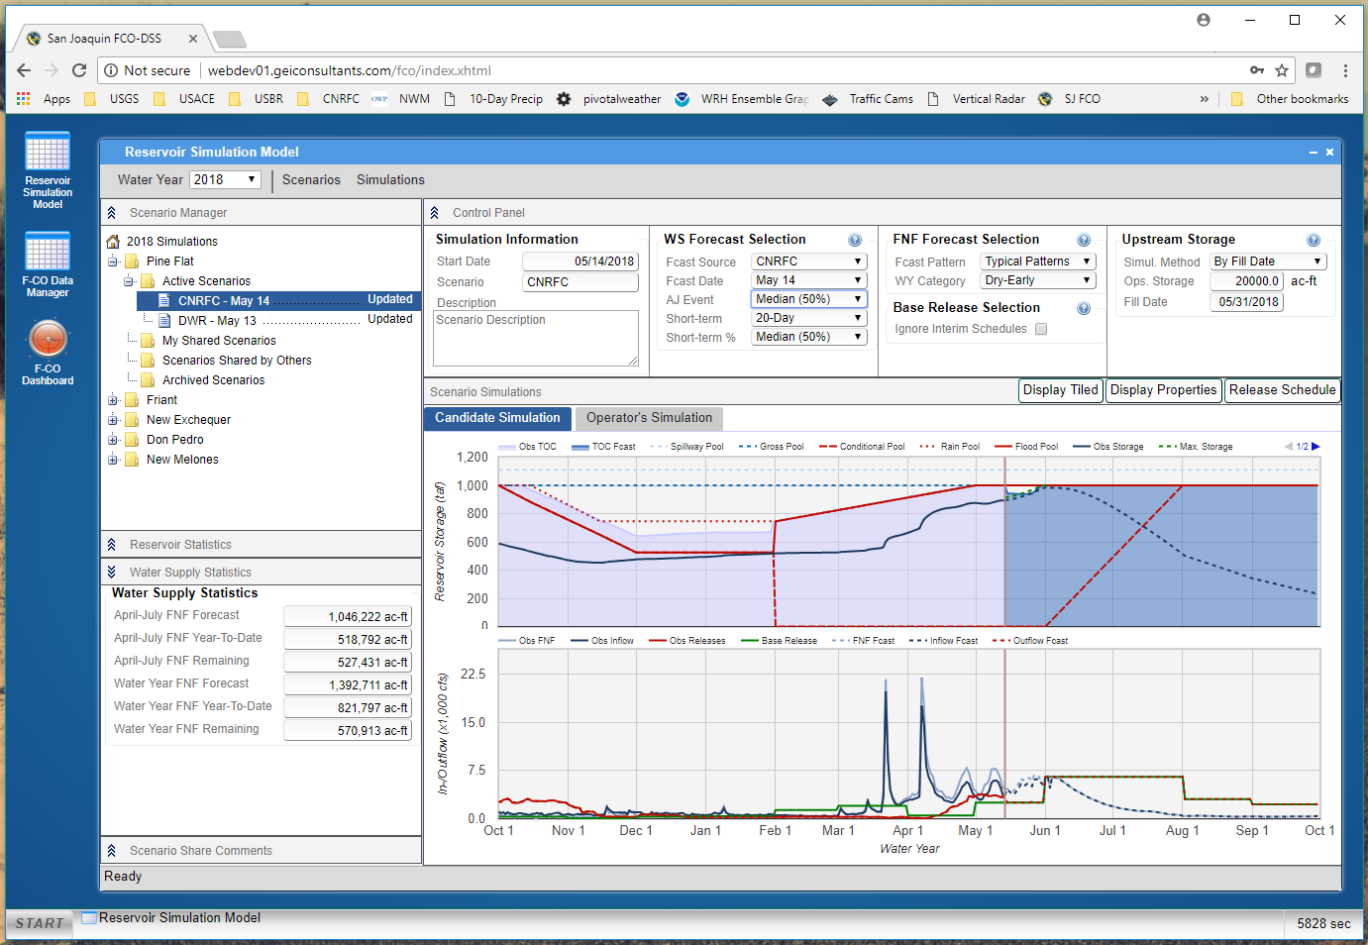

Slide 8
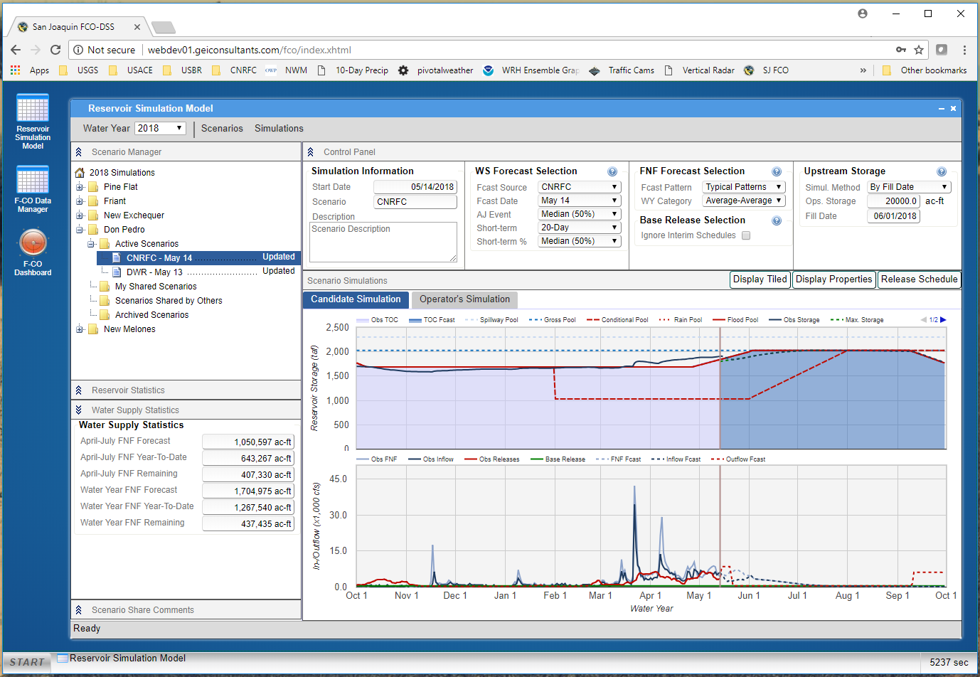

Slide 9
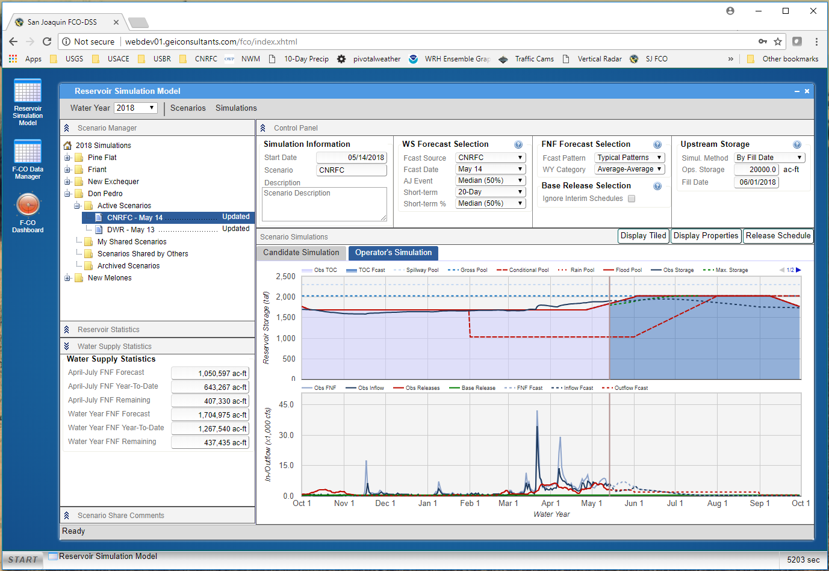

Slide 10
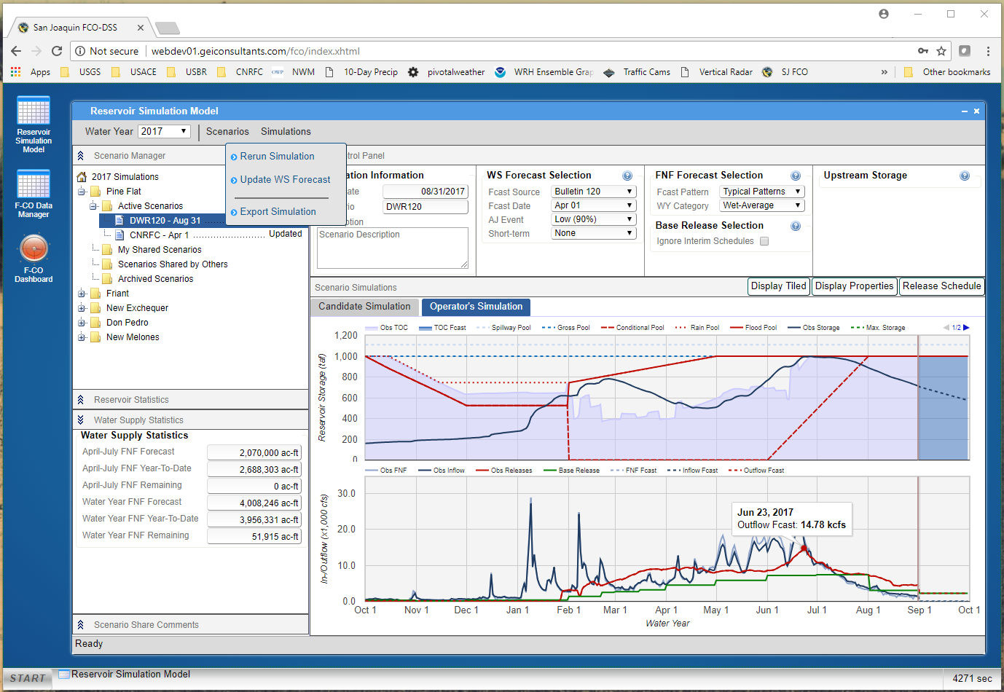

Slide 11
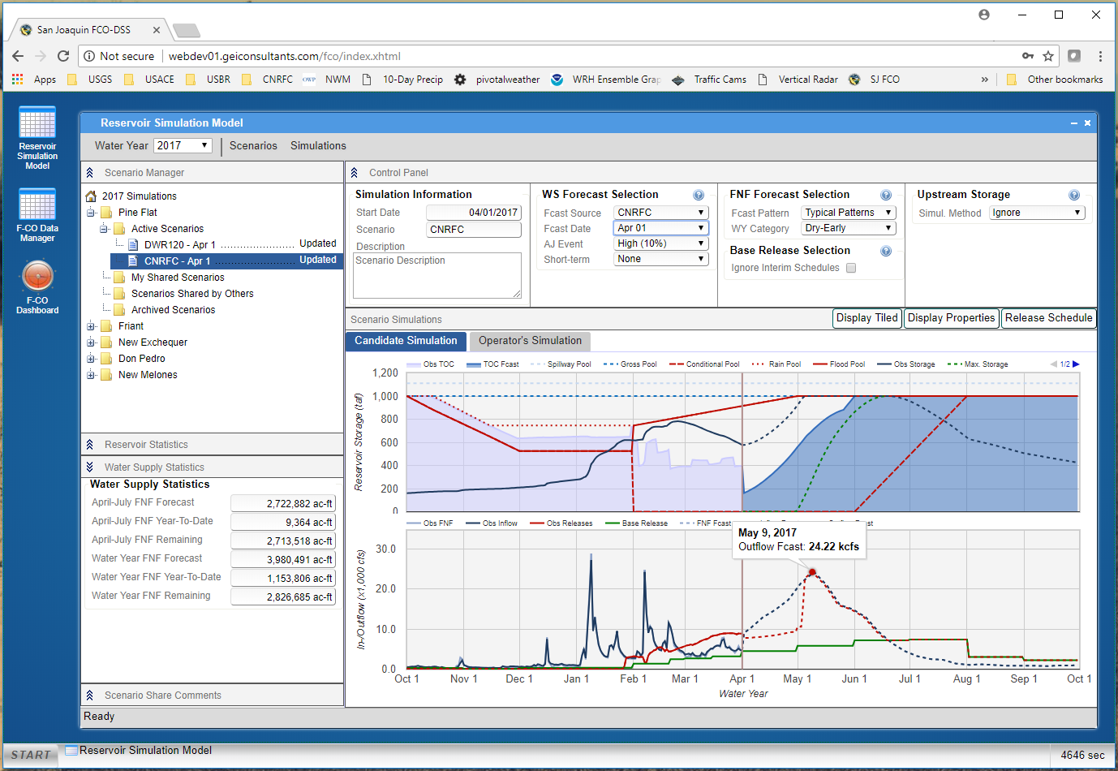

Slide 12
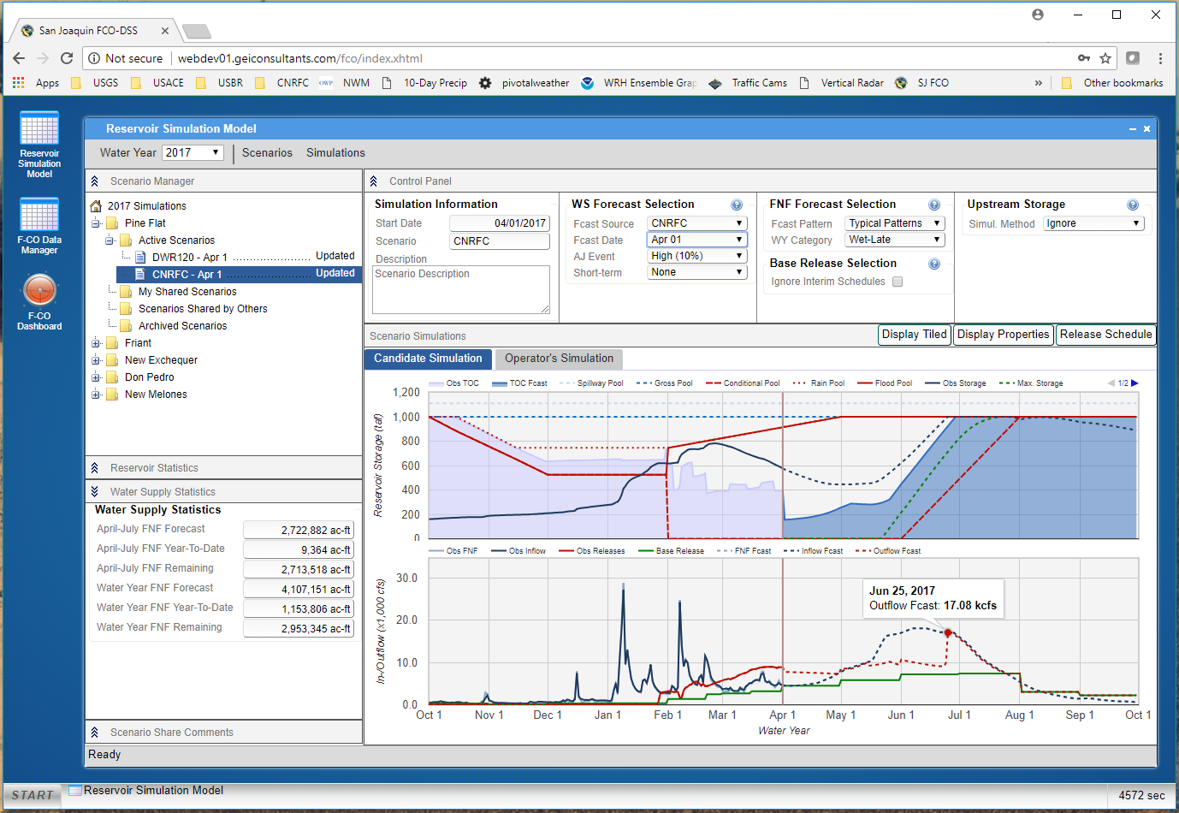

Slide 13
Continuing Work
Fixing bugs
Graph functionality and image exports
Outreach to reservoir operators
Comments and Questions
Nathan.Burley@water.ca.gov
Division of Flood Management Hydrology & Flood Operations

