Slide 1
2018 snowpack conditions update and seasonal runoff forecasts
Presentation to the Central Valley Flood Protection Board
May 18, 2018
David Rizzardo, P.E.
Chief, California Cooperative Snow Surveys
Division of Flood Management
California Department of Water Resources

Slide 2
Agenda
May 1st Snow Pack Conditions
Snow Course Data
University of Colorado Satellite Snow Pack Analysis
NASA/JPL Airborne Snow Observatory (ASO) Data
Comparisons of ASO and Univ. of Colorado Data
USBR Use of Modeled ASO data
Latest Snow Sensor Report
May 17th B120 Update

Slide 3
May 1st Snow Course Measurements
REGION | No. Courses | Average W.C. | % Avg. April 1 | % Avg. May 1
North Coast | 5 | 2.2” | 7% | 10%
Sacramento | 62 | 6.7” | 16% | 23%
San Joaquin | 55 | 12.0” | 31% | 38%
Tulare Lake | 32 | 6.9” | 22% | 29%
North Lahontan | 4 | 7.4” | 27% | 31%
Statewide |  |  | 21% | 27%
Note: Most courses below 6,000’ elevation in the Northern Sierra and
Below 8,000’ elevation in the Central and Southern Sierra were melted out by the May 1st snow course measurements.

Slide 4
University of Colorado satellite analysis

Slide 7
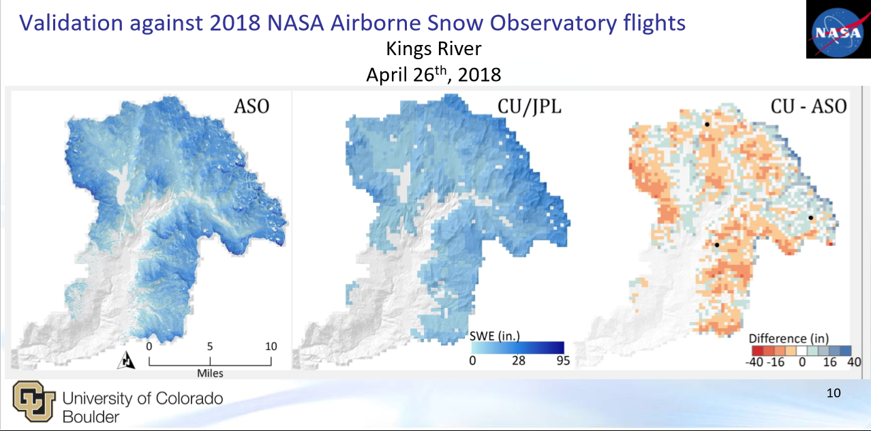
Comparison of ASO and satellite snow data
ASO Data:
Higher Resolution
Includes SWE, Density, and Albedo estimates
Limited to a few basins currently
Monthly to bi-weekly flights depending on funding
Impacted by weather and military flight zone restrictions
Univ. Colorado Satellite Data:
Lower Resolution
Provides basin wide SWE estimates across Sierra Nevada
Can be weekly
Biggest limitation is cloud cover
Still considered experimental
Note: Ground observations (courses and pillows) are crucial data validation for both products

Slide 8
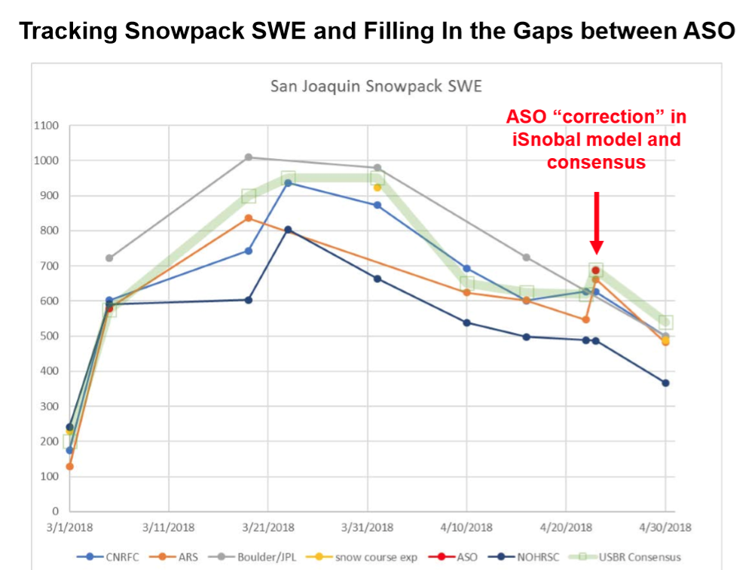
Operational Use of modeled ASO snow data usbr friant operations
ASO data is ingested into the iSnoBal model.
iSnoBal is developed by the
US Dept. of Agriculture
Agriculture Resource Service – Boise, ID
iSnoBal uses ASO SWE data and
Adjusts with known climate
forcings to refine SWE estimates across measured watersheds.

Slide 9
May 14th Snow sensor Measurements
REGION | No. Courses | Average W.C. | % Avg. April 1 | % Avg. May 14
Northern Sierra | 30 | 2.3” | 8% | 16%
Central Sierra | 42 | 3.6” | 12% | 20%
Southern Sierra | 27 | 2.6” | 10% | 16%
Statewide |  |  | 10% | 17%
Note: Most sensors below 8,000’ elevation in the Northern Sierra and
Below 9,000’ elevation in the Central and Southern Sierra are now melted out. Thunderstorms this past week reduced solar radiation and thus slowed melt rate. Limited dusting of snow above 9,500 ft. also reset albedo in some locations.

Slide 10
May 10th bulletin 120 april-july runoff forecast update
WATERSHED | MEDIAN APRIL-JULY FORECAST (TAF) | % OF AVERAGE
Shasta Lake total Inflow | 1,300 | 74%
Sacramento River at Bend Bridge | 1,850 | 76%
Feather River at Oroville | 1,280 | 82%
Yuba River near Smartsville | 790 | 82%
American River below Folsom Lake | 1,080 | 90%
Mokelumne River inflow to Pardee | 380 | 83%
Stanislaus River below Goodwin | 580 | 85%
WATERSHED | MEDIAN APRIL-JULY FORECAST (TAF) | % OF AVERAGE
Tuolumne River below La Grange | 1,070 | 90%
Merced River below Merced Falls | 500 | 80%
San Joaquin River below Millerton | 1,020 | 83%
Kings River below Pine Flat | 970 | 80%
Kaweah River below Terminus | 175 | 61%
Tule River below Lake Success | 28 | 41%
Kern River inflow to Lake Isabella | 250 | 55%
Note:

