Slide 1
CVFPB Meeting Agenda Item 9C April 27, 2018 DWR Maintenance Area Budget: FY 2018/19
Presented by:
Mark List, PG, CEG, CHG
Supervising Engineering Geologist
Chief, Maintenance Support Branch
Flood Maintenance Office, DWR/Div. of Flood Mgmt.

Slide 2
Department of Water Resources State Plan of Flood Control Operations and Maintenance Responsibilities
California Water Code Section 8361(a)-(p)
O&M costs - State General Fund
Sacramento River Flood Control Project
~ 1,200 miles of channels (flood flow conveyance)
Pumping Plants, Hydraulic Control Structures, Weirs, Certain Seepage and Collecting Canals, specific Bridges
Levees (~145 miles)
California Water Code Section 12878 et seq.
O&M costs – reimbursed by benefiting properties
Maintenance Areas
Levees (~150 miles)
10 designated areas

Slide 3
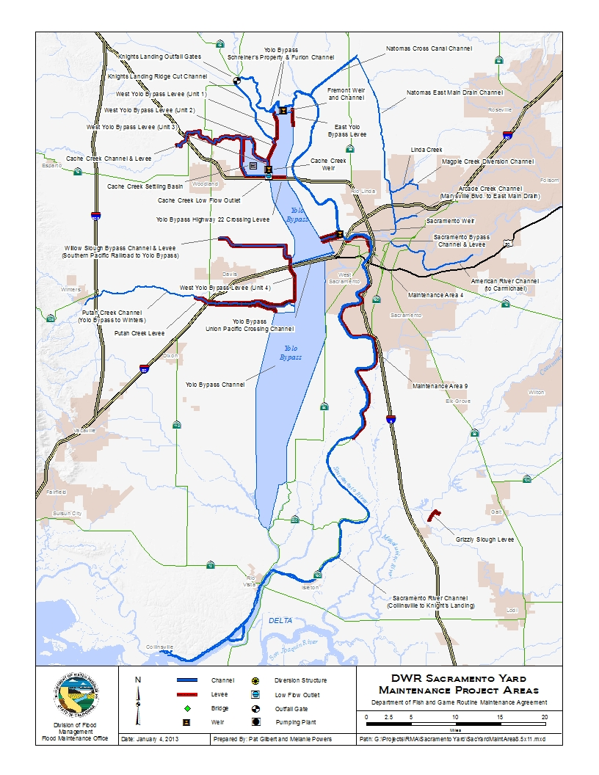
DWR Sacramento Yard Areas of Responsibility
(NOT TO SCALE)

Slide 4
DWR Sacramento Yard Areas of Responsibility
(NOT TO SCALE)

Slide 5
Department Programmatic Levee Maintenance Plan
Complete USACE Systemwide Improvement Framework (SWIF) for all DWR levee areas
Regain active Public Law (PL) 84-99 status
Seek Fed. Endangered Species Act, Section 7 Nexus
(for SWIF implementation actions)
Environmental Permitting Efforts
Env. Permitting for Operations & Maintenance
Obtain new CA Dept. of Fish & Wildlife (CA Fish & Game Code)
Section1600 (Lake and Streambed Alteration Agreement)
Section 2081 (CA Endangered Species Act) Permits
Federal ESA B.O.s for SWIF Implementation Actions
Seeking Section 7 nexus (USACE 3/21/2014 Interim Policy)
Culverts/Discharge Pipes
System pipes evaluated on risk basis
(Deferred Maintenance Project)

Slide 6
PL 84-99 Rehabilitation Program Status Summary
MA | PL 84-99 RP Status | Dates
MA 1 | Active | LOI approved (3/9/15); SWIF submitted 3/9/17 & awaiting USACE review
MA 3 | Active | LOI approved (2/24/14); SWIF submitted 3/22/17 & awaiting USACE review
MA 4 | Inactive | LOI formally submitted (11/6/17; awaiting USACE review)
MA 5 | Active | LOI approved (7/6/17; progress report due 7/6/18
MA 7 | Active | LOI approved (2/24/14); SWIF submitted 3/22/17 & awaiting USACE review
MA 9 | Active | LOI approved (10/1/13); SWIF submitted 12/18/17 & awaiting USACE review
MA 12 | Active | LOI approved (3/9/15); SWIF submitted 3/9/17 & awaiting USACE review
MA 13 | Active | LOI approved (5/18/17; progress report due 5/18/18
MA 16 | Active | LOI approved (2/24/14); SWIF submitted 3/22/17 & awaiting USACE review
MA17 | Inactive | Currently evaluating LOI submittal with Lake County
BENEFITS OF PL 84-99 ACTIVE STATUS
PL84-99 Rehab Program Storm Damage Repairs - 2017 Repairs: MA 16 (1-site). 2018/2019 Planned Repairs: MA 3 (1-site), MA 9 (2-sites), and MA 12 (1-site).

Slide 7
PL 84-99 Rehabilitation Program 2017 Storm Damage Repair Summary
MA | PL 84-99 Site ID | Status / Repair Schedule | Planned/Actual* Federal Investment (USACE PIR data) | Estimated/Actual* State Costs (LERRDs)
2017 Storm Damage Repair Construction
MA 16 | 0521-11 | Repair Completed / 2017 | $ 1,714,000* | $ 0*
2018 / 2019 Storm Damage Repair Construction
MA 3 | 0521-41 | Repair Planned / 2019 | $ 58,961,867 ⁽¹⁾ | $ 0 ⁽²⁾
MA 9 | 0441-21 | Repair Planned / 2019 | $ 51,759 | $ 5,885
MA 9 | 0441-23 | Repair Planned / 2018 | $ 416,000 | $ 4,000 ⁽³⁾
MA 12 | 0561-11 | Repair Planned / 2018 | $ 1,255,000 | $ 138,000
Total PL 84-99 Expenditures in MAs (Est.) $ 62,398,626 $ 147,855
Notes:
* Actual Costs
8,900 linear feet seepage berm
State costs may increase for soil disposal (LERRDs cost) when design is finalized
Additional Repair work may be needed to restore the levee section – USACE identifies the additional work as a betterment, with additional (potentially significant) State costs - TBD

Slide 8
DWR Actions in Response to Periodic Inspection Results
Maintenance Area Periodic Inspection – PL 84-99 Status
MA 9
Part of the American River Left Bank Levee System – PL 84-99 Active Status
LOI Approved (10/1/2013); Progress Report Approved (2/19/15); SWIF submitted (5/14/2016); reviewed by USACE and modified and resubmitted 12/18/17
Partners: DWR (MA9), City of Sacramento (Lead), and American River Flood Control District
CVFPB Encroachment Enforcement Pilot Program for MA9
MA 3, MA 7, MA 16
Part of the Feather River System– PL 84-99 Active Status
LOI Approved (2/24/2014); Progress Report Approved (3/22/16); SWIF submitted (2/24/2017) and under review by USACE
Partners: DWR (MA3, MA7, MA16, HAM1, SBP2, WAD1), LD9, LD1, and SBFCA (Lead)
MA 1, MA 12
Part of the Sac River West Levee System Draft LOI PL 84-99 Active Status
LOI Approved (3/9/15); Progress Report Approved (3/18/16); SWIF submitted (3/9/2017) and under review by USACE
Partners: DWR (MA1, MA12), RD 108 (Lead), SWS, LD1, LD2

Slide 9
DWR Actions in Response to Periodic Inspection Results
Maintenance Area Periodic Inspection – PL 84-99 Status
MA 5
Butte Creek Left Bank and Butte Creek Right Bank Levee Systems
PL 84-99 Active Status
LOI approved (7/6/17)
Biological Assessment and Request for Section 7 ESA Consultation submitted to USACE for Interim Risk Reduction Measures (January 2018)
MA 13
Cherokee Canal Levee Systems PL 84-99 Active Status
LOI approved (5/18/17)
MA 4
Part of the West Sacramento – Sac Yolo South Levee System
PL 84-99 Inactive Status
LOI formally submitted (11/6/17) for northern urban portion of levee system and currently under review by USACE
USACE has approved system separation.
Partners: DWR (MA4), RD-900, RD 537, Lead: WSAFCA
MA 17
Middle Creek Levee System (MC1C and MC1D) PL 84-99 Inactive Status
Currently evaluating LOI submittal with Lake County Flood Control and Water Conservation District
Notes:
Do we want to submit an LOI for MA17?

Slide 10
DWR Actions in Response to Periodic Inspection Results - Continued
Animal Control
All areas implementing DWR’s Rodent Abatement/Damage Repair and Rehabilitation Program
Completed evaluation for GGS habitat presence or absence (about half of all DWR maintained levees in GGS habitat)
Rodent damage repair restricted by Fed ESA and CA ESA in areas with GGS habitat, pending State and federal permitting
Rodent Damage Repair (primarily grouting) under CA DFW Routine Maintenance Agreement where no GGS habitat
Rodent Damage Repair within GGS habitat requires new State permits under EPOM (Pushing for 2018 work season; pending CDFW permit issuance); and Section 7 BO (USFWS)

Slide 11
O&M Restrictions Due to Potential GGS Habitat
MA | Length (miles) | Approximate length prohibited from grouting due to GGS (without CESA Take Permit)
 |  | (miles) | (%)
MA 1 | 16.8 | 0.3 | 2%
MA 3 | 5.1 | 1.2 | 24%
MA 4 | 3.58 | 0 | 0%
MA 5 | 32.7 | 17 | 52%
MA 7 | 11.9 | 0 | 0%
MA 9 | 19.5 | 0 | 0%
MA 12 | 11.4 | 9.4 | 82%
MA 13 | 40.1 | 35.4 | 88%
MA 16 | 4.1 | 0 | 0%
MA17 | 3.86 | Out of Range for GGS habitat
Overall |  | 63.3 | 42%
*Approximately 49% of 8361 levees are restricted from grouting due to potential GGS habitat. This grouting moratorium started Feb of 2013.

Slide 12
DWR Actions in Response to Periodic Inspection Results - Continued
Encroachments
Easement Identification continuing throughout system
Address encroachments that pose levee threat
“worst-first” in all areas
Culverts/Discharge Pipes
Utility Crossing Inventory Program Database Developed
Risk based assessment and pipe repair program (DMP)
Completed reconnaissance to determine pipe accessibility and environmental issues at all SPFC pipes
2 Envirosight roving cameras purchased by FMO
(25% of DWR (MA & 8361) pipes video inspected so far)
Vegetation
Routine Maintenance to meet visibility and accessibility criteria
California Levee Research Program – High Hazard Trees
Notes:
-California Levee Research Program is the official name of the tree hazard assessment program.

Slide 13
CCTV Inspection Progress
MA | System Drainage Pipes | Inspected as of April 1, 2018 | % Complete
MA 1 | 6 | 0 | 0%
MA 3 | 3 | 0 | 0%
MA 4 | 3 | 0 | 0%
MA 5 | 46 | 8 | 17%
MA 7 | 17 | 0 | 0%
MA 9 | 5 | 0 | 0%
MA 12 | 11 | 0 | 0%
MA 13 | 65 | 28 | 43%
MA 16 | 4 | 0 | 0%
MA17 | 3 | 0 | 0%
MA Total | 163 | 36 | 22%
310 pipes in DWR Areas of O&M Responsibility (MAs & 8361).
There are 147 pipes in 8361 levees; 32% of them have been video inspected as of 4/1/18.
All DWR pipes are scheduled to be inspected by Sep 2018.
Notes:
* Only found/non-permitted/non-capped DMP eligible pipes included in this table

Slide 14
DWR Actions in Response to Periodic Inspection Results - Continued
Areas of concern being addressed during annual maintenance activities or under Small Erosion Repair Program and Flood System Repair Project, or Systemwide Programs
Erosion/Bank Caving Riprap Revetments and
Bank Protection
Slope Stability
Sod Cover/Erosion Rills
Depressions/Rutting
Settlement
(local settlement often caused by burrowing animal activity)
Questions on programmatic efforts before moving to the specific budget items?

Slide 15
Annual Routine Maintenance Breakdown (FY18/19 Expected/Proposed Budgets for DWR 8361 and MAs)
Notes:
Budget:
DWR 8361 Levees, Channels, Structures $4.1M, $1.4M, 1.7M
MA $3.3M
TOTAL $10.5 M
Note: DWR numbers are based on actual money spent in FY17/18 rather than projected costs.

Slide 16
Note:
OMRR&R Workgroup
Report Comparison
(Average $/Mile Expended)
Urban: $22,000
Non-Urban: $13,000
Notes:
Data: MA Routine Maintenance - Reimbursable (MA Budget for proposed FY 2017/18 used as an estimate)
DWR (8361) only includes levees and based on FY17/18 money spent rather than projected
Comparisons from OMRR&R Workgroup: Urban $22,000/mile average, $13,000/mile average. Report conclusion is all O&M is underfunded

Slide 17
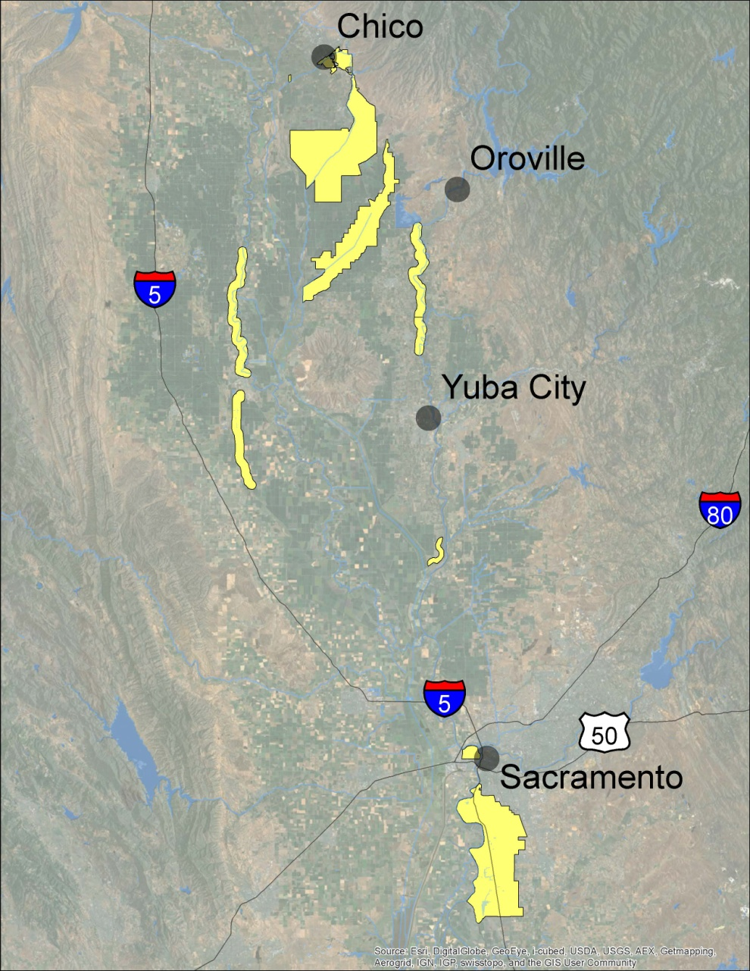
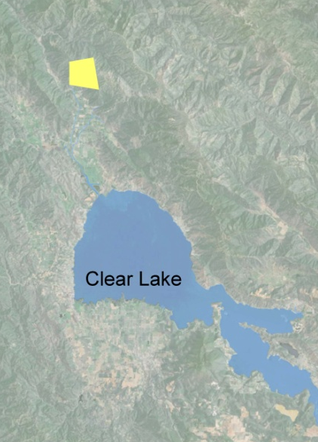
Maintenance Areas
SACRAMENTO MAINTENANCE YARD
MA 4 Sacramento River at West Sacramento
MA 9 Sacramento River from Sacramento to Freeport
SUTTER MAINTENANCE YARD
MA 1 Sacramento River from Colusa Bridge to Glenn County Line
MA 3 Feather River just upstream of Sutter Bypass
MA 5 Butte Creek
MA 7 Feather River north of Horncutt Creek in Butte County
MA 12 Northern half of the Colusa Basin Drain
MA 13 Cherokee Canal in Butte County
MA 16 Feather River south of Horncutt Creek in Butte County
MA 17 Lake County near Clear Lake (Middle Creek Pumping Plant)
MA 5
MA13
MA 7
MA 1
MA16
MA 12
MA 3
MA 17
MA 4
MA 9
(NOT TO SCALE)
Notes:
SUTTER MA’s
MA 17 Lake County near Clear Lake (Middle Creek Pumping Plant)
MA 16 Feather River south of Horncutt Creek in Butte County
MA 13 Cherokee Canal in Butte County
MA 12 Northern half of the Colusa Basin Drain
MA 7 Feather River north of Horncutt Creek in Butte County
MA 5 Butte Creek
MA 3 Feather River just upstream of Sutter Bypass
MA 1 Sacramento River from Colusa Bridge to Glenn County Line
SACTO MA’s
MA 4 Sacramento River at West Sacramento
MA 9 Sacramento River from Sacramento to Freeport

Slide 18
Proposed Maintenance Areas Budget FY 18/19 ($3,344,197)
Notes:
SUTTER MA’s
MA 17 Lake County near Clear Lake (Middle Creek Pumping Plant)
MA 16 Feather River south of Horncutt Creek in Butte County
MA 13 Cherokee Canal in Butte County
MA 12 Nothern half of the Colusa Basin Drain
MA 7 Feather River north of Horncutt Creek in Butte County
MA 5 Butte Creek
MA 3 Feather River just upstream of Sutter Bypass
MA 1 Sacramento River from Colusa Bridge to Glenn County Line
SACTO MA’s
MA 4 Sacramento River at West Sacramento
MA 9 Sacramento River from Sacramento to Freeport

Slide 19
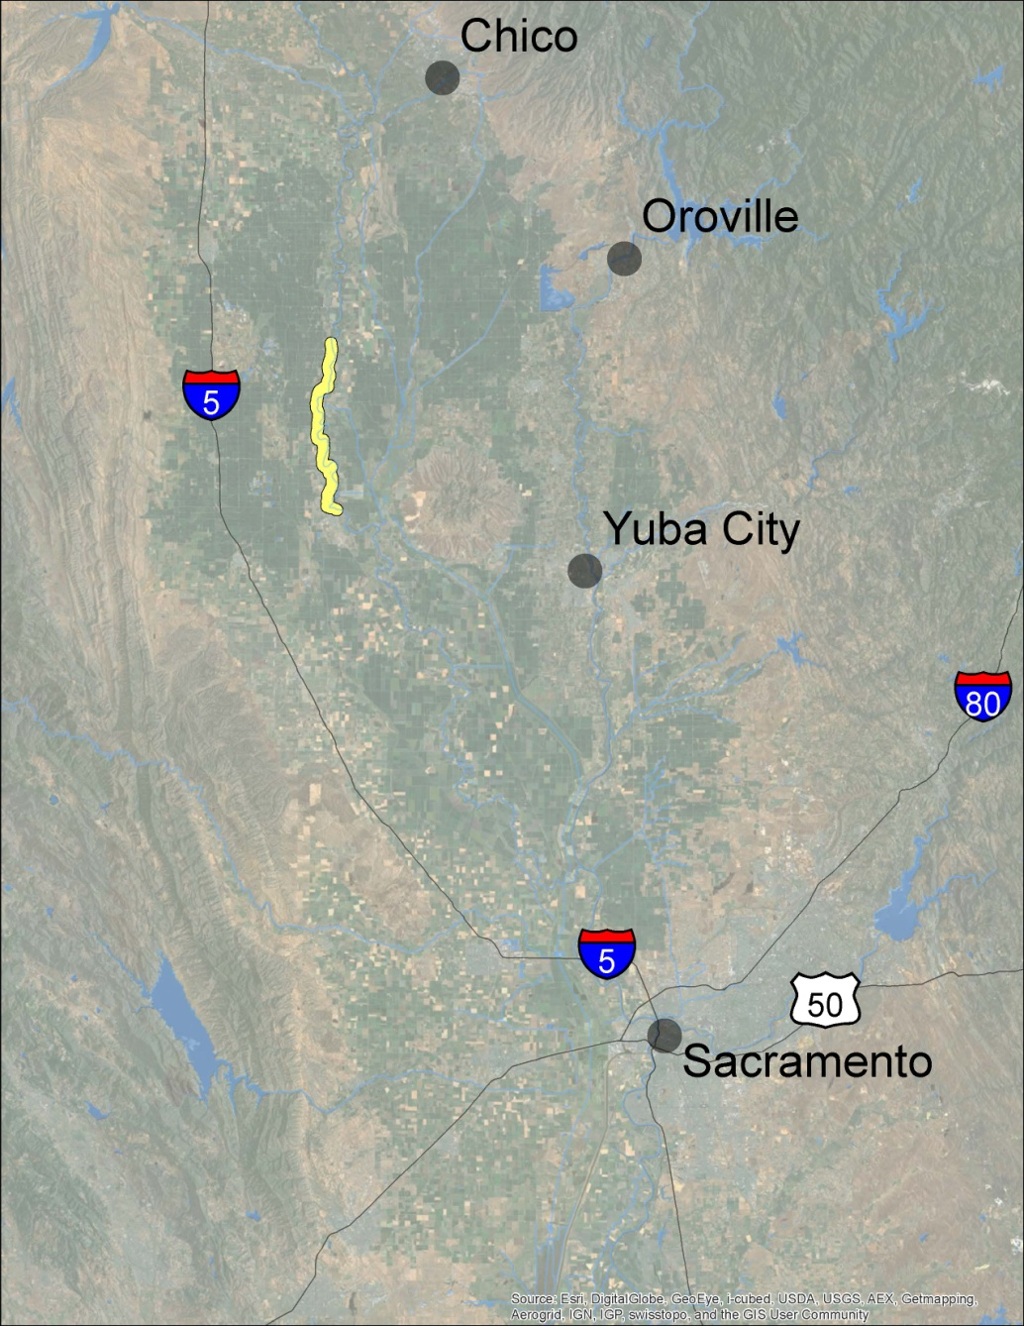
MA 1
West Levee of
Sacramento River
Near Colusa
FY18/19 - $317,000 (proposed)
17 Levee Miles

Slide 20
MA 1 JOB CATEGORY | 2017-2018 | 2018-2019
 | APPROVED | PROPOSED | % Change
 | BUDGET | BUDGET | BUDGET
Vegetation Control | $ 60,000 | $ 60,000 | -
Burning | $ 30,000 | $ 30,000 | -
Rodent Control | $ 30,000 | $ 30,000 | -
Patrolling | $ 30,000 | $ 28,000 | - 6.7%
Mowing | $ 10,000 | $ 11,000 | + 10%
Inspection | $ 8,000 | $ 8,000 | -
Encroachment Removal | $ 20,000 | $ 20,000 | -
Restoration/Repair | $ 31,000 | $ 31,000 | -
Crown Roadways | $ 20,000 | $ 20,000 | -
Minor Structures | $ 9,000 | $ 9,000 | -
Dragging | $ 15,000 | $ 15,000 | -
MEO Equipment Costs | $ 17,000 | $ 17,000 | -
Maintenance Yard Overhead | $ 17,000 | $ 15,000 | - 12%
Telemetry Maintenance | $ - | $ - | -
Engineering Support | $ 10,000 | $ 10,000 | -
Environmental Support | $ 10,000 | $ 13,000 | + 30%
TOTAL BUDGET | $ 317,000 | $ 317,000 | -
17 Levee Miles

Slide 21
MA 3
West Levee
Feather River near
Sutter Bypass
FY18/19 - $84,000 (proposed)
5 Levee Miles

Slide 22
MA 3 JOB CATEGORY | 2017-2018 | 2018-2019
 | APPROVED | PROPOSED | % Change
 | BUDGET | BUDGET | BUDGET
Vegetation Control | $ 12,000 | $ 12,000 | -
Burning | $ 10,000 | $ 10,000 | -
Rodent Control | $ 6,500 | $ 7,000 | +7.7%
Patrolling | $ 1,500 | $ 1,500 | -
Mowing | $ 10,000 | $ 12,000 | +20%
Inspection | $ 1,000 | $ 1,500 | +50%
Encroachment Removal | $ 1,000 | $ 1,000 | -
Restoration/Repair | $ 20,000 | $ 18,000 | -10%
Crown Roadways | $ 3,000 | $ 3,000 | -
Minor Structures | $ 1,000 | $ 1,000 | -
Dragging | $ 5,000 | $ 5,000 | -
MEO Equipment Costs | $ 3,000 | $ 3,000 | -
Maintenance Yard Overhead | $ 4,000 | $ 3,000 | -25%
Telemetry Maintenance | $ - | $ - | -
Engineering Support | $ 3,000 | $ 3,000 | -
Environmental Support | $ 3,000 | $ 3,000 | -
TOTAL BUDGET | $ 84,000 | $ 84,000 | -
5 Levee Miles

Slide 23
MA 4
Sacramento River Levee in
West Sacramento
FY18/19 - $132,240 (proposed)
3.5 Levee Miles

Slide 24
MA 4 JOB CATEGORY | 2017-2018 | 2018-2019
 | APPROVED | PROPOSED | % Change
 | BUDGET | BUDGET | BUDGET
Vegetation Control | $ 38,000 | $ 38,000 | -
Burning | $ - | $ - | -
Rodent Control | $ 3,500 | $ 3,500 | -
Patrolling | $ 5,000 | $ - | Eliminated*
Mowing | $ 13,500 | $ 13,500 | -
Inspection | $ 4,000 | $ 4,000 | -
Encroachment Removal | $ 10,000 | $ 10,000 | -
Restoration/Repair | $ 20,000 | $ 20,000 | -
Crown Roadways | $ 3,000 | $ 3,000 | -
Minor Structures | $ 5,800 | $ 5,800 | -
Dragging | $ - | $ - | -
MEO Equipment Costs | $ 17,000 | $ 17,000 | -
Maintenance Yard Overhead | $ 8,000 | $ 8,000 | -
Telemetry Maintenance | $ - | $ - | -
Engineering Support | $ 1,940 | $ 1,940 | -
Environmental Support | $ 7,500 | $ 7,500 | -
TOTAL BUDGET | $ 137,240 | $ 132,240 | -3.6%
3.5 Levee Miles
* DWR Sacramento Maintenance Yard sits on MA-4 levee

Slide 25
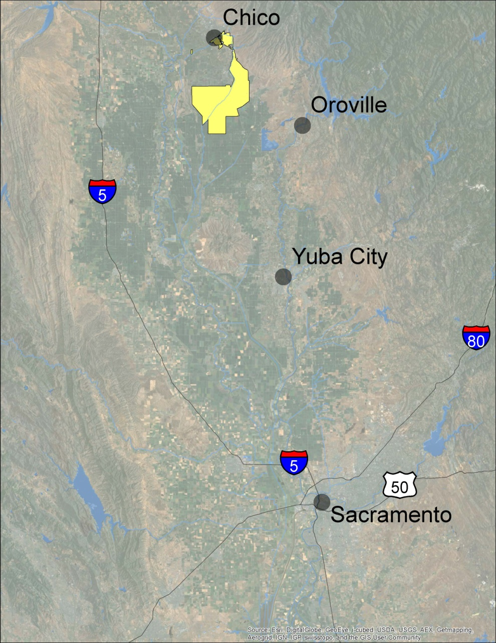
MA 5
Butte Creek Levees and
Little Chico
Creek Channel
FY18/19 - $447,357 (proposed)
33 Levee Miles

Slide 26
MA 5 JOB CATEGORY | 2017-2018 | 2018-2019
 | APPROVED | PROPOSED | % Change
 | BUDGET | BUDGET | BUDGET
Vegetation Control | $ 59,500 | $ 59,500 | -
Burning | $ 30,000 | $ 30,000 | -
Rodent Control | $ 30,000 | $ 30,000 | -
Patrolling | $ 4,000 | $ 4,000 | -
Mowing | $ 15,000 | $ 15,000 | -
Inspection | $ 15,000 | $ 15,000 | -
Encroachment Removal | $ 80,000 | $ 80,000 | -
Restoration/Repair | $ 30,000 | $ 30,000 | -
Crown Roadways | $ 30,000 | $ 30,000 | -
Minor Structures | $ 20,000 | $ 20,000 | -
Dragging | $ 14,000 | $ 14,000 | -
Little Chico Diversion Structure | $ 20,000 | $ 20,000 | -
Sediment Removal | $ - | $ - | -
Vegetation Control Channel | $ 20,000 | $ 20,000 | -
MEO Equipment Costs | $ 35,000 | $ 35,000 | -
Maintenance Yard Overhead | $ 17,000 | $ 17,000 | -
Telemetry Maintenance | $ 7,857 | $ 7,857 | -
Engineering Support | $ 10,000 | $ 10,000 | -
Environmental Support | $ 10,000 | $ 10,000 | -
TOTAL BUDGET | $ 447,357 | $ 447,357 | -
33 Levee Miles

Slide 27
MA 7
West Levee
Feather River below Oroville
FY18/19 - $128,000 (proposed)
12 Levee Miles

Slide 28
MA 7 JOB CATEGORY | 2017-2018 | 2018-2019
 | APPROVED | PROPOSED | % Change
 | BUDGET | BUDGET | BUDGET
Vegetation Control | $ 22,000 | $ 23,000 | +4.5%
Burning | $ 1,000 | $ 1,000 | -
Rodent Control | $ 25,000 | $ 23,000 | -8.0%
Patrolling | $ 2,000 | $ 2,000 | -
Mowing | $ 20,000 | $ 23,000 | +15%
Inspection | $ 6,000 | $ 5,000 | -17%
Encroachment Removal | $ 12,000 | $ 11,000 | - 8%
Restoration/Repair | $ 5,000 | $ 5,000 | -
Crown Roadways | $ 7,000 | $ 7,000 | -
Minor Structures | $ 7,000 | $ 5,000 | -29%
Dragging | $ 2,500 | $ 2,500 | -
MEO Equipment Costs | $ 8,500 | $ 8,500 | -
Maintenance Yard Overhead | $ 4,000 | $ 3,000 | -25%
Engineering Support | $ 3,000 | $ 3,000 | -
Environmental Support | $ 3,000 | $ 6,000 | +100%
TOTAL BUDGET | $ 128,000 | $ 128,000 | -
12 Levee Miles

Slide 29
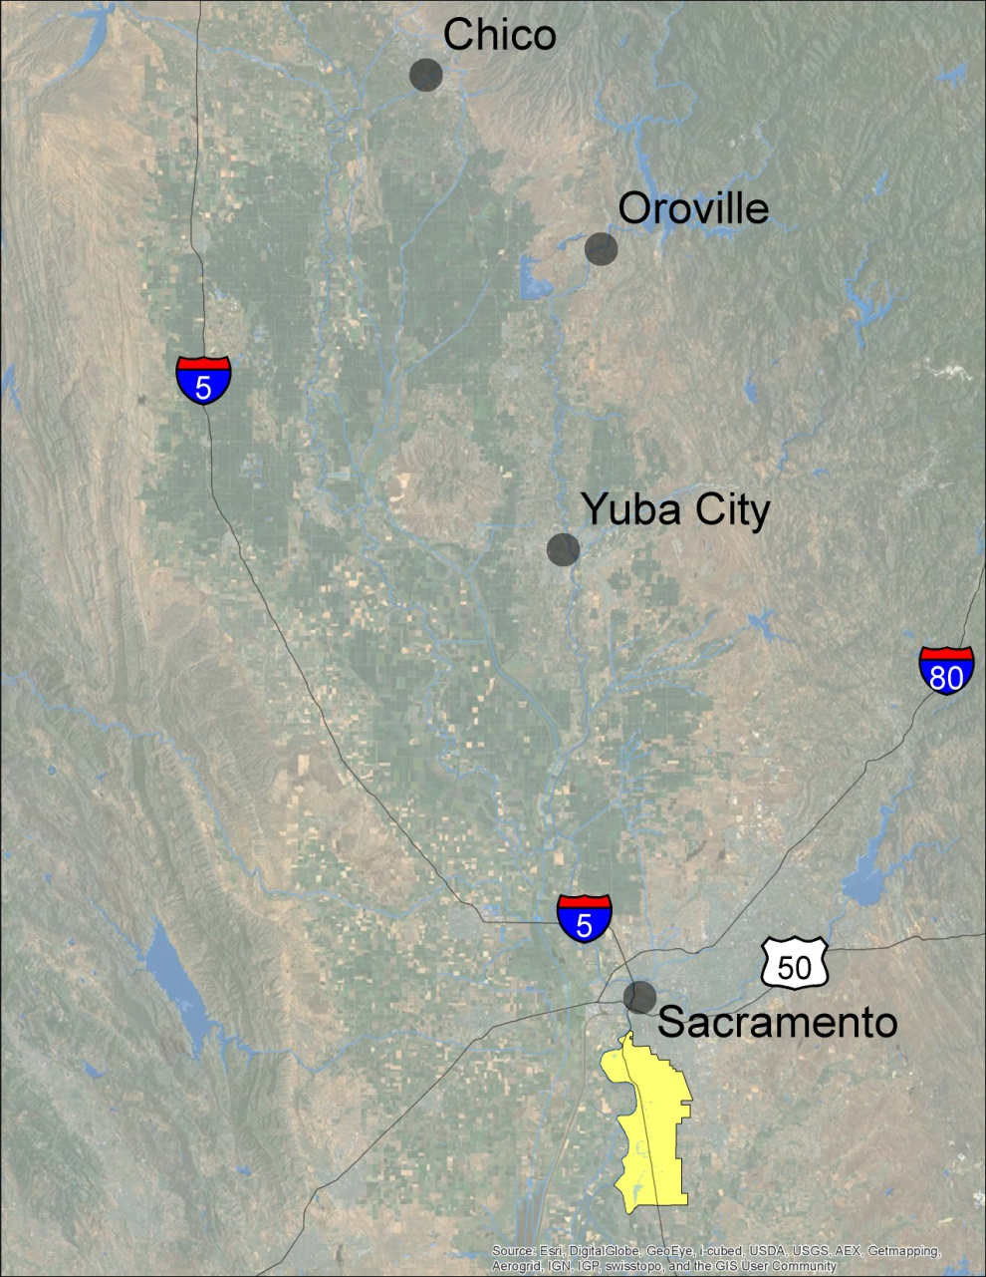
MA 9
East Levee of
Sacramento River
in Sacramento
FY18/19 - $1,650,600 (proposed)
~20 Levee Miles

Slide 30
MA 9 JOB CATEGORY | 2017-2018 | 2018-2019
 | APPROVED | PROPOSED | % Change
 | BUDGET | BUDGET | BUDGET
Vegetation Control | $ 250,000 | $ 250,000 | -
Burning | $ - | $ - | -
Rodent Control | $ 85,000 | $ 85,000 | -
Patrolling | $ 45,000 | $ 45,000 | -
Mowing | $ 120,000 | $ 120,000 | -
Inspection | $ 10,000 | $ 10,000 | -
Encroachment Removal | $ 240,000 | $ 240,000 | -
Restoration/Repair | $ 540,000 | $ 540,000 | -
Crown Roadways | $ 40,000 | $ 40,000 | -
Minor Structures | $ 40,000 | $ 40,000 | -
Dragging | $ - | $ - | -
MEO Equipment Costs | $ 135,000 | $ 135,000 | -
Maintenance Yard Overhead | $ 75,000 | $ 75,000 | -
Telemetry Maintenance | $ - | $ - | -
Engineering Support | $ 60,000 | $ 60,000 | -
Environmental Support | $ 10,600 | $ 10,600 | -
TOTAL BUDGET | $ 1,650,600 | $ 1,650,600 | -
~20 Levee Miles

Slide 31
MA 12
Colusa Drain Levee
FY18/19 - $125,000 (proposed)
11 Levee Miles

Slide 32
MA 12 JOB CATEGORY | 2017-2018 | 2018-2019
 | APPROVED | PROPOSED | % Change
 | BUDGET | BUDGET | BUDGET
Vegetation Control | $ 20,000 | $ 20,000 | -
Burning | $ 13,000 | $ 13,000 | -
Rodent Control | $ 5,000 | $ 5,000 | -
Patrolling | $ 3,000 | $ 3,000 | -
Mowing | $ 5,000 | $ 5,000 | -
Inspection | $ 5,000 | $ 5,000 | -
Encroachment Removal | $ 5,000 | $ 5,000 | -
Restoration/Repair | $ 20,000 | $ 20,000 | -
Crown Roadways | $ 20,000 | $ 20,000 | -
Minor Structures | $ 3,000 | $ 3,000 | -
Dragging | $ 8,000 | $ 8,000 | -
MEO Equipment Costs | $ 7,000 | $ 7,000 | -
Maintenance Yard Overhead | $ 3,000 | $ 2,000 | -33%
Telemetry Maintenance | $ - | $ - | -
Engineering Support | $ 3,000 | $ 3,000 | -
Environmental Support | $ 3,000 | $ 6,000 | +100%
TOTAL BUDGET | $ 123,000 | $ 125,000 | +1.6%
11 Levee Miles

Slide 33
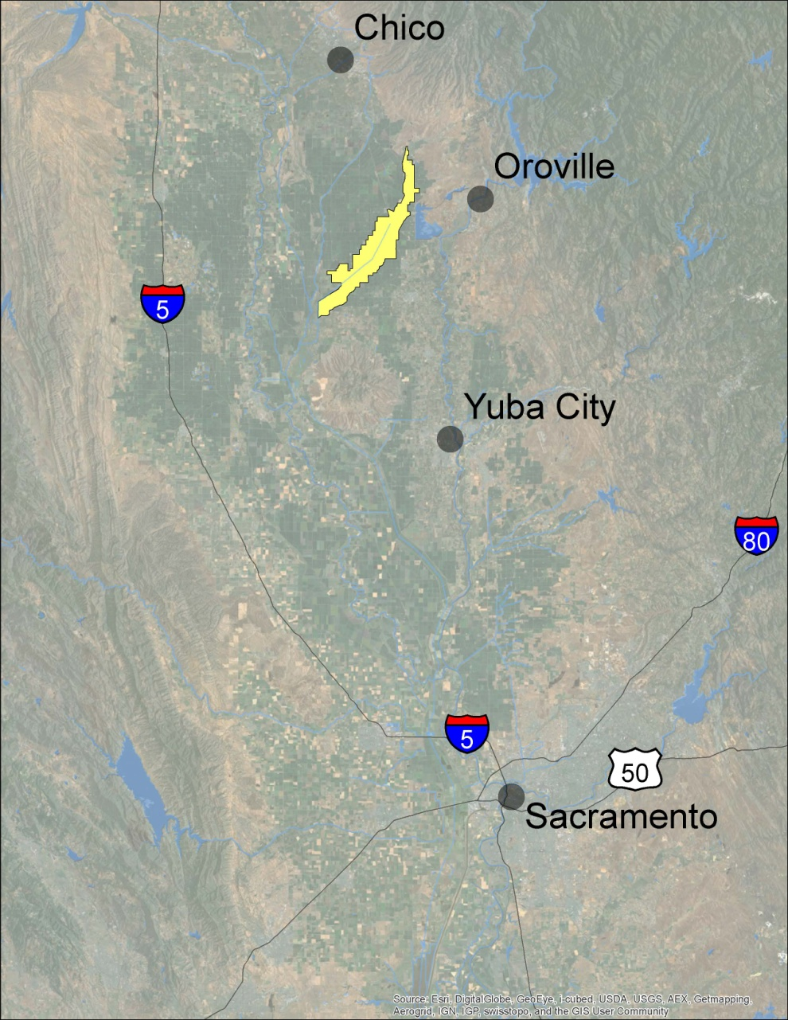
MA 13
Cherokee Canal Levees
FY18/19 - $261,500 (proposed)
41 Levee Miles

Slide 34
MA 13 JOB CATEGORY | 2017-2018 | 2018-2019
 | APPROVED | PROPOSED | % Change
 | BUDGET | BUDGET | BUDGET
Vegetation Control | $ 40,000 | $ 40,000 | -
Burning | $ 23,000 | $ 23,000 | -
Rodent Control | $ 15,000 | $ 15,000 | -
Patrolling | $ 8,000 | $ 5,000 | -38%
Mowing | $ 20,000 | $ 25,500 | +28%
Inspection | $ 8,000 | $ 6,500 | -19%
Encroachment Removal | $ 16,000 | $ 15,000 | -6.3%
Restoration/Repair | $ 15,000 | $ 18,000 | +20%
Crown Roadways | $ 19,500 | $ 19,500 | -
Minor Structures | $ 11,000 | $ 12,000 | +9.1%
Dragging | $ 10,000 | $ 10,000 | -
MEO Equipment Costs | $ 27,000 | $ 27,000 | -
Maintenance Yard Overhead | $ 17,000 | $ 15,000 | -12%
Telemetry Maintenance | $ 22,000 | $ 15,000 | -32%
Engineering Support | $ 5,000 | $ 5,000 | -
Environmental Support | $ 5,000 | $ 10,000 | +100%
TOTAL BUDGET | $ 261,500 | $ 261,500 | -
41 Levee Miles

Slide 35
MA 16
West Levee
Feather River near Live Oak
FY18/19 - $76,000 (proposed)
4 Levee Miles

Slide 36
MA 16 JOB CATEGORY | 2017-2018 | 2018-2019
 | APPROVED | PROPOSED | % Change
 | BUDGET | BUDGET | BUDGET
Vegetation Control | $ 13,000 | $ 15,000 | +15%
Burning | $ 1,000 | $ 1,000 | -
Rodent Control | $ 11,500 | $ 10,000 | -13%
Patrolling | $ - | $ - | -
Mowing | $ 16,000 | $ 16,000 | -
Inspection | $ 1,000 | $ 1,000 | -
Encroachment Removal | $ 15,000 | $ 10,000 | -33%
Restoration/Repair | $ 5,000 | $ 5,000 | -
Crown Roadways | $ 3,000 | $ 5,000 | +67%
Minor Structures | $ 2,500 | $ 2,000 | -20%
Dragging | $ 1,000 | $ 2,000 | +100%
MEO Equipment Costs | $ 4,000 | $ 4,000 | -
Maintenance Yard Overhead | $ 1,000 | $ 1,000 | -
Telemetry Maintenance | $ - | $ - | -
Engineering Support | $ - | $ 1,000 | New
Environmental Support | $ - | $ 3,000 | New
TOTAL BUDGET | $ 74,000 | $ 76,000 | +2.7%
4 Levee Miles

Slide 37
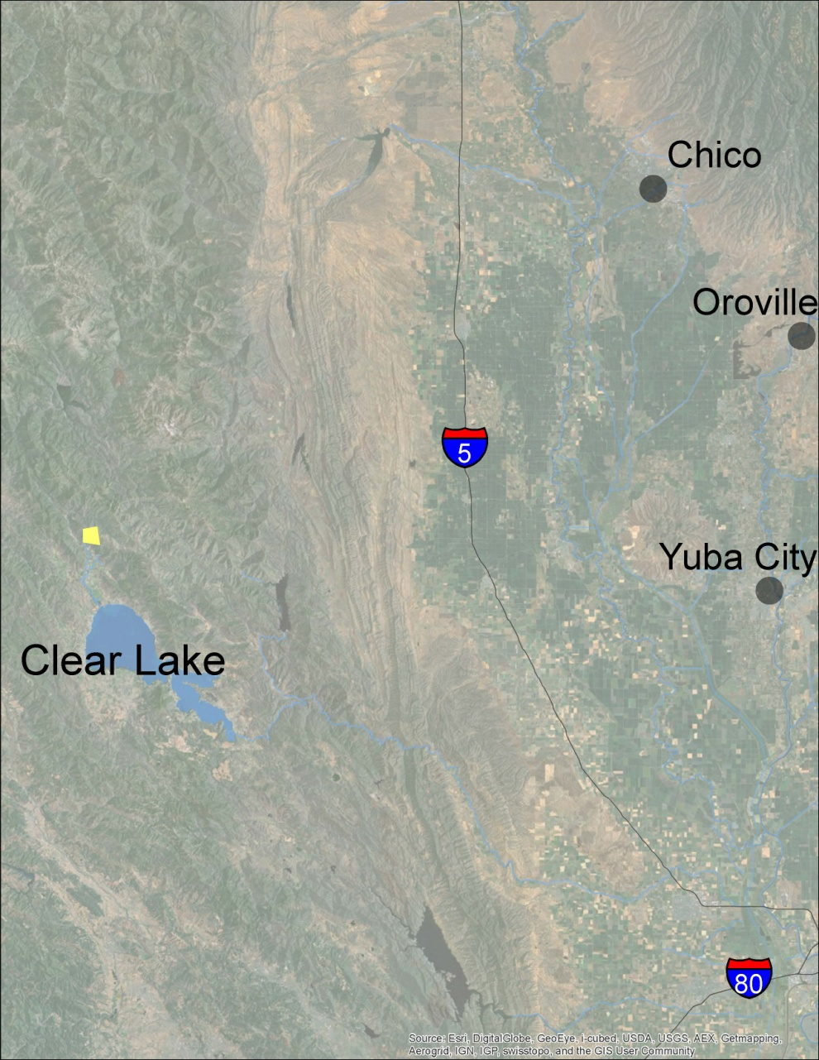
MA 17
Middle Creek at
Clear Lake
FY18/19 - $122,500 (proposed)
4 Levee Miles

Slide 38
MA 17 JOB CATEGORY | 2017-2018 | 2018-2019
 | APPROVED | PROPOSED | % Change
 | BUDGET | BUDGET | BUDGET
Vegetation Control | $ 5,000 | $ 5,000 | -
Burning | $ - | $ - | -
Rodent Control | $ 1,000 | $ 1,000 | -
Patrolling | $ 5,000 | $ 5,000 | -
Mowing | $ 25,000 | $ 30,000 | +20%
Inspection | $ 3,000 | $ 2,000 | -33%
Encroachment Removal | $ 5,000 | $ 3,000 | -40%
Restoration/Repair | $ 25,000 | $ 25,000 | -
Crown Roadways | $ - | $ 2,000 | new
Minor Structures | $ 3,500 | $ 3,500 | -
Dragging | $ - | $ - | -
Plant Maintenance & Repairs | $ 7,000 | $ 3,000 | -57%
Plant Operations | $ 10,000 | $ 8,000 | -20%
MEO Equipment Costs | $ 5,000 | $ 5,000 | -
Maintenance Yard Overhead | $ 1,000 | $ 1,000 | -
Telemetry Maintenance | $ 25,000 | $ 25,000 | -
Engineering Support | $ 1,000 | $ 1,000 | -
Environmental Support | $ 1,000 | $ 3,000 | +200%
TOTAL BUDGET | $ 122,500 | $ 122,500 | -
4 Levee Miles

Slide 39
MA 5
MA13
MA 7
MA 1
MA16
MA 12
MA 3
MA 17
MA 4
MA 9
Proposed Budget Same as Previous Year
MA 1, MA 3, MA 5, MA 7, MA 9, MA 13, MA 17
Proposed Budget Increase (%)
MA 12 (1.6%), MA 16 (2.7%)
Proposed Budget Decrease
MA 4 (-3.6%)
FY 2017/18 Approved Budget: $3,345,197
FY 2017/18 Projected Expend: $2,709,658
FY 2018/19 Proposed Budget: $3,344,197
152 Levee Miles
Overall 0.03% Increase for FY 2018/19

Slide 40
MA 5
MA13
MA 7
MA 1
MA16
MA 12
MA 3
MA 17
MA 4
MA 9
Proposed Budget Same as Previous Year
MA 1, MA 3, MA 5, MA 7, MA 9, MA 13, MA 17
Proposed Budget Increase (%)
MA 12 (1.6%), MA 16 (2.7%)
Proposed Budget Decrease
MA 4 (-3.6%)
FY 2017/18 Approved Budget: $3,345,197
FY 2017/18 Projected Expend: $2,709,658
FY 2018/19 Proposed Budget: $3,344,197
152 Levee Miles
Overall 0.03% Increase for FY 2018/19

Slide 41
MA 5
MA13
MA 7
MA 1
MA16
MA 12
MA 3
MA 17
MA 4
MA 9
Proposed Budget Same as Previous Year
MA 1, MA 3, MA 5, MA 7, MA 9, MA 13, MA 17
Proposed Budget Increase (%)
MA 12 (1.6%), MA 16 (2.7%)
Proposed Budget Decrease
MA 4 (-3.6%)
FY 2017/18 Approved Budget: $3,345,197
FY 2017/18 Projected Expend: $2,709,658
FY 2018/19 Proposed Budget: $3,344,197
152 Levee Miles
Overall 0.03% Increase for FY 2018/19

Slide 42
MA 5
MA13
MA 7
MA 1
MA16
MA 12
MA 3
MA 17
MA 4
MA 9
Proposed Budget Same as Previous Year
MA 1, MA 3, MA 5, MA 7, MA 9, MA 13, MA 17
Proposed Budget Increase (%)
MA 12 (1.6%), MA 16 (2.7%)
Proposed Budget Decrease
MA 4 (-3.6%)
FY 2017/18 Approved Budget: $3,345,197
FY 2017/18 Projected Expend: $2,709,658
FY 2018/19 Proposed Budget: $3,344,197
152 Levee Miles
Overall 0.03% Increase for FY 2018/19

Slide 43
Requested Board Action
DWR requests the Central Valley Flood Protection Board Adopt the Fiscal Year 2018/19 Maintenance Area Budgets as presented, pursuant to California Water Code Section 12878, et. seq.
Applicable California Water Code Sections:
12878.27 – DWR provides annual cost estimate
12878.28 – Hearing held after April 1
12878.29 – Notice of Hearing; publication
12878.32 – Fixing amount of estimate
Requested Board Action:
Adopt Proposed Budget as Presented

Slide 44
California Water Code 12878 et seq. Relevant Sections
Cal. Water Code § 12878 (f) "Maintenance" means work described as maintenance by the federal regulations issued by the Secretary of the Army, the Secretary of Agriculture, the department, or the board for any project.
Cal. Water Code § 12878.21. Upon the formation of a maintenance area, the department shall thereafter operate and maintain the unit until such time as the maintenance area may be dissolved pursuant to this chapter. If the board or the department forms a maintenance area for a portion of a unit of a project, any remaining portion of the unit of a project not included in the maintenance area shall remain the responsibility of the local agency obligated to operate and maintain that unit.
Cal. Water Code §12878.27. The department shall, prior to the first day of April of each year, estimate the cost of the operation and maintenance of each unit during the ensuing fiscal year and during the current fiscal year where no assessment has been levied or collected for the current fiscal year and adjust such estimates as provided in Section 12878.44. The department shall transmit a copy of such estimates to the board as to all units within the jurisdiction of the board.
Cal. Water Code §12878.28. Following the first day of April of each year, the board or department shall hold a hearing at Sacramento on the matter of fixing the estimates and assessments for all units to be operated or maintained by the department pursuant to this chapter.
Cal. Water Code §12878.29. Notice of the hearing shall be given by publication in at least one newspaper of general circulation in each maintenance area affected for at least once a week for two successive weeks.
Cal. Water Code §12878.30. The notice shall set the time and place of the hearing which shall be held not less than 10 days following the completion of publication as to all maintenance areas, and shall state that the purpose of the hearing is to confirm or modify or revise the program of work to be performed on the units for which estimates have been made pursuant to Section 12878.27, and to determine the necessity for such work and the amount of the estimates therefor.
Cal. Water Code §12878.31. At the hearing any owner of land in any maintenance area affected, or other interested person may offer, and the board or department shall receive, any relevant evidence or testimony concerning the proposed program of work relating to any such unit, the necessity for such work, or the estimate of the cost thereof.
Cal. Water Code §12878.32. Upon the final conclusion of such hearing the board or department shall fix the amount of the estimate for each such unit for all purposes of the assessments provided for in this article, and in all cases where the board fixes the said amount it shall immediately notify the department of the amounts thereof.

