Slide 1
CALIFORNIA DEPARTMENT OF WATER RESOURCES
DIVISION OF FLOOD MANAGEMENT
Monthly Report
Central Valley Flood Protection Board Meeting
March 23, 2018
Jon Ericson
Division of Flood Management
California Department of Resources

Slide 2
Today’s Topics
Current Hydrologic Conditions
FOC Update on Santa Barbara County
SB-92: Emergency Preparedness
2017 ASCE Project of the Year Award
Additional DWR Items

Slide 3
Current Hydrologic Conditions

Slide 4
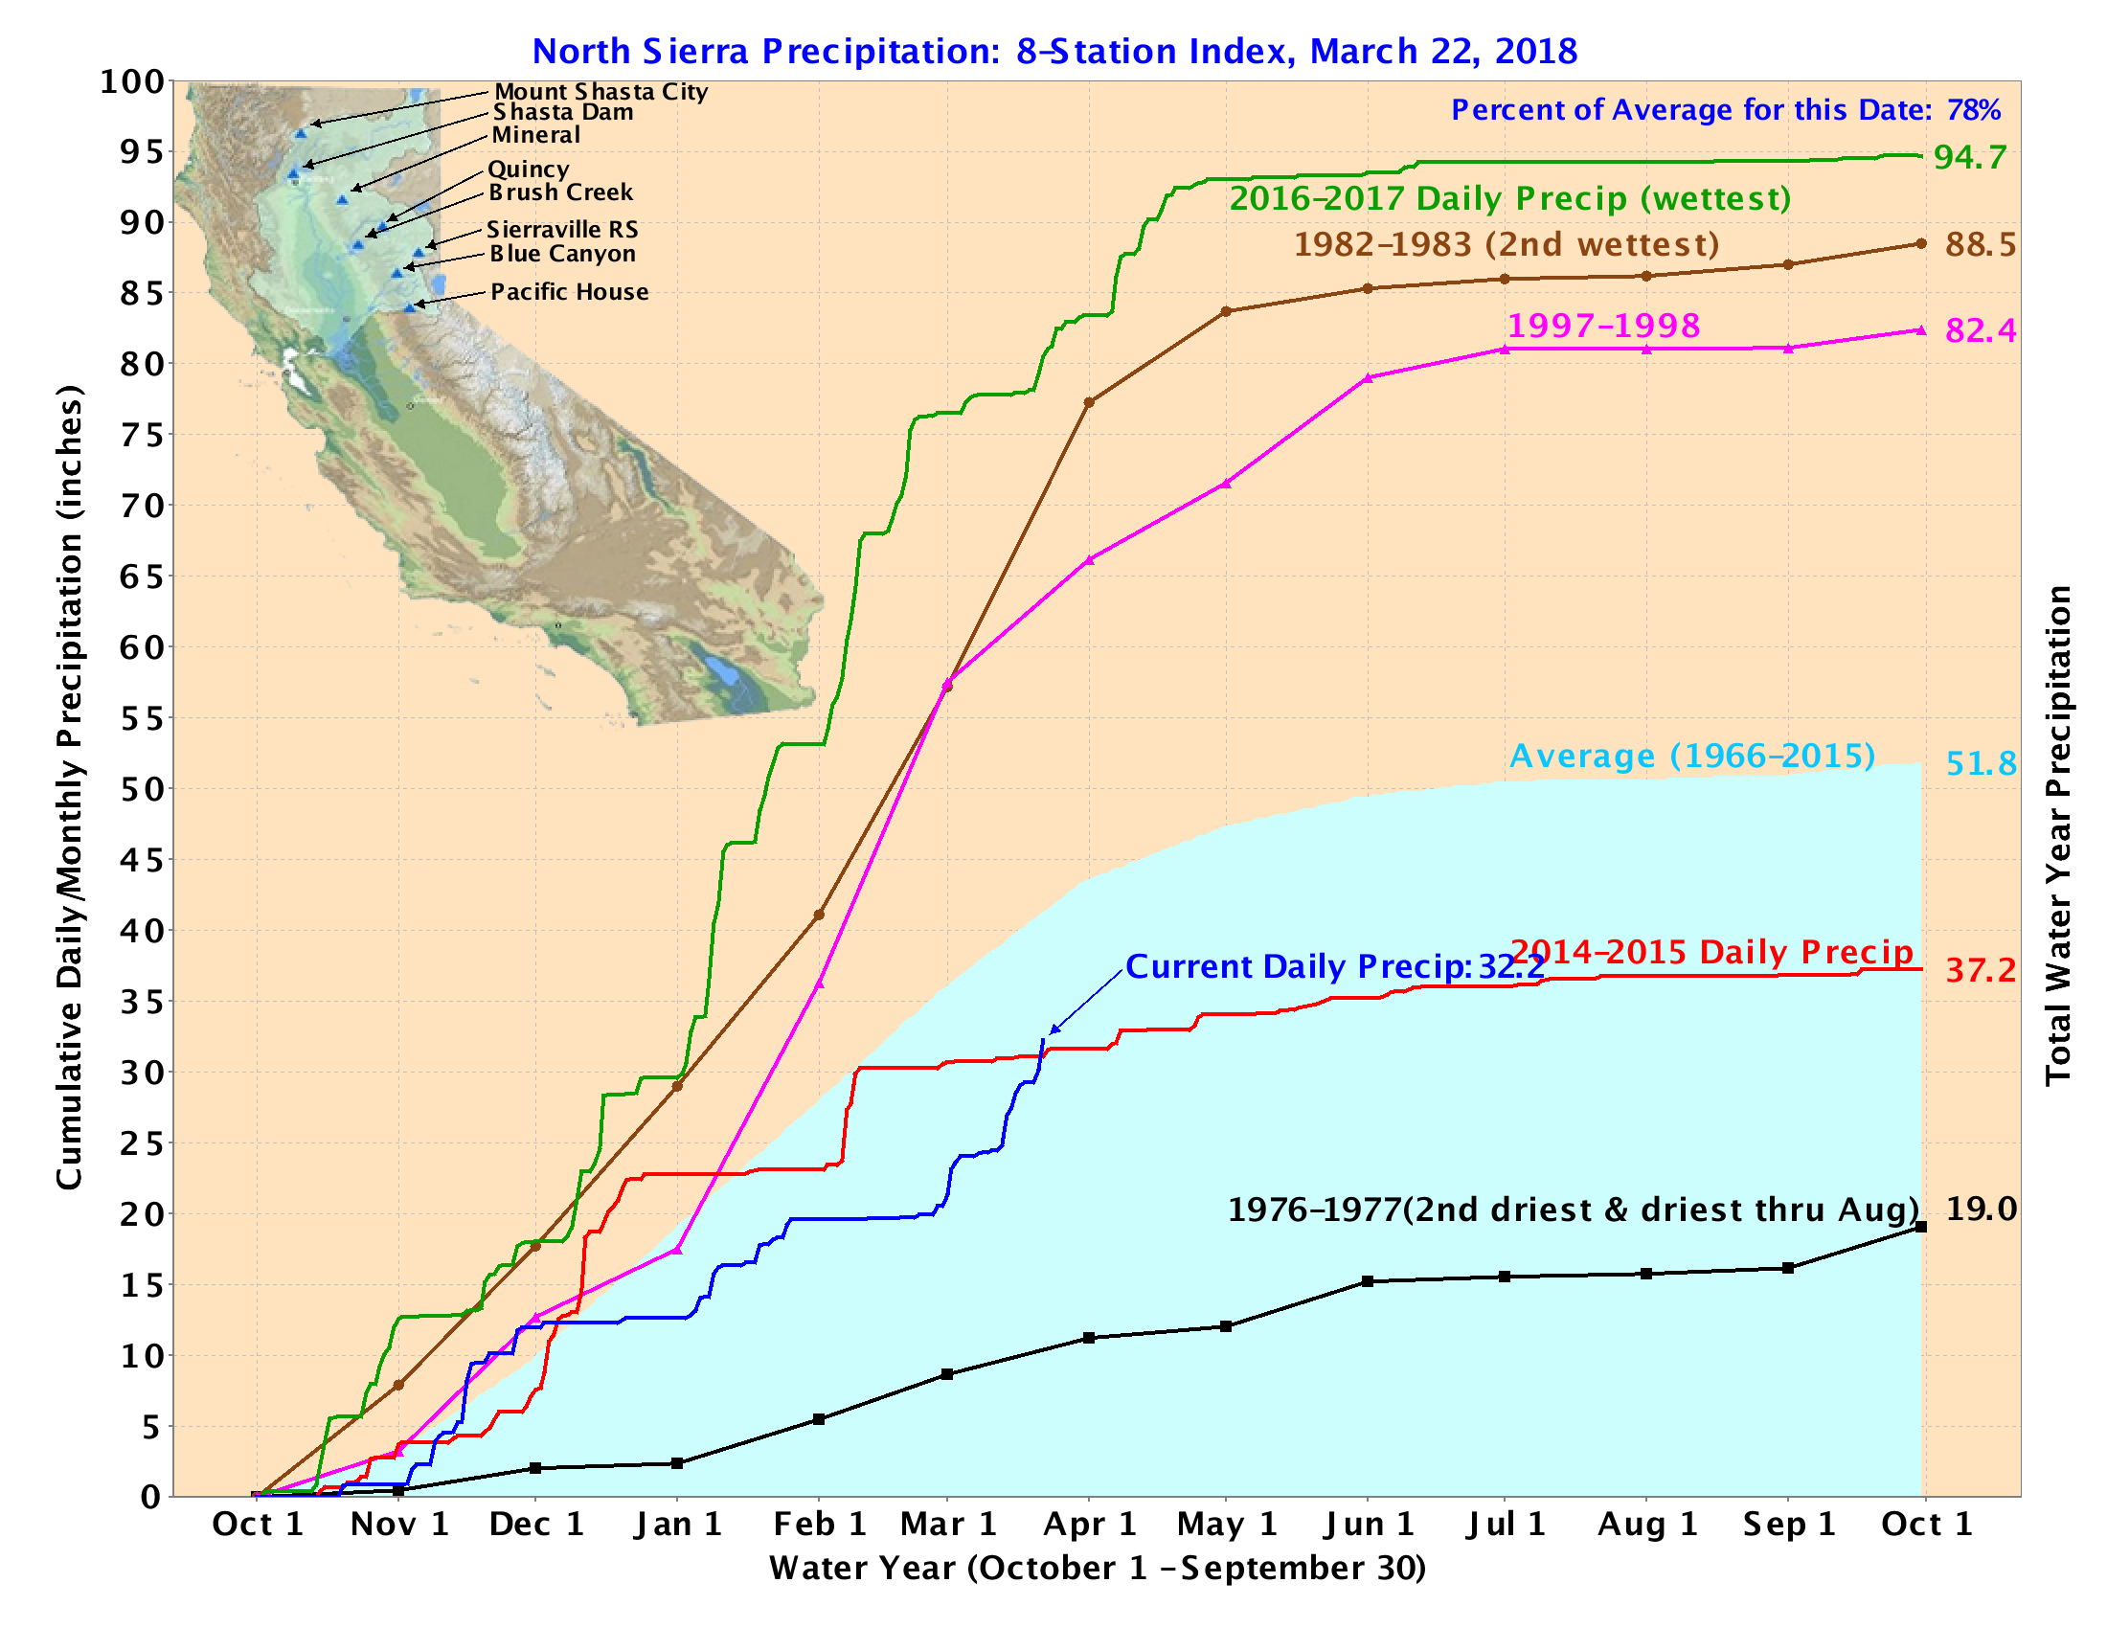
Notes:
Current hydrologic conditions

Slide 5

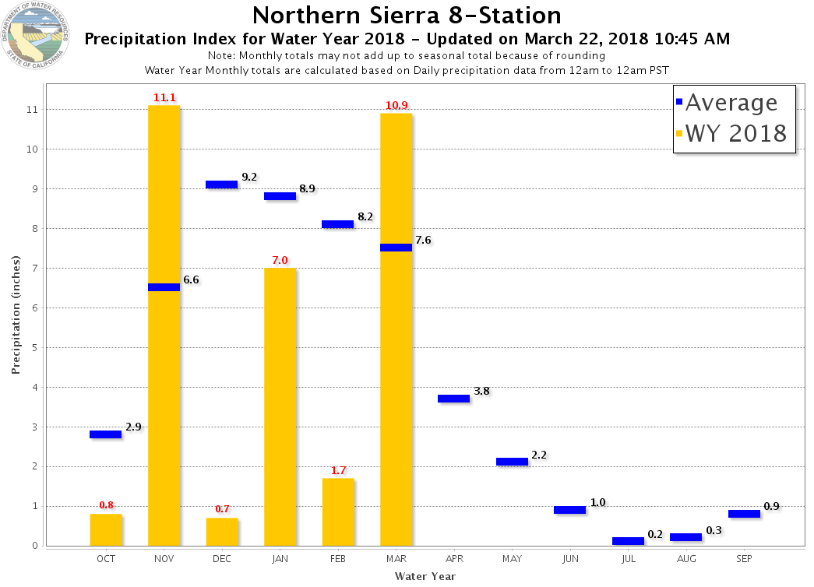

Slide 6
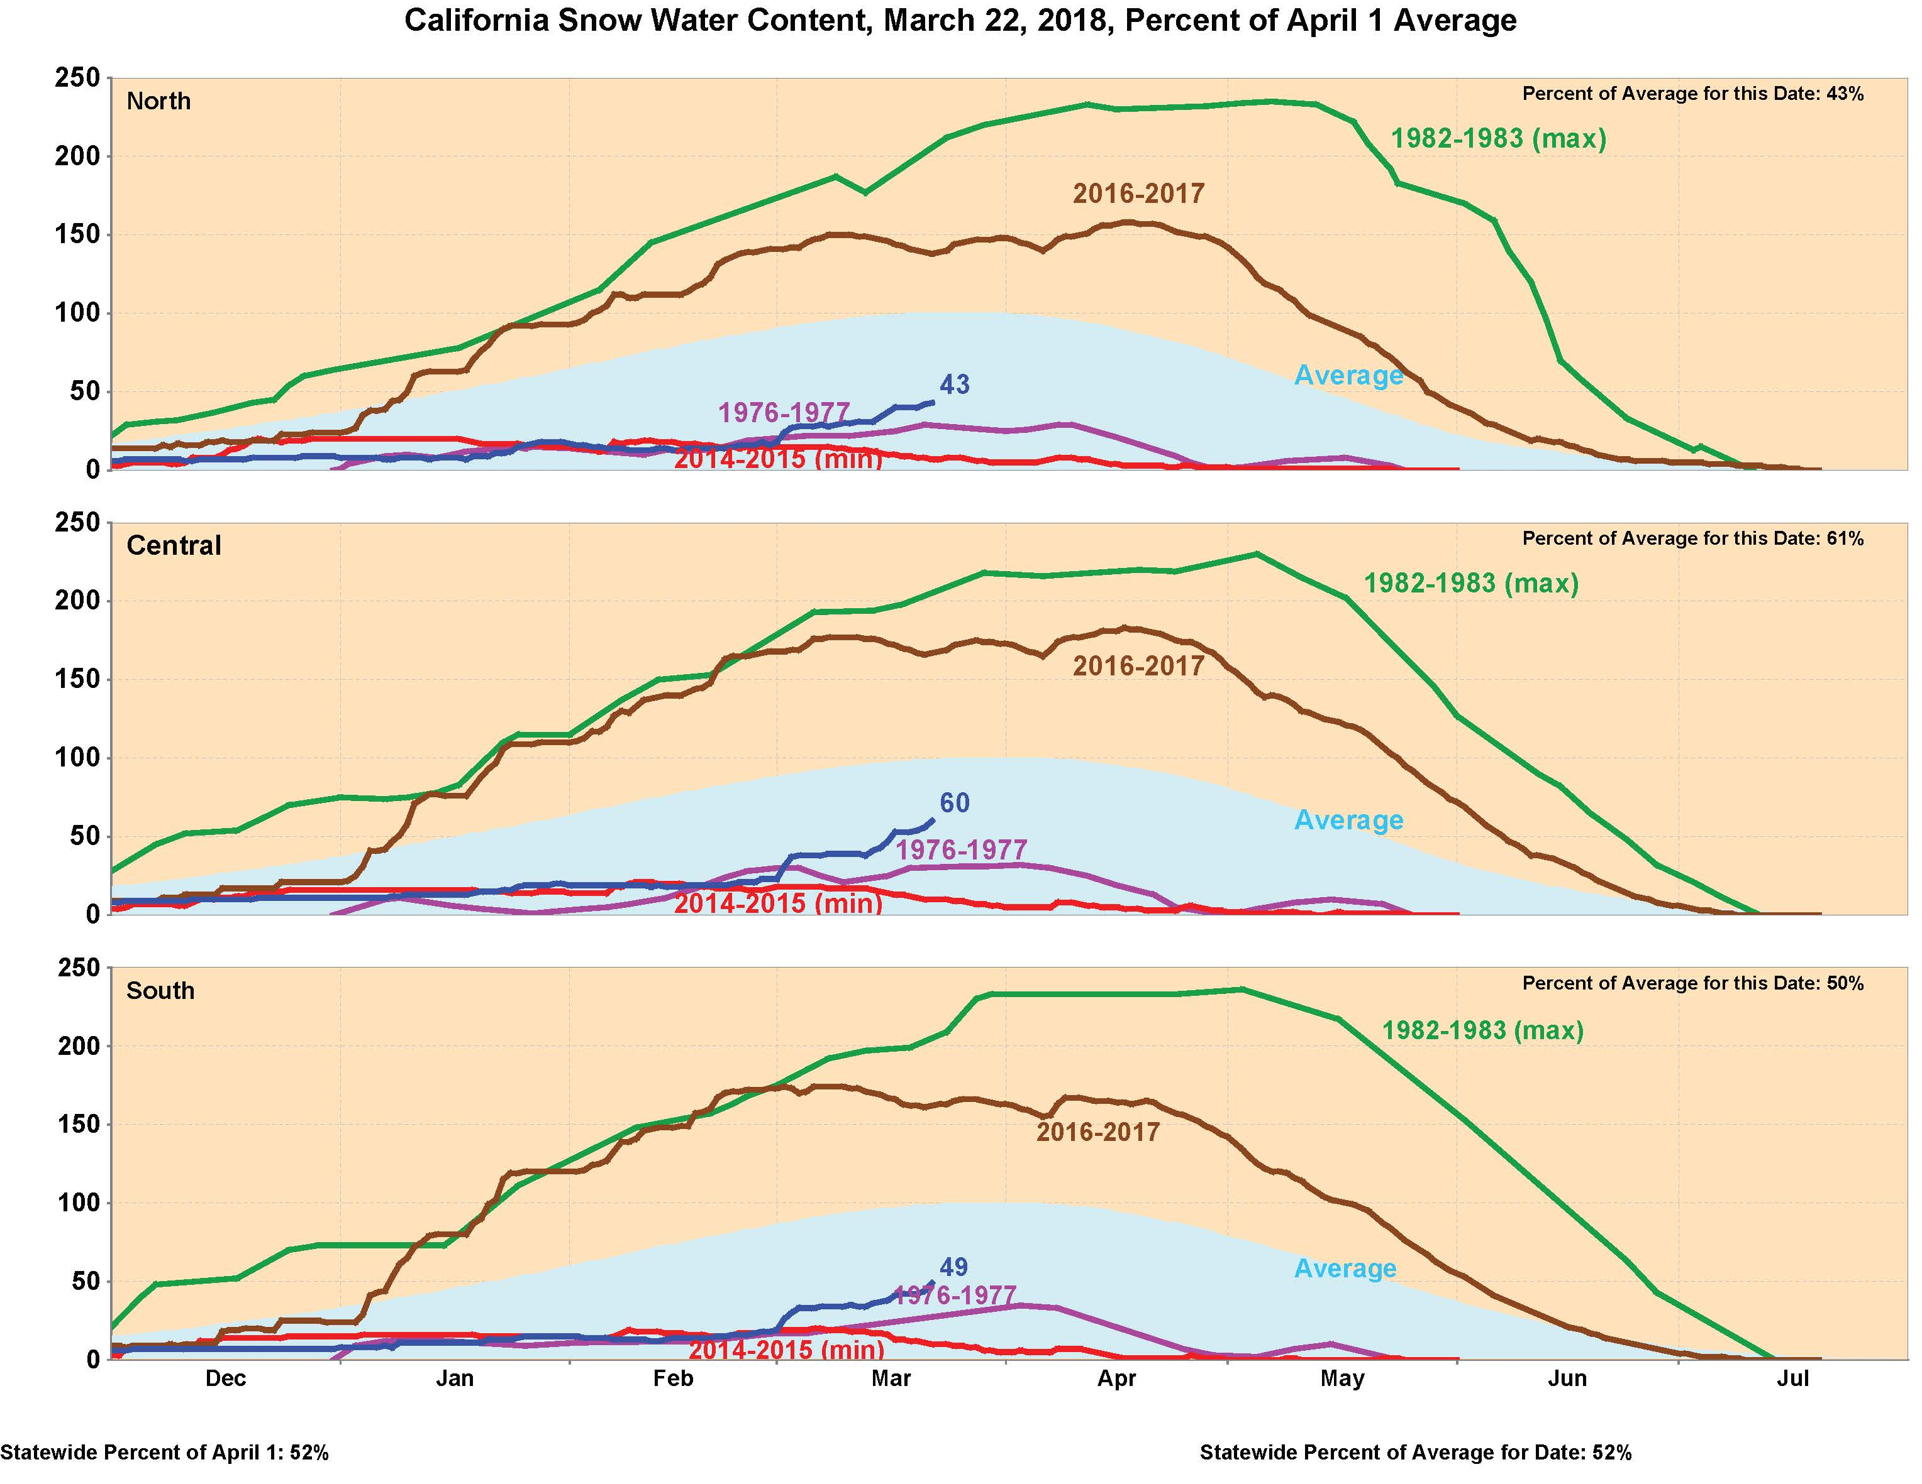

Slide 7
Snow and Reservoir Conditions
SHASTA
OROVILLE
FOLSOM
NEW MELONES
DON PEDRO
NEW EXCHEQUER
MILERTON
PINE FLAT
Reservoir condition as of midnight 3/21/2018
Snowmelt runoff forecast as of 3/22/2018 (B-120 April-July runoff)

Slide 8
FOC Update on
Santa Barbara County

Slide 9
Status Update
Urban and small stream flooding expected
Possible mud and debris flows over recent burn scar areas
9 forecast points have exceeded or expected to exceed monitor stage
2 forecast points expected to exceed flood stage
Tisdale Weir is expected to start flowing this evening
Flash flood warning issued by NWS for Sherpa and Whittier burn areas in Santa Barbara County
Areas that could experience flooding include El Capitan State Beach, Refugio State Beach, Lake Cachuma, and Hwy 154 over San Marcos Pass
2 FOC flood fight specialists pre-positioned in Northern Santa Barbara County yesterday and today
DWR provided representatives to the Santa Barbara and Ventura county EOCs and one to the SOC

Slide 10
Senate Bill 92:
Emergency Preparedness
Emergency Action Plans and Inundation Maps

Slide 11
Senate Bill 92: Emergency Preparedness
Emergency Action Plans
Inundation Maps
Guide response during serious dam incidents
Cal OES responsible for overseeing review, approval, and ongoing activities associated with EAPs.
Help dam owners understand their local flood risks and make cost-effective mitigation decisions.
DSOD responsible for review and approval of inundation maps.
Hazard Classification | EAP due (to Cal OES)
Extremely High | Jan. 1, 2018
High | Jan. 1, 2019
Significant | Jan. 1, 2021
Low | EAP Not Required

Slide 12
ASCE 2017 Project
of the Year Award
2017 DWR Storm Damage Emergency Rehabilitation Project

Slide 13

2017 Project of
the Year Award
2017 DWR Storm Damage Emergency Rehabilitation Project
May-December 2017 DWR & Partners’ Accomplishments:
Field evaluated, reviewed and ranked nearly 400 damaged sites in the Sac and SJ River systems
Provided LERRDs and program support for repair of 15 USACE PL 84-99 sites
Designed and permitted 30 Critically damaged sites
Completed construction on these 30 sites
Coordinated repair activities with Native American Tribes, permitting agencies, LMAs among others
Notes:
“The American Society of Civil Engineers (ASCE), Sacramento Section is pleased to announce that the 2017 DWR Storm Damage Emergency Rehabilitation Project has been selected as the 2017 Project of the Year. This is a tremendous accomplishment for the project team, your organization, and all project proponents” -March 14, 2018

Slide 14
2017 DWR SDDER
Partners & Stakeholders
Consultant Support: AECOM, ESA, GEI, PSOMAS
Resource Agencies: CDFW, USFWS, NMFS, SLC, CVFPB, RWQCB, SHPO
Reclamation Districts, Maintenance Areas, Private Landowners
SBFCA, CCVFCA
State and Federal Native American Tribes
DWR DOE, PAO, FOC, DFM
14

Slide 15
Additional DWR
Agenda Items
Marysville Ring Levee Phase 2A South and 2C Environmental Update
Flood Forecasting Overview
Operations, Maintenance, Repair, Rehabilitation, and Replacement (OMRR&R) Update
Folsom Dam Raise Environmental Update
15

Slide 16
Questions
Jon Ericson
Division of Flood Management
California Department of Water Resources
Jon.Ericson@water.ca.gov

