Slide 1
CALIFORNIA DEPARTMENT OF WATER RESOURCES
Monthly Report
Central Valley Flood Protection Board Meeting
February 23, 2018
Jeremy Arrich
Division of Flood Management
California Department of Water Resources

Slide 2
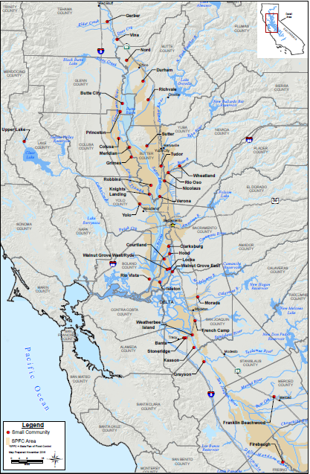
Small Communities Flood Risk Reduction Program
Program was created as a result of the adoption of the 2012 Central Valley Flood Protection Plan
Program split into two phases:
Phase 1 – Feasibility Studies
Phase 2 – Design/Implementation
Phase 1 Awards were posted in March 2017
DWR Approved $18 million for 35 Central Valley small communities.

Slide 3
Small Communities Flood Risk Reduction Program
DWR has executed 13 feasibility study funding agreements
Sacramento County (5)
Yolo County (3)
Colusa County (3)
City of Isleton
City of Rio Vista
Phase 2: Design/Implementation:
Guidelines and PSP draft will be released summer 2018
Solicitation scheduled for late 2018
Awards scheduled for summer 2019
Prop 1E funding needs to be committed by June 2020
An additional 6 agreements pending grantee signature in San Joaquin County.

Slide 4
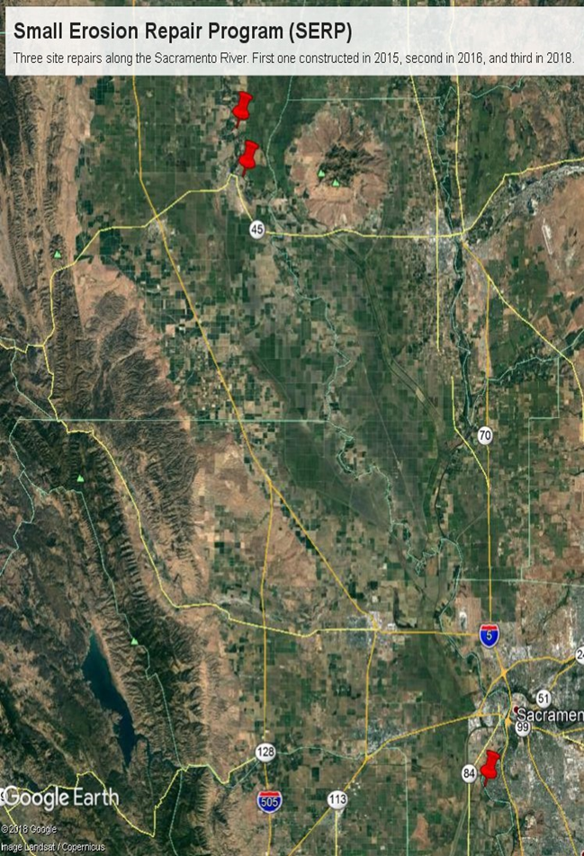
Small Erosion Repair Program
SERP is a pilot maintenance program created in 2014 under CVFPB Resolution 2014-04
SERP Program Timeline for erosion site repairs:
2014 – 10 sites identified
(5 along Wadsworth Canal and 5 along Willow Slough Bypass)
2015 –
2 sites identified along Willow Slough
1 site completed along the Sacramento River (LM 10.5) near Colusa
2016 – 1 site completed along the Sacramento River (LM 4.6) near Colusa
2017 – 1 site identified along the Sacramento River near Freeport
Of 15 total sites identified, 2 erosion repairs have been completed

Slide 5
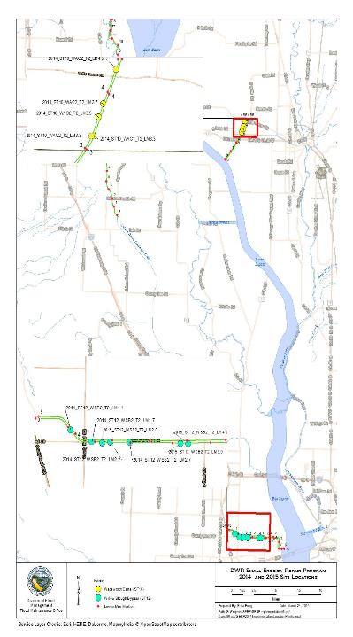
Upcoming Erosion Sites
2018 – 13 remaining sites to be completed this construction season:
7 along Willow Slough Bypass
5 along Wadsworth Canal
1 along Sacramento River near Freeport
Note: California Endangered Species Act (CESA) coverage granted February 2018.

Slide 6
Next Steps
Begin construction on 13 sites in 2018
Evaluate continuation of program based on lessons learned to date

Slide 7
Additional DWR Items
Maintenance Area #9 Easements
Michael Sabbaghian, Chief, Flood Maintenance Office, DWR
Lower Elkhorn Basin Levee Setback Update
Ruth Darling, Senior Environmental Scientist, CVFPB staff
Joe Bartlett/Shelly Amrhein, Senior Environmental Scientist, Division of Flood Management, Department of Water Resources
Delta Emergency Response Tool
Laurence Sanati, Hydrology and Flood Operations Office, DWR
7

Slide 8
Questions
Jeremy Arrich
Division of Flood Management
California Department of Water Resources
Jeremy.Arrich@water.ca.gov

