Slide 1


Sacramento River
General Reevaluation Report (GRR)
Central Valley Flood Protection Board
Presentation
Alicia Kirchner, Chief of Planning
Sacramento District Corps of Engineers
23 February 2018

Slide 2
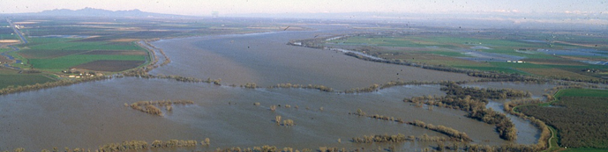

Briefing Purpose:
Information on the current status of the study and next steps
Inform the Board on the strategy to Inactivate the study

Slide 3
Study Purpose
Provide durable solutions to preserve integrity of Sacramento River Flood Control Project
FRM and Eco
Assumes other projects in place:
  Urban FRM
  Water Supply BiOPs
Relationship to CVFPP

Slide 4
Formulating
Alternatives
Identify all possible measures – building blocks (FRM and Eco)
Combined elements to create alternatives

Slide 5
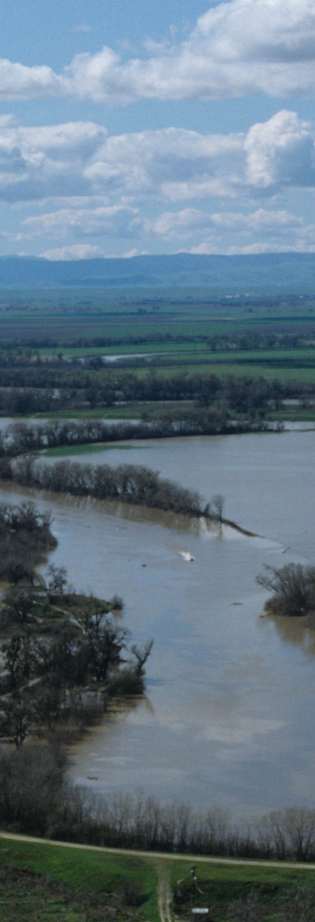
Drivers
    Urban FRM projects significantly reduced flood risk and associated damages
    Mainstem actions more costly than bypass actions
    BiOp mitigation needs
    Agricultural land use

Slide 6
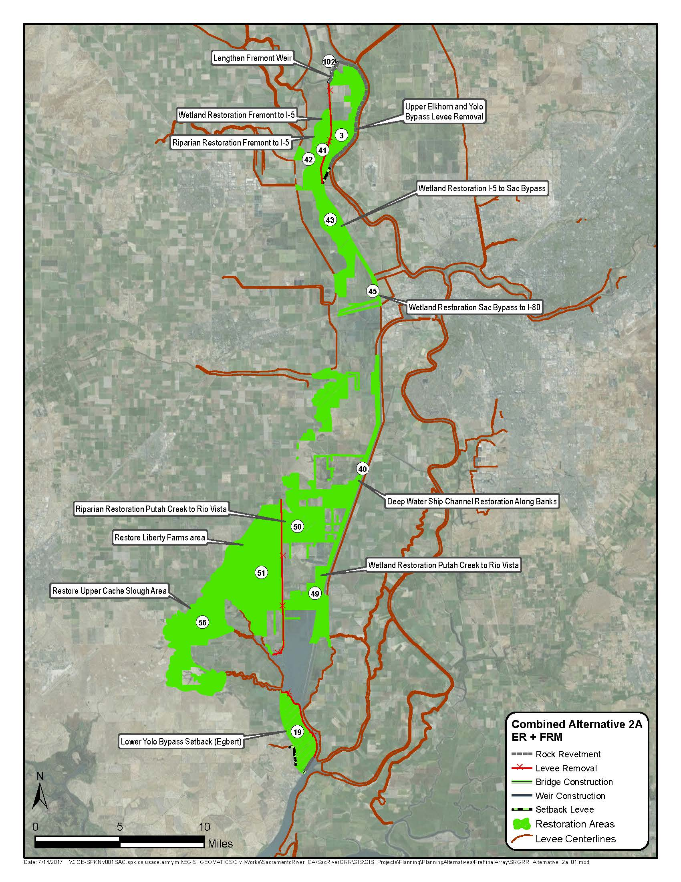
NED/NER Plan
Tried to maximize consistency with CVFPP
1.3 mile extension of Fremont Weir
Extensive restoration of nationally significant resources
Reduces flood stages in the greater Sacramento area
Cost: $ 1.9B; $72M annual
FRM Benefits: $11M
ER Benefits: Approx. 47,000 acres of habitat
FRM BCR = 1.7

Slide 7
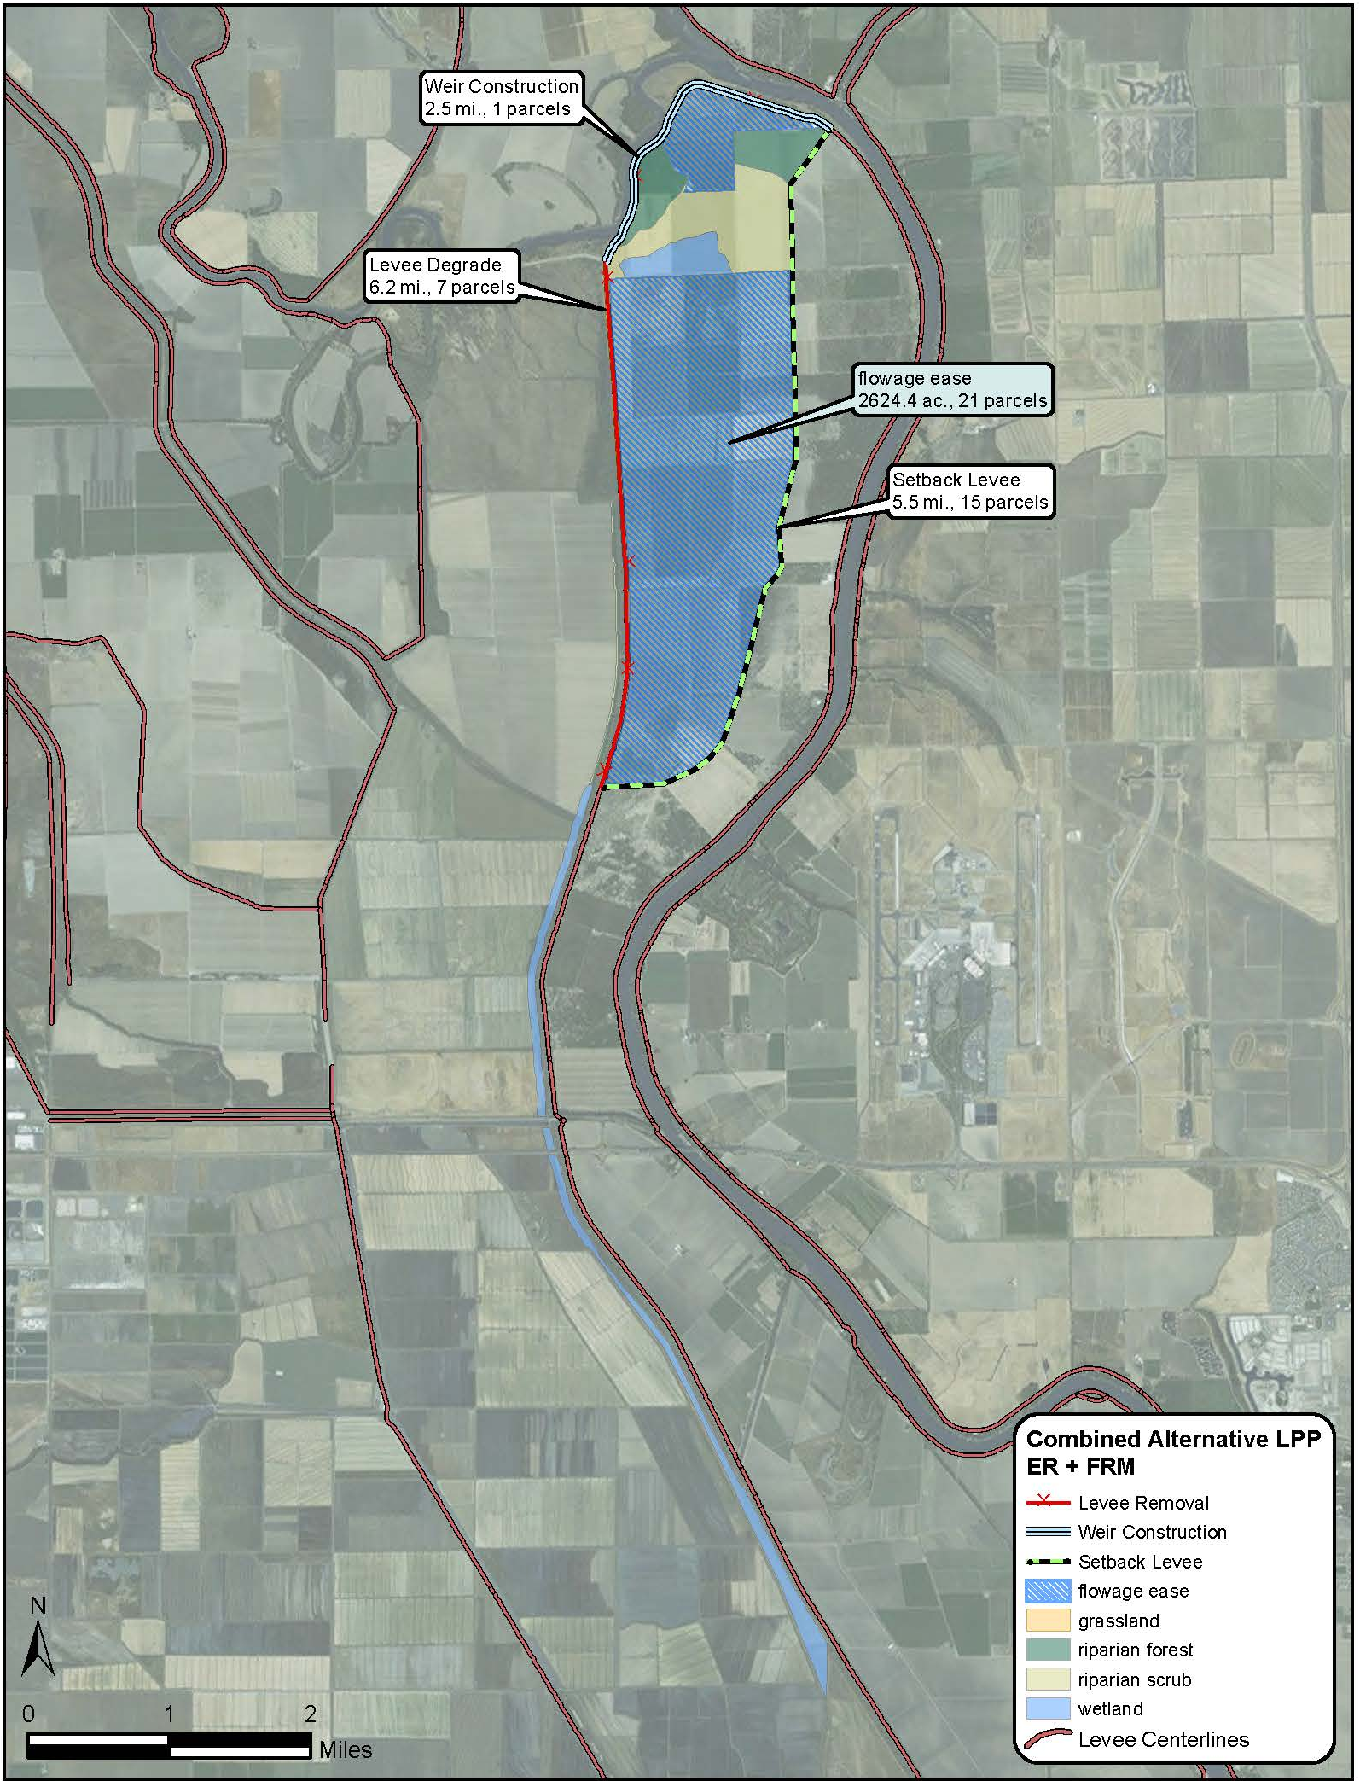
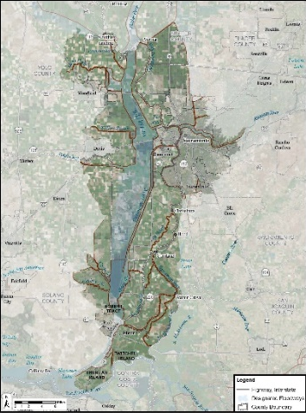
Locally Preferred Plan
Consistent with CVFPP
2.5 mile extension of Fremont Weir
Construct 5.5 mile setback levee with minimal restoration and flowage easements
Cost: $ 613M; $23M annual
FRM Benefits: $7M
ER Benefits: Approx. 1,000 acres of habitat
Unjustified FRM BCR = .35

Slide 8
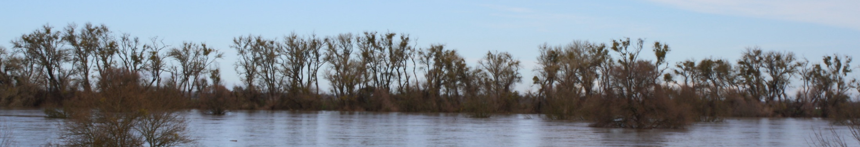
Can LPP be Justified?
    Reduction of features = reduction of costs
    Additional benefit categories
    Continue refinement of tools

Slide 9
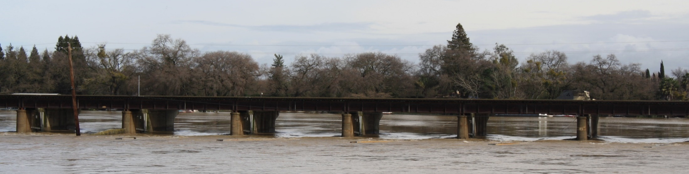
Study Status
Identified NED/NER
LPP as currently designed is not justified
Cost share balance
Recommending study go “Inactive” to stop the Federal clock and preserve funding

Slide 10

Key Takeaways
Difficult to achieve alignment with CVFPP
NED/NER represents a strategic opportunity to increase resilience and create habitat
Sac Bank will be the status quo
Going inactive is the best course of action

Slide 11
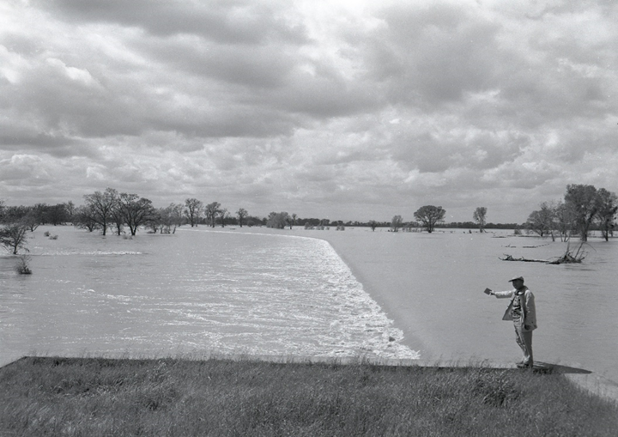
Questions?
Fremont Weir - 1963

