Slide 1
Variance Request Hearing
Project:
Dwelling Replacement, Butte County
Applicant:
Deane and edith Williams trust
Presented by:
Minh Chieng (Board Staff)
January 26, 2018
APPLICATION NO. 9082-1

Slide 2
BOARD ACTION
Consider approval of Permit No. 9082-1 to:
Remove an existing 1,960-sf dwelling and 1,020-sf carport and replace with a 5,875-sf dwelling including garage.

Slide 3
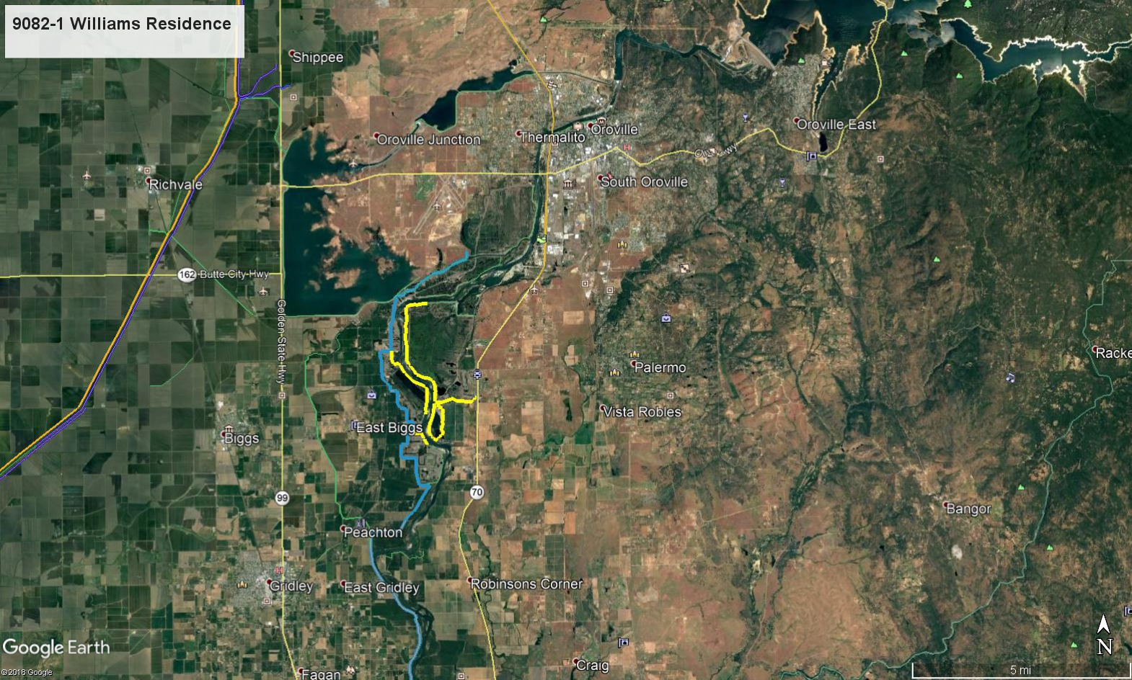
PROJECT LOCATION MAP
Oroville Dam
Project Location
3288 Larkin Road, Biggs
Thermalito Afterbay
City of Biggs

Slide 4
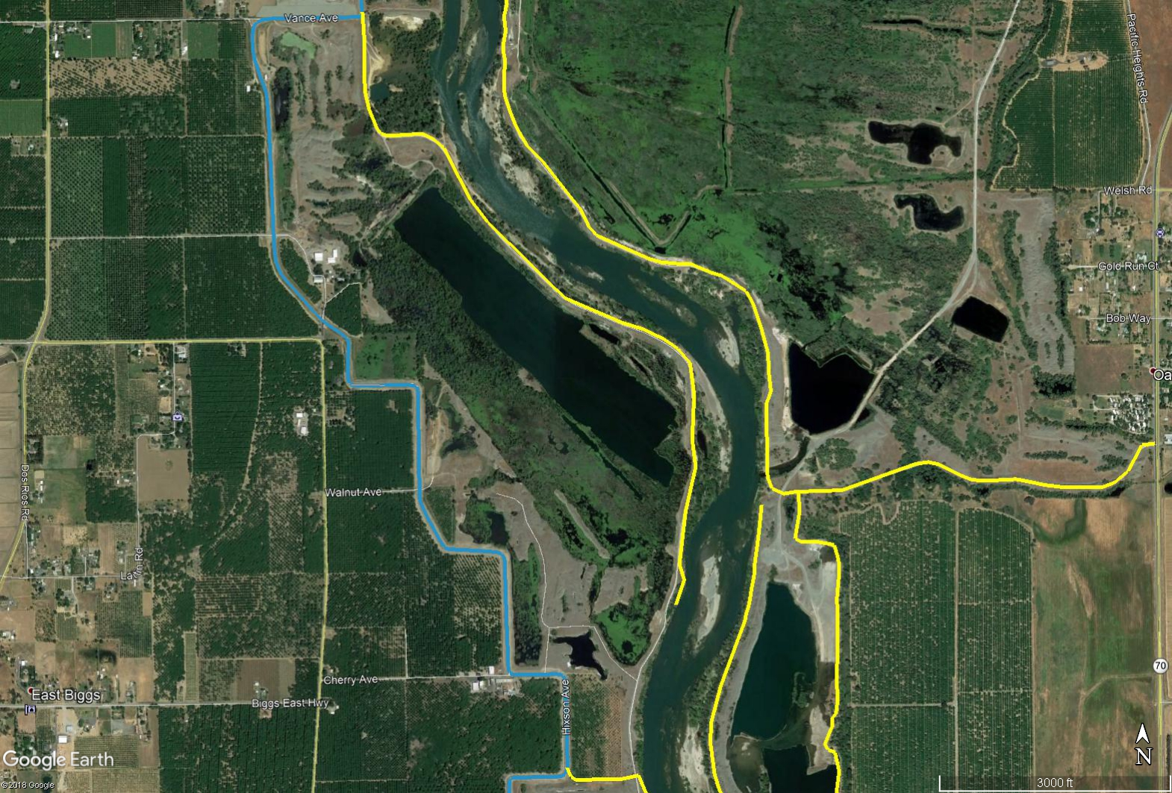
PROJECT LOCATION MAP
Connection Between Federal Levees and Dikes
Property Location
Feather River
Levee Ramps
Non-Federal Levees (Dikes) authorized by Permit 3930
Federal Levees
One Mile Pond
Low Point of Dikes

Slide 5
PROJECT ANALYSIS
The ranch has existed at this location since the 1870s and the Williams family has resided at this ranch for five generations.
The existing dwelling was constructed in 1940s prior to the construction of the Federal levees and is shown in the levee as-constructed drawings.
The proposed dwelling would be an improvement:
  Approximately 4.5 feet higher (Finished Floor ≈ 118.5 feet) than the existing dwelling (Finished Floor ≈ 114 feet).
  More securely anchored to its foundation.

Slide 6
HYDRAULIC ANALYSIS
Feather River is constrained by dikes, which were constructed in the 1960s to protect borrow sites used for construction of Oroville Dam.
Dikes’ crest elevation (≈ 124 feet) prevents overtopping from 100- (DWSE ≈ 121 feet) and 200-year events (DWSE ≈ 122.3 feet) based on Sutter Butte Flood Control Agency’s (SBFCA) Feather River West Levee Improvement Project’s hydraulics.
The ranch only experiences backwater from the low point of the dikes. However, the existing dwelling has never been inundated throughout the family’s course of residency.
The incremental cross-sectional blockage calculations resulted in approximately 0.4%, which is less than the 1% blockage criteria from the USACE. Therefore there will be no adverse hydraulic impacts to the Feather River Designated Floodway.

Slide 7
VARIANCE REQUEST
The applicant submitted a variance request to Title 23 Division 1 §113 Dwelling and Structures Within an Adopted Plan of Flood Control
Subsection (b)(3)(B):
  The finished floor of any remodeling, modification, addition, or repair to the dwelling or structure must be a minimum of two (2) feet above the design flood plane or two (2) feet above the 100-year flood elevation, whichever is higher.
Staff recommends approval of the variance request for this project based on:
  The ranch only experiences backwater from the Feather River at the low point of the dikes. However, the applicant has stated their existing dwelling has never been inundated throughout the family’s course of residency.
  The proposed dwelling is a betterment as it will be approximately 4.5 feet higher than existing and more securely anchored to its foundation.
  The applicable standard would require an additional raise of 4.5 feet, which would result in the need to import a significant amount of fill into the floodway further increasing the hydraulic blockage.

Slide 8
AGENCY COMMENTS/ENDORSEMENTS
Department of Water Resources Sutter Maintenance Yard (Maintenance Area 7) has endorsed the project with conditions that have been incorporated into the conditions of the Draft Permit No. 9082-1.
USACE 33 U.S.C. 408 approval letter has been received and the USACE Sacramento District Engineer approves the project, subject to conditions.

Slide 9
CEQA CONCLUSIONS
Board staff has determined the project is categorically exempt from CEQA under a Class 3 Categorical Exemption (CEQA Guidelines Section 15303(a)) covering new construction of a single-family residence in a residential zone.

Slide 10
STAFF RECOMMENDATION
Staff Recommends that the Board:
Adopt:
  The CEQA Findings;
Approve:
  Encroachment Permit No. 9082-1 in substantially the form provided including the requested variance to Title 23 Division 1 §113 (b)(3)(B) standard; and
Direct:
  The Executive Officer to take the necessary actions to prepare and execute the permit and related documents and to prepare and file a Notice of Exemption with the State Clearinghouse.

Slide 11
QUESTIONS
?
Presented by: Minh Chieng (Board Staff)

