Slide 1
Roles & responsibilities in Cvfpb Enforcement processes Agenda No. 8C
Jit Dua, Board Counsel
Kelly Soule, Board Enforcement Section Chief
January 26, 2018

Slide 2
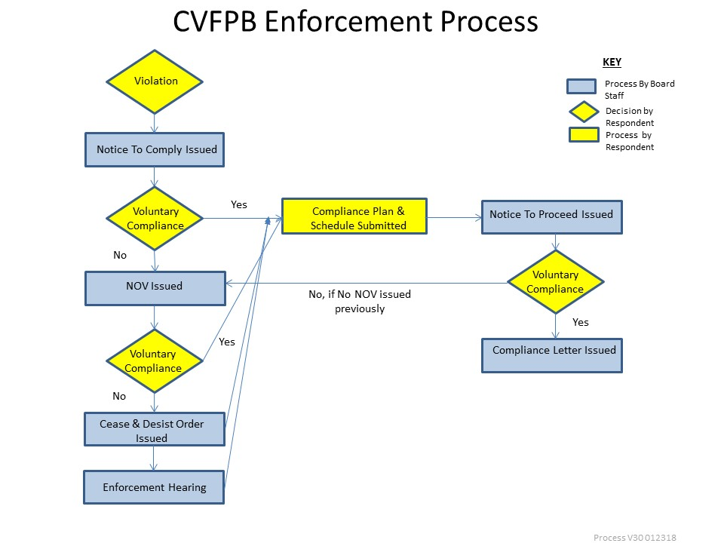
GENERAL PROCESS
Example:
Consider approval of Permit No. XXXXX to:
Bulleted items for Board to consider

Slide 3
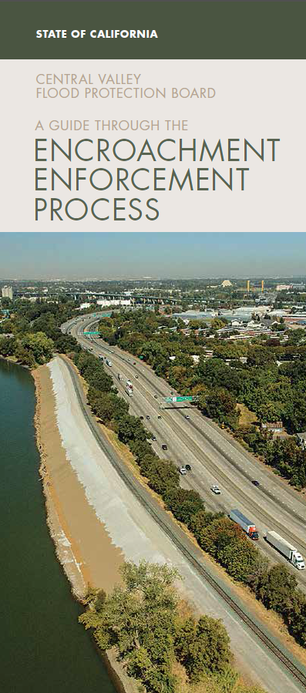
ENCROACHMENT ENFORCEMENT PHASES
Informal Phase
Notice to Comply
Formal Phase
Notice of Violation (NOV)
Cease & Desist Order (C&D)
Enforcement Hearing

Slide 4
Board’s Role and Responsibilities
Cease & Desist Order and Public Meeting
Purpose of C&D hearing – Board to determine whether or not to approve the C&D Order issued by the Executive Officer
Not an evidentiary hearing – merits of case are not to be considered
Board to determine sufficiency of the C&D Order
Limited to questions of due process – proper notice provided, etc.
C&D hearing offers an additional offramp from the formal enforcement process
Board may affirm, amend, modify, stay, or rescind the C&D Order based on available information

Slide 5
Board’s Role and Responsibilities Cont’d
Enforcement Hearing (Hearing)
Board to act as the independent arbiter and trier of fact
Hear and receive evidence from the prosecution team and respondent
Ask any questions regarding alleged facts of the case to the prosecution team, respondent, and/or other interested party
Render the Board’s decision

Slide 6
QUESTIONS
?

